Slide 1
Are you thinking about any of the following?
I put so much work in making our SharePoint intranet environments great, but there is not that much usage.
We have been doing ‘user adoption’ type activities for a while without seeing much benefit.
We have provided so much training and content to people, but I don’t see people using the intranet much.
If Yes, this session is for You!
Notes:
If any of these points or similar is true then this is the right presentation for you.

Slide 2
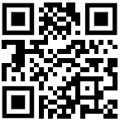
Download all my presentations and video recordings
http://bit.ly/AsifConference
Presentations on:
Organizational Change Management
Increase user adoption while decreasing support tickets
Learning in the flow of work
Blended learning
Microsoft Viva Learning
Microsoft Learning Pathways
And more…
Notes:
My conference topics include:
Organizational change management
Ways to increase user adoption
Learning in the flow of work
Introduction to Dynamics 365 for the Microsoft 365 guy or gal
Microsoft Viva: what are the components of Viva and why you should care

Slide 3
Setting Up Effective Onboarding and Contextual Support For Your SharePoint Intranet Users
Presented by:
Asif Rehmani, MVP
VisualSP
Download All of my presentations at:
https://bit.ly/AsifConference
Notes:
The URL to download all my presentations Including many recordings of presentations :
https://info.visualsp.com/download-conference-presentations-1
The focus of this presentation is to help you effectively on-board new users to an existing intranet or existing users to new functionality on your intranet.
We will also talk about mechanisms to provide users ongoing support.
We will not be going into designing your intranet.

Slide 4
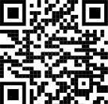
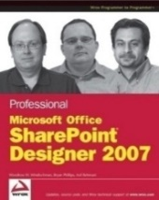
About me - Asif Rehmani
Conference Speaker
MS Ignite
Dynamics Summit
DynamicsCon
ESPC
365 EduCon
TechEd
Learning Conferences
And many more…
Microsoft MVP
CEO
Founder and CEO
VisualSP
Chicago, IL
Since 2007
Digital Adoption Platform (DAP) for M365 & D365
Author
My LinkedIn profile
asif@visualsp.com
www.VisualSP.com
Notes:
My name is Asif Rehmani
Founder and CEO of VisualSP – a Digital Adoption Platform (DAP) providing Contextual Microlearning to Dynamics 365 users to increase user adoption by 3X and reduce support tickets by 50%.
Been in the Learning business since 2005 as a trainer.
Speak at conferences around the world on end user training, user adoption and performance support.
Authored multiple books on Microsoft technologies for Wiley publications
Microsoft MVP since 2007.
I started my journey and SharePoint back in 2002 (when the software really sucked!). as the software became better and better and better and more popular in companies, I stuck with it training, consulting , mentoring and writing about it.
In 2016, I turned my focus to SharePoint online and then to Microsoft Office 365.
All along the way, my interactions have been with administrators, power users and end users of the software throughout the world. I see my job as empowering these folks to get the best use out of the software That their companies have invested in.
end user adoption is near and dear to my heart. I strongly believe that without proper usage of the software, it is all for nothing. Getting users on board and having them see what's in it for them is the Holy Grail that all of us should be chasing to make sure we get it right!

Slide 5
Is Your organization using SharePoint as an intranet?

Slide 6
What word(s) come to mind when you think of SharePoint?
ⓘ Start presenting to display the poll results on this slide.

Slide 7
Agenda
The history and current state of SharePoint
Making sure your intranet will serve your users’ needs
Onboarding users effectively
Setting up contextual experiences
Setting up the support infrastructure for your intranet initiative
All of this with a bunch of stories I’ll share…

Slide 8
An ‘unofficial’ history of SharePoint
SharePoint 2001 was not cool
SharePoint 2003 became the first usable product.
SharePoint 2007 was better, but still not great.
SharePoint 2010 is when SharePoint became ‘SharePoint’ and took off in popularity.
Lots of 3rd party vendors started building their 'intranet in a box' offerings
Valo, Powell Software, Unily, Bonzai, etc.
SharePoint Online came out in 2016.
Starting in 2019, out of the box SharePoint started becoming cool again with so much constant innovation that Microsoft was doing.
The need for buying an 'intranet in a box' started decreasing
Currently, in 2023, Microsoft is continuing to innovate on the SharePoint platform making it one of the best options for running your intranet on
More than 75% of Fortune 500 companies use Microsoft SharePoint

Slide 9
The current use of SharePoint
SharePoint used to be the main catch-all for everything
Document library, lists, team calendar, pages to display content, storing videos & images, forms and surveys, holding discussions, project management and more.
Since Office 365 came out, lots of these SharePoint functions have been decoupled and are now within their own separate apps:
Teams, Forms, Calendar, Stream, Lists, Planner, etc.
The main reason for SharePoint in 2023 is for hosting your intranet site pages - which SharePoint technology is still best for
SharePoint is the back end for documents and lists storage
Documents can be accessed through Teams or SharePoint
Lists can be accessed through Lists app or SharePoint
Microsoft Teams’ backend is all in SharePoint

Slide 10
So we have a SharePoint based intranet
Now What??

Slide 11
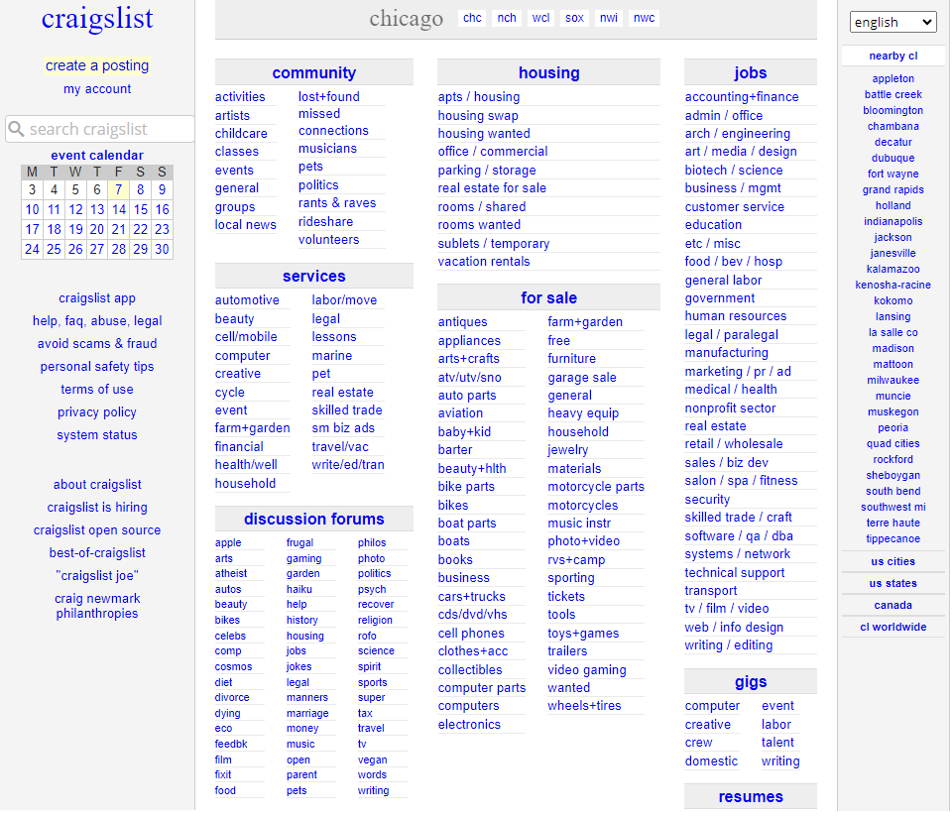
User adoption is Everything
ex: Craigslist is a terrible looking site but…. great adoption rate!
Notes:
Craigslist used to be Very popular in United States. Still is pretty popular even after so many years and so much competition.
Not because of the way it looks of course. It's a really busy looking interface and almost entirely covered with links.
It became popular because of the benefit it provides connecting buyers and sellers.
Providing simple classifieds – small advertisements organized in categories.
It started in 1995 as a way to get information to people – simply, easily and fast!
Site grew as the demand grew. They ‘listened’ to what people wanted and provided it.
With this type of an interface, they have $694 Million in revenue (as of 2016).

Slide 12
“You never get a second chance to make a first impression”
Notes:
If the Microsoft 365 or Dynamics 365 CRM environment that users see day one is too complicated and slows down their work, chances are that they will start looking for workarounds to avoid using it.
The complicated environment is not only necessarily a busy environment. A complicated one is something that is difficult to work with and does not provide the support you need at your moment of need.

Slide 13
The story of the University of Michigan intranet

Slide 14
How do you get people to your intranet?

Slide 15
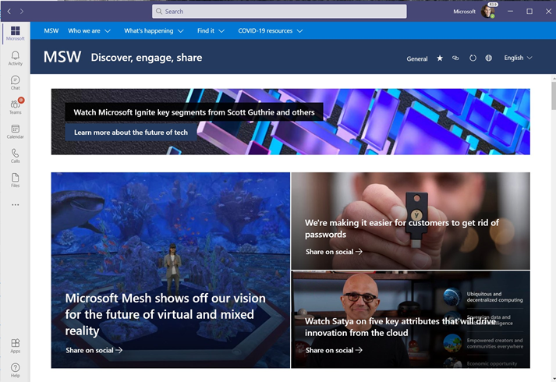
Bring your intranet into Teams using Viva Connecions (free)

Slide 16
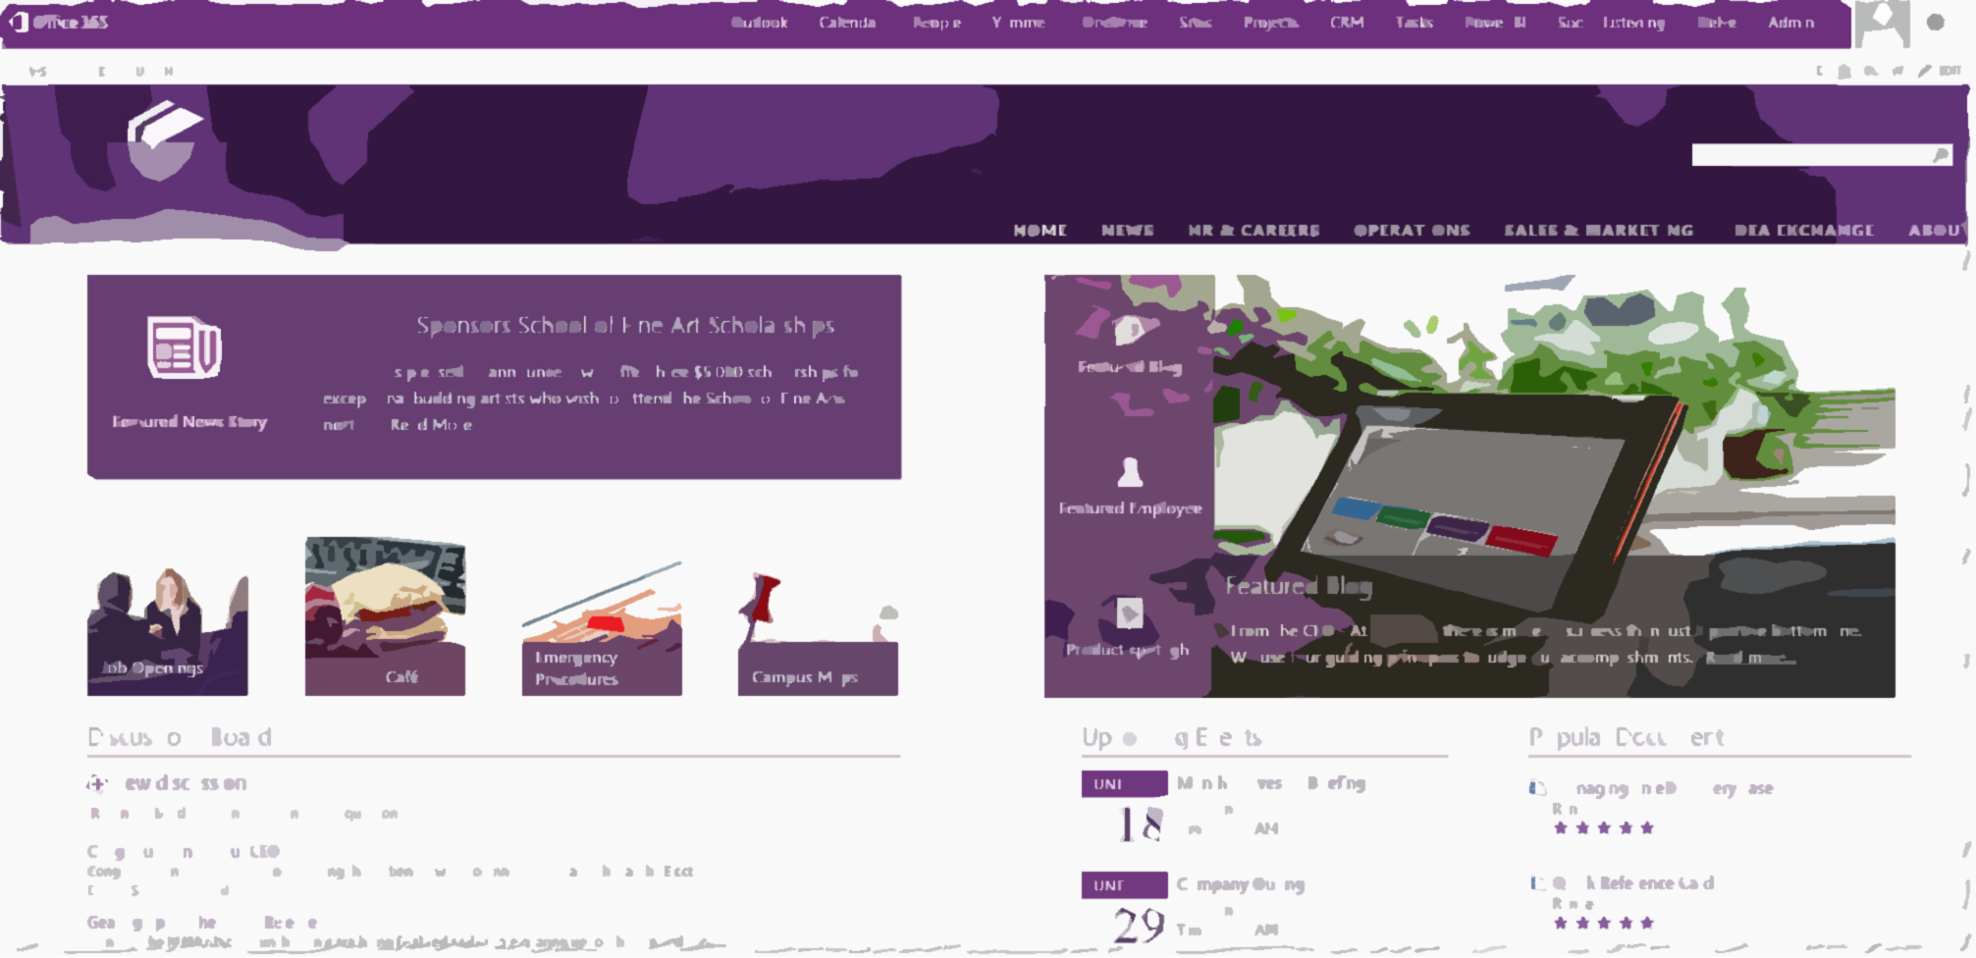
Story – What Sony corp did to drive adoption of their intranet
Find the Nearest Printer web part
CEOs weekly message
Notes:
Sony First, they used pictures of Spiderman to get people's attention about the upcoming launch of the new intranet Printing to the closest printer web part on page. Why..??? Because that was their pain point. Of course other info they wanted the end users to know also went on the site.

Slide 17
Get users oriented to your intranet
Let’s look at some examples of orientation videos

Slide 21
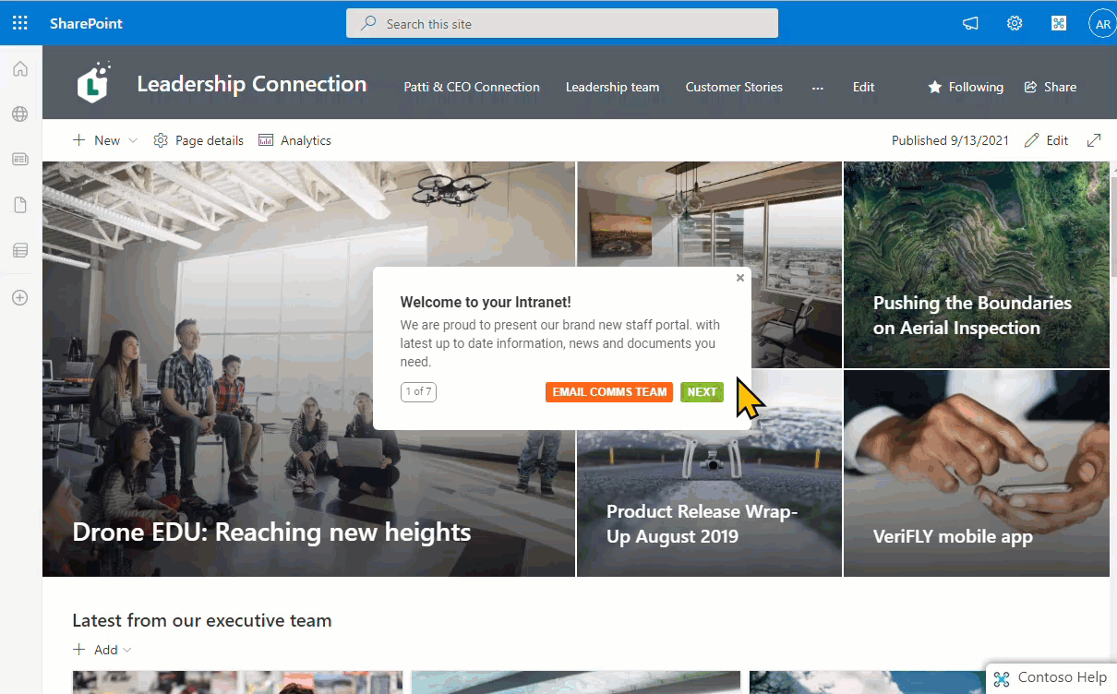
Step by step walkthrough guidance
From VisualSP
Notes:
Create no-code walkthroughs on your intranet and any other web application using VisualSP

Slide 22
How do you ‘train’ your users on SharePoint?

Slide 23
My story of training end users in Chicago
Notes:
Let me share with you a story about an experience I had.
Back in 2009, I was invited to teach a two day end users class in my hometown of Chicago to employees of an organization that was in the business of providing secondary educational institutions (so colleges, universities) with insurance.
I taught the class to 30 folks over a 2 day period.
(No, this is not the actual class and no, that is not me at the front of the class ☺ )
This was a SharePoint focused class so I taught them all about SharePoint as a power user and end user.
We went over all the basics like how to use pages, lists, libraries, set up permissions, use web parts and a lot of other goodies present in SharePoint.
After the two days of training was over, the person who hired me invited me to stay for one extra day. They would pay me to just sit in a nice corner office with a beautiful view of the Chicago river and all I would have to do is to answer any questions that people had. I said sure. That’s easy enough. I have already taught them everything that they needed to know over the last couple of days. I'm sure there will be little to no questions ….
Boy was I wrong ….
there was a line out the door the whole day of people with questions. Questions about how they get their job done using the technology that I had taught them about. Now I was explaining to them one on one what I just taught them the last two days.
I felt pretty ashamed. My first thought was that I must have been a horrible teacher. If all of them have questions regarding what I just taught them. that means I did not do a good job teaching in the last two days because if I did, they should remember everything I taught them and know how to do it. Right…?
After that experience in Chicago, I thought about this some more. Do end users really want to be trained? Is that the best way for us to empower them to help them do their job?

Slide 24
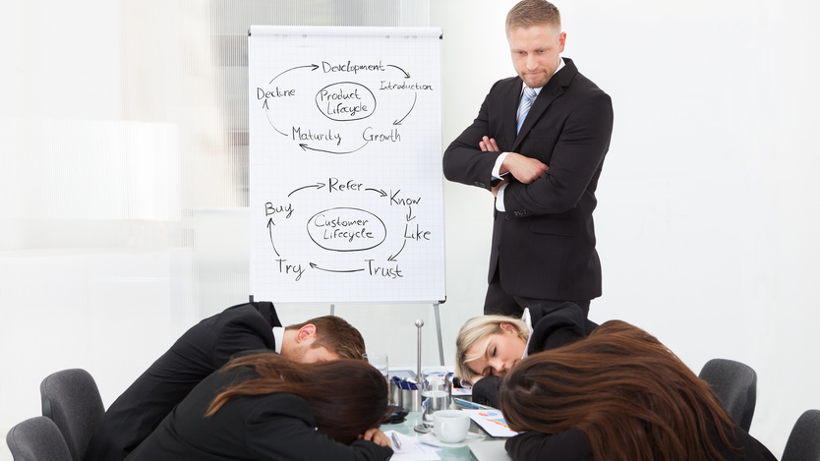
Challenge Traditional training doesn’t work for end users
Notes:
My conclusion was:
Thoroughly training end users doesn't really work.
Traditional classroom and binge learning just doesn’t work for end users. And it Never has!
We are not preparing employees to take a test. We are preparing them to help them do their job.

Slide 25
Users cannot be made to do things they don’t want to do
Notes:
Users cannot be made to do things they don’t want to do… Unless you want to take extreme measures – which for the record, I definitely do not recommend 😬

Slide 26
Use diverse training & support methods
Self help resources
Virtual training
In-person training
Change champions
Help desk support
Microlearning tips and tricks

Slide 27
Self-Help Resources
Virtual Training
In-Person Training
Change Champions
Training Portal
Scenario based
Product based
Quick-start guides
Videos
FAQs
Lunch and Learns
Scenario based
Product based
Delivered by training leads or Change Champions
White glove
Scenario based
Product based
Delivered by training leads or Change Champions
Scenario based
Business group focused
Delivered by Change Champions
Ad-hoc assistance for colleagues
Community management for SharePoint end user Yammer group

Slide 28
Help Desk
Support
Tips
(micro-learning)
Buzz Days
‘How-to’ tips
Provide links to scenario and product-based resources
‘How-to’ tips regarding productivity features
Links to scenario and product based resources
Multi channel distribution (email, Yammer, newsletter)
Live events
Scenario based
Genius bars for providing ‘how-to’ tips

Slide 29
Orientation and awareness sessions Not multi-day end user training

Slide 30
Support resources for You
Microsoft Learn
Microsoft Docs
TechCommunity

Slide 31
Support resource for your users
Microsoft Support site:
https://support.microsoft.com/en-us/sharepoint

Slide 32
Self help with Microsoft 365 learning pathways
Free from Microsoft
A learning portal created as a SharePoint communication site within your Microsoft 365 tenant
Learning content for end users focused on Microsoft 365 apps such as OneDrive, SharePoint, Teams, etc.
Content automatically updated, curated and delivered by Microsoft into your portal
Your own training content can be added to this portal
An open source solution created by Microsoft
Notes:
Microsoft 365 learning pathways is a learning portal that is created and supported by Microsoft themselves.
The training content for most of Microsoft 365 apps is provided and more is released every quarter by Microsoft.
The connection to the Microsoft training repository is always open so the content is updated automatically in your portal.
The content is served through GitHub Content Data Network (CDN).
Your own content can be added to this training portal to supplement learning for your users.

Slide 33
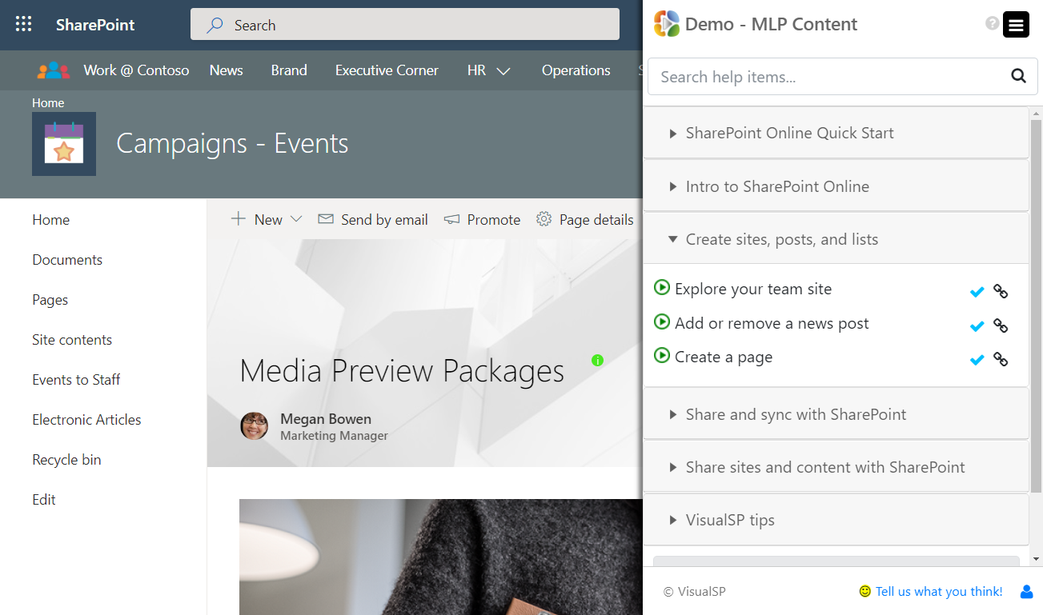
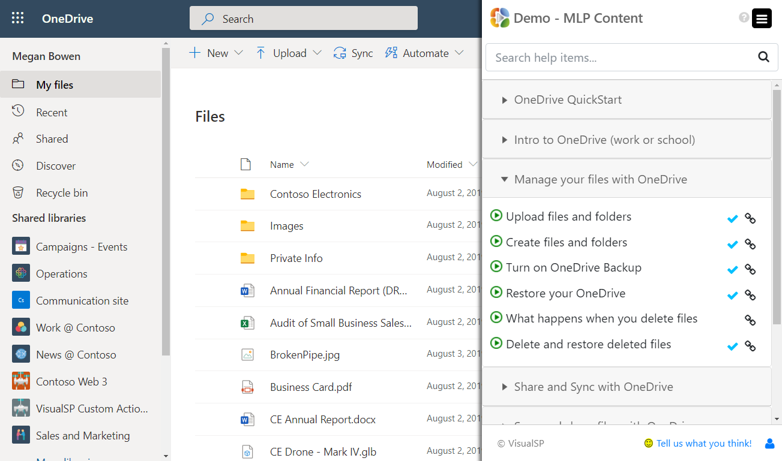
Learning Pathways content delivered in-context
Free from VisualSP
https://www.visualsp.com/learning-pathways/
Notes:
VisualSP provides a training overlay on top of Microsoft 365 applications that serves up learning pathways content contextually to the user.
https://www.visualsp.com/learning-pathways/
So for example, when the user is within Teams, SharePoint, OneDrive, Yammer or other apps, they will see training content specific to just that app they are in. This experience makes the learning and understanding of features much easier for the user to consume instead of having to go to a communication site and look for the content that they want.

Slide 34
Microsoft 365 learning pathways
Demo

Slide 35
The main end goal Get information and support to users as efficiently as possible
Contextual delivery of information
Notes:
The actual information that a user needs should be brought as close as possible to them.
The information should not be on a SharePoint site or a separate portal where the user has to go looking for it.
Learning comes to the learner instead of the learner going to the learning.

Slide 36
Focus on Context Not Only Content
Access to content is not a challenge anymore
The new challenge is a lack of context
Notes:
The challenge used to be that we did not have access to much content. In the age of information that we live in, that is no longer the challenge. The new challenge is a lack of context:
How do we get the right information at our moment of need quickly and efficiently?
That's what we need to be solving for - for ourselves as well as for our end users.
Too much content is available these days - both good and bad. It's hard to decipher the good content from the bad (or plainly wrong) content.

Slide 37
The story of the Governance Guy
Notes:
My story about the intranet admin who wanted users to follow governance guidelines

Slide 38
Deliver governance, info, support “in context” of the environment
Not a large governance document that no one will look at
But instead through contextual experiences
Notes:
Contextual Experiences are elements such as:
Inline help (in the form of icons, buttons, links) that are on the interface to be discovered as needed by the user
Interactive walkthroughs that appear automatically to guide the user to perform a task or give them a tour of a new interface they are not familiar with
Announcement banners at the top or bottom of the page that appear automatically targeted to the appropriate users to inform them about important information, events, etc.
A widget on the page that provides the user a way to explore their company’s knowledgebase of information
These are all types of context sensitive elements that support users naturally when they need support within their own application interface.

Slide 39
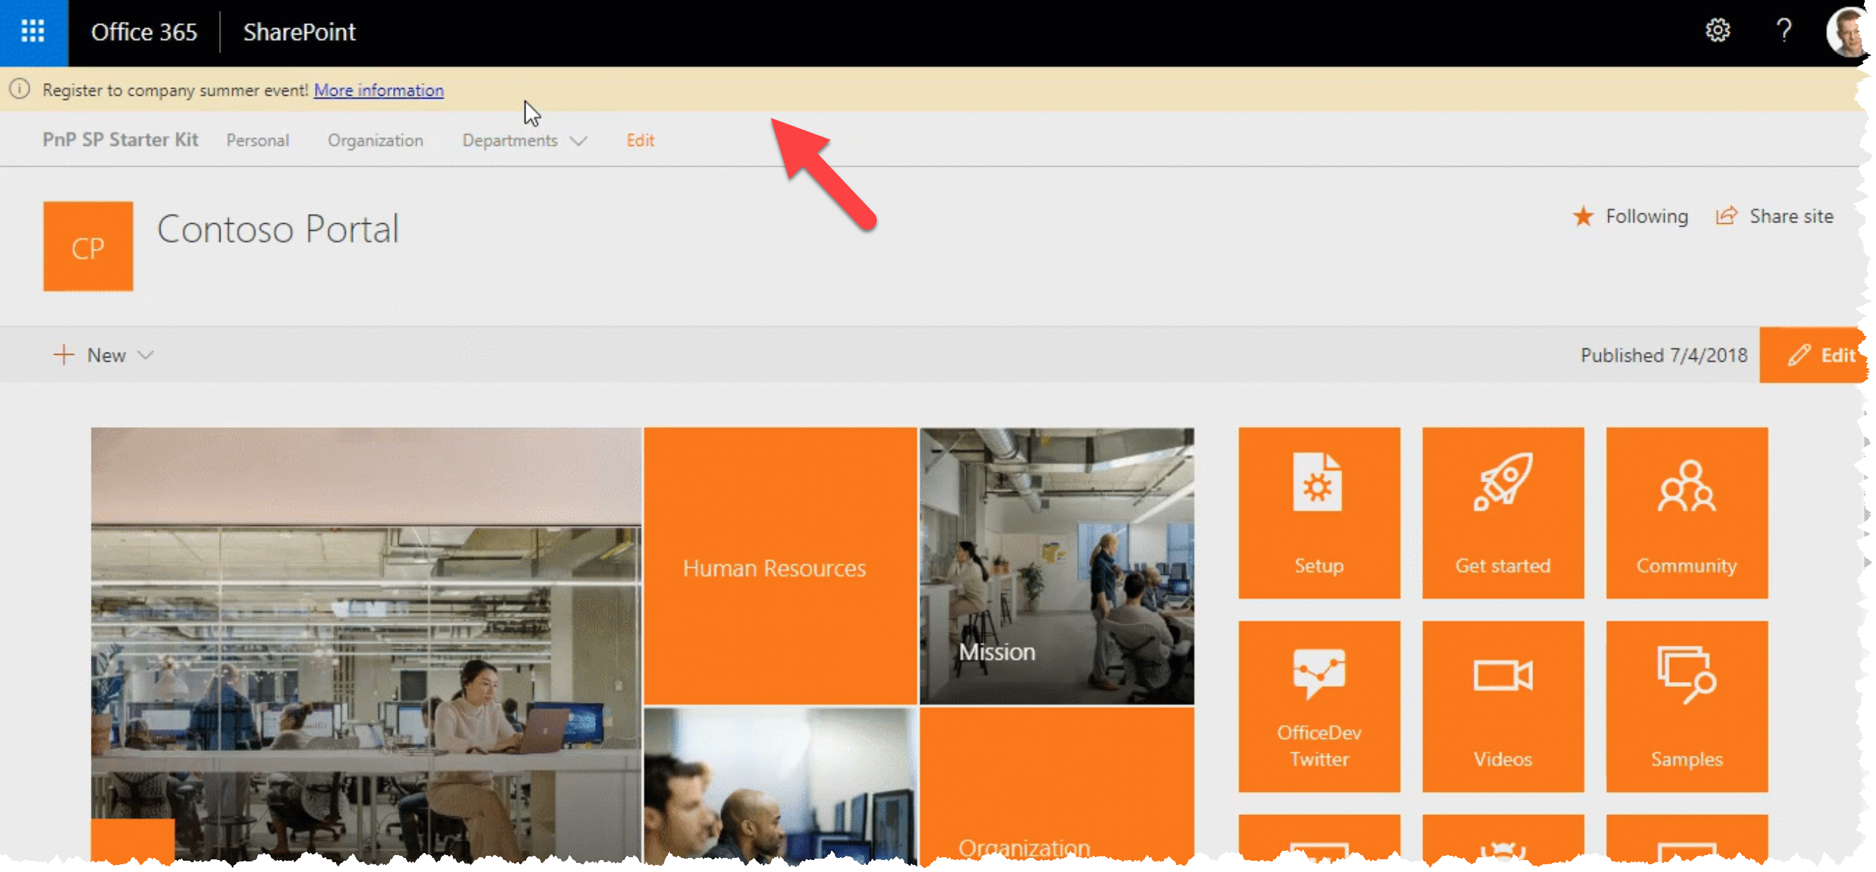
Banner on your SharePoint intranet – from github
Free from Microsoft
Notes:
https://github.com/pnp/sp-starter-kit/blob/master/source/react-application-alerts/README.md

Slide 40
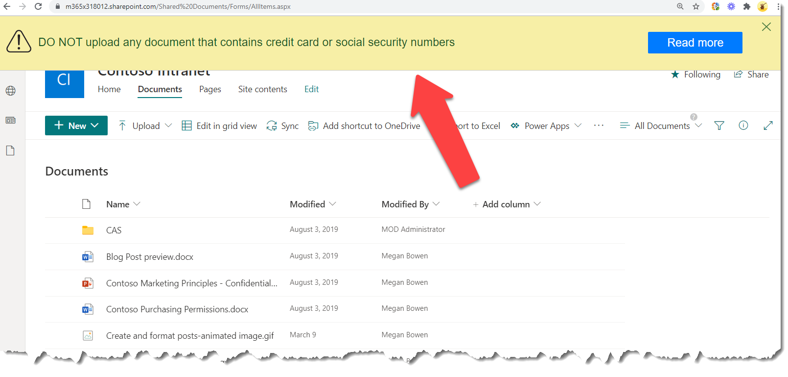
Scheduled Banner on SharePoint with CTA
From VisualSP
Notes:
Instead of regular email communication, an announcement banner like this it is impossible to miss when displayed over an application that the users routinely go to.

Slide 41
Also referred to as “Performance Support”
Helping users get their job done at their moment-of-need
Notes:
The Performance Support discipline has been around for decades. It just has not been popularized yet in the Microsoft ecosystem so not many people know about it yet.
https://elearningindustry.com/how-performance-support-tools-different-from-training-3-pst-examples-microlearning

Slide 42
An example of how I received Performance Support

Slide 43
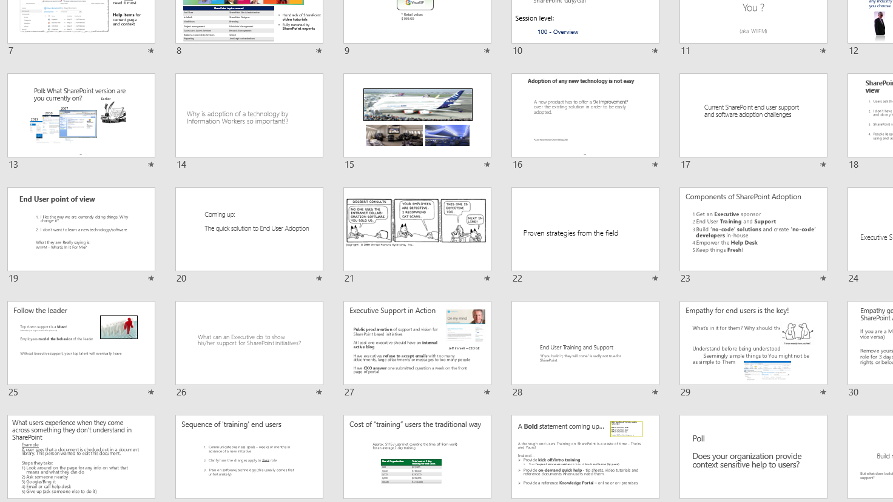
What my presentations used to look like

Slide 44
What my presentations look like now
Notes:
All thanks to the ‘Designer’ feature in PowerPoint that just presented itself to me one day.

Slide 45
Implement contextual support and training for your users
Deliver information to your users within
2 clicks and 10 seconds
Notes:
The 2 clicks and 10 seconds formula was developed by a renowned learning strategist named Dr. Conrad Gottfredson.
It has been proven that when you get info to the user within 2 clicks and 10 seconds, they experience a positive emotion and satisfaction in their amygdala.
This feeling of satisfaction and pride encourages them to try self support again next time they need help.

Slide 46
Create the necessary support infrastructure for your intranet to thrive
Notes:
The support infrastructure that is necessary for your users to be successful using your intranet

Slide 47
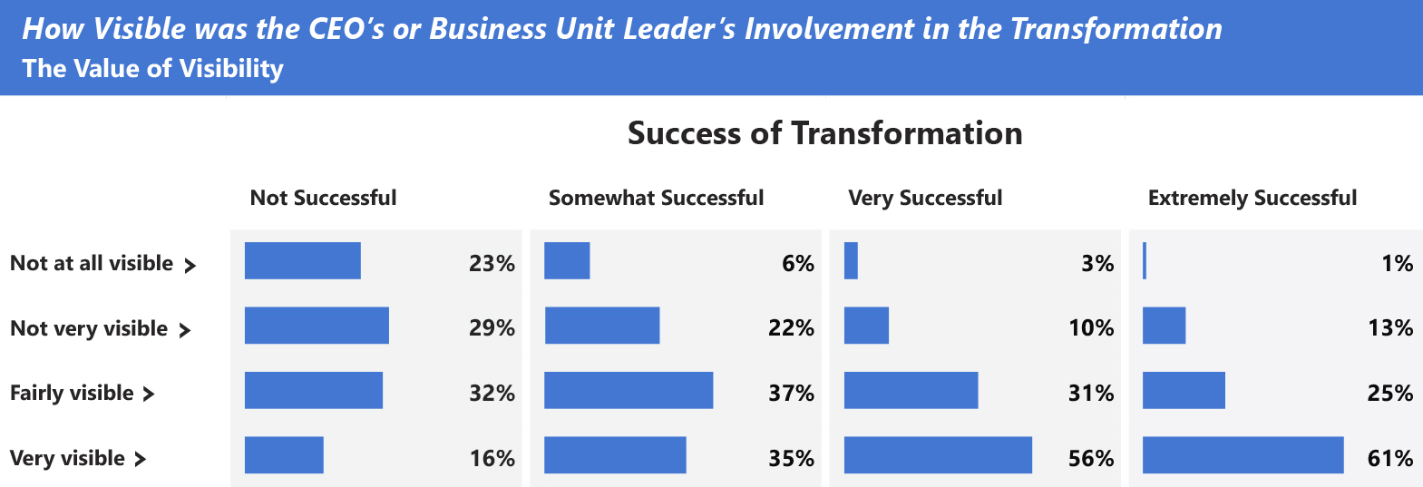
Have at least 1 executive sponsor
Adapted exhibit from “Creating organizational transformations”, July 2008, McKinsey Quarterly, www.mckinsey.com
Copyright© 2008 McKinsey & Company. All rights reserved. Reprinted by permission.
Notes:
Executive sponsorship is key. If you don’t have at least 1 executive sponsor supporting you, you might as well call it quits now.

Slide 48
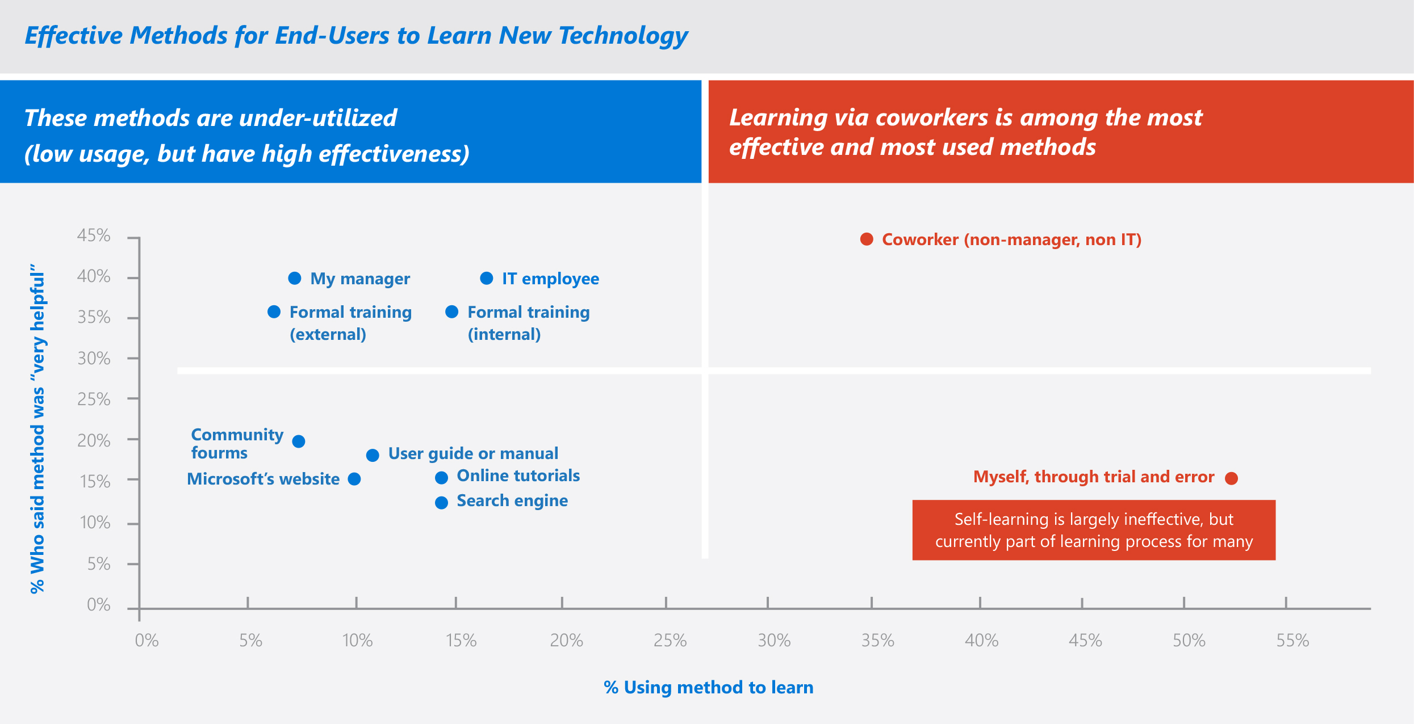
Understand how your end users truly learn / get help
SharePoint End-User Study, Apr 2013, Microsoft Corporation
Notes:
What really works:
Collaborative learning through coworkers

Slide 49
Have a SharePoint champions community
Get your champions to sign up for this Microsoft led community, you’ll have access to following opportunities:
Regular email communications (community topics, latest news, tips and resources)
Regular champion-peer networking and sharing
Partnerships with Microsoft at premier events and meetups in your industry
Access to Microsoft subject matter experts and unique Office 365 training and content
https://aka.ms/O365Champions

Slide 50
How do you know what your users are actually doing on your intranet?

Slide 51
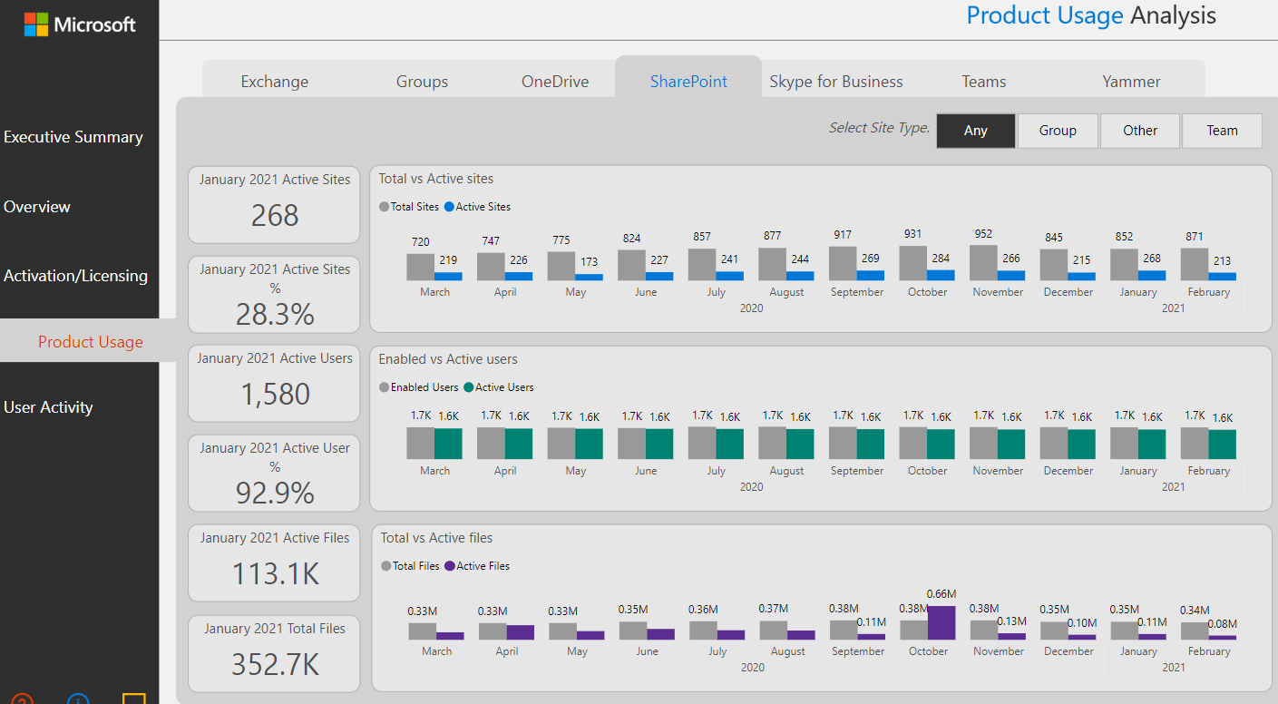
Monitor SharePoint analytics regularly
Notes:
SharePoint site usage analytics in a Power BI dashboard:
https://learn.microsoft.com/en-us/microsoft-365/admin/usage-analytics/enable-usage-analytics?view=o365-worldwide

Slide 52
And… Have you heard of Microsoft Clarity?
Deploy Clarity and use it to get heatmaps and user recordings of actual usage of your intranet
Notes:
Clarity is a free, easy-to-use tool that captures how real people actually use your site. Setup is easy and you'll start getting data in minutes.
https://clarity.microsoft.com/

Slide 53
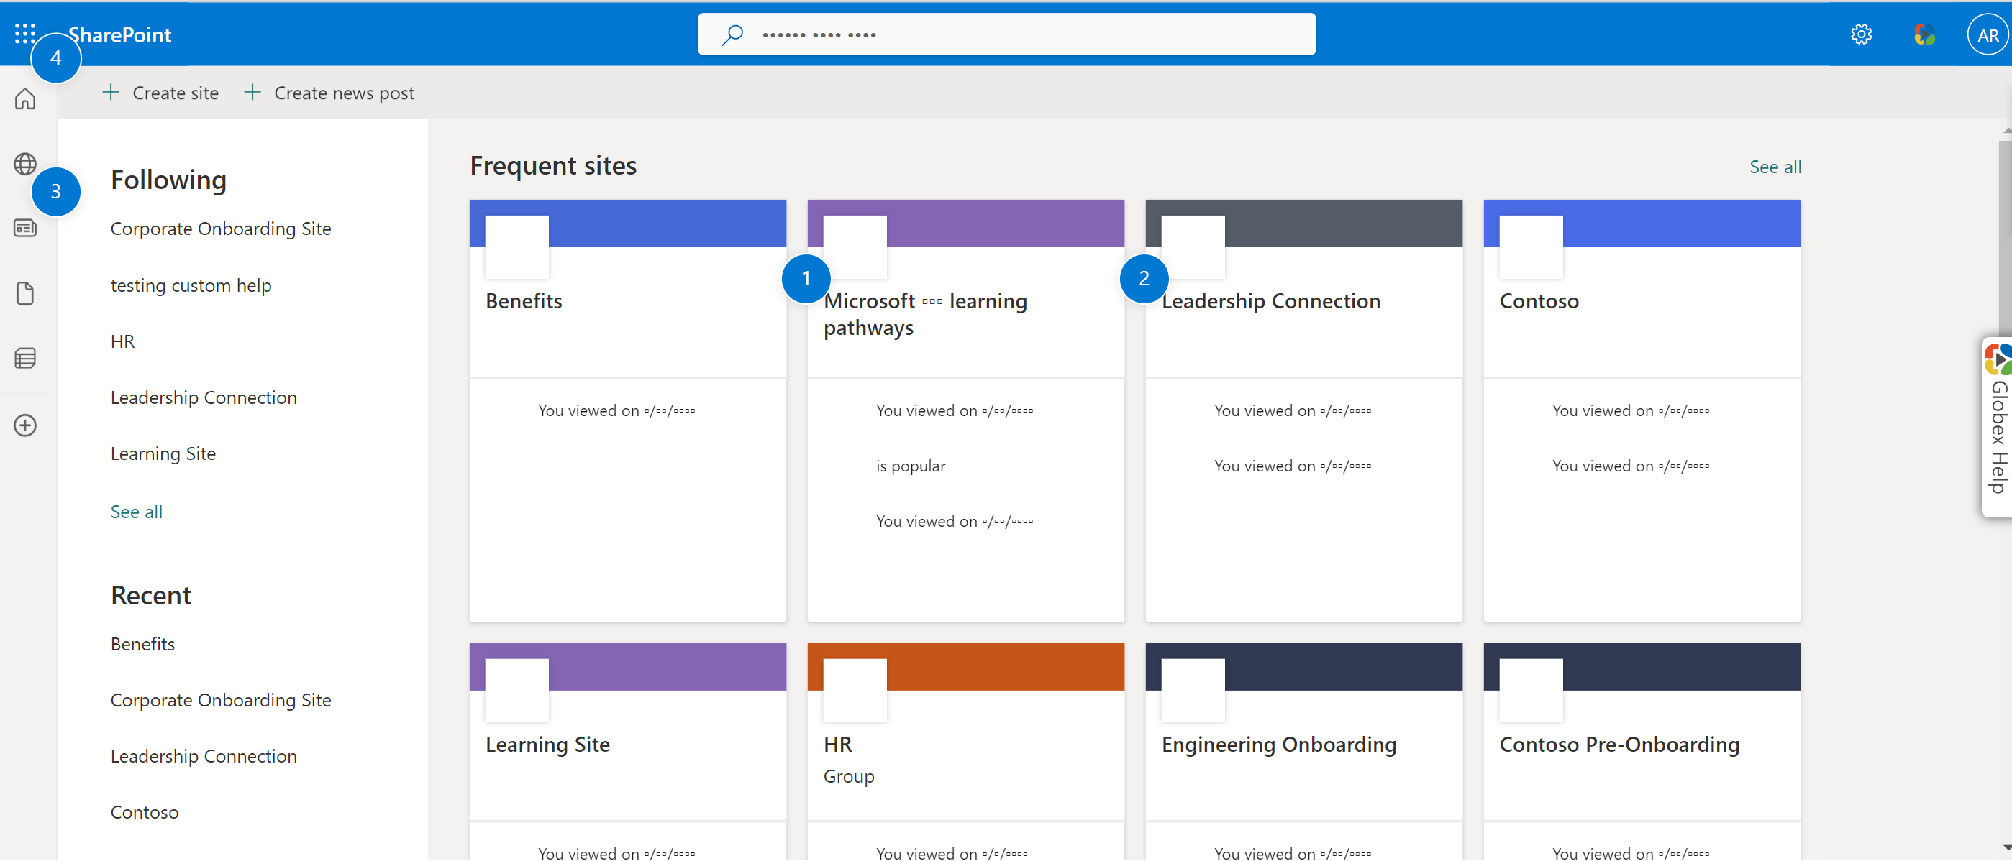
Click map of the SharePoint site directory
Notes:
An example of a heatmap showing clicks on a web page.
You can use Clarity for not just websites, but also internal web applications also. This can be done through Clarity’s integration with VisualSP. Message us so we can help you going: info@visualsp.com

Slide 54
Microsoft Clarity & SharePoint site usage dashboard in Power BI
Demo

Slide 55
Next Steps
Reach out to me with your questions on context sensitive support and training for your users
asif@visualsp.com
Download this and my other presentations
http://bit.ly/AsifConference
Digital Adoption Platform for All web applications
Notes:
Feel free to reach out to me at my email address or message me on LinkedIn. I Love hearing from like minded folks.
The long URL where I upload All of my presentations:
https://info.visualsp.com/download-conference-presentations-1

