Slide 1
Learning in the Flow of Work Providing Learning Just-In-Time instead of Just-In-Case
Presented by:
Asif Rehmani, MVP
VisualSP
Notes:
The URL to download all my presentations:
https://info.visualsp.com/download-conference-presentations-1
Learning in the flow of work. I'm sure you have heard this phrase before. the question is of course: what is it? What does it look like in reality and not just in theory? And why should you care?
That's what this presentation is all about. Not just understanding what learning in the flow of work is but exactly what does it look like in a practical sense. In a work environment. And how does it help you and your employees. That's what I will be digging into in this session.
There are all these components like Learning Management Systems, Viva Learning, Digital Coaches etc. How do we put it all together into a seamless blended learning solution for our users?
Agenda
This presentation starts out with a personal story of Asif’s end user teaching experience to set the stage.
Then we move on to understanding what is Learning in the Flow of Work, why it’s important and how it’s different from other types of learning.
Then we explore the various phases of learning that employees go through.
Afterwards we explain how Learning in the Flow of Work can be accomplished.
Then at the end we talk about how your learning efforts can be measured in time and money.

Slide 2
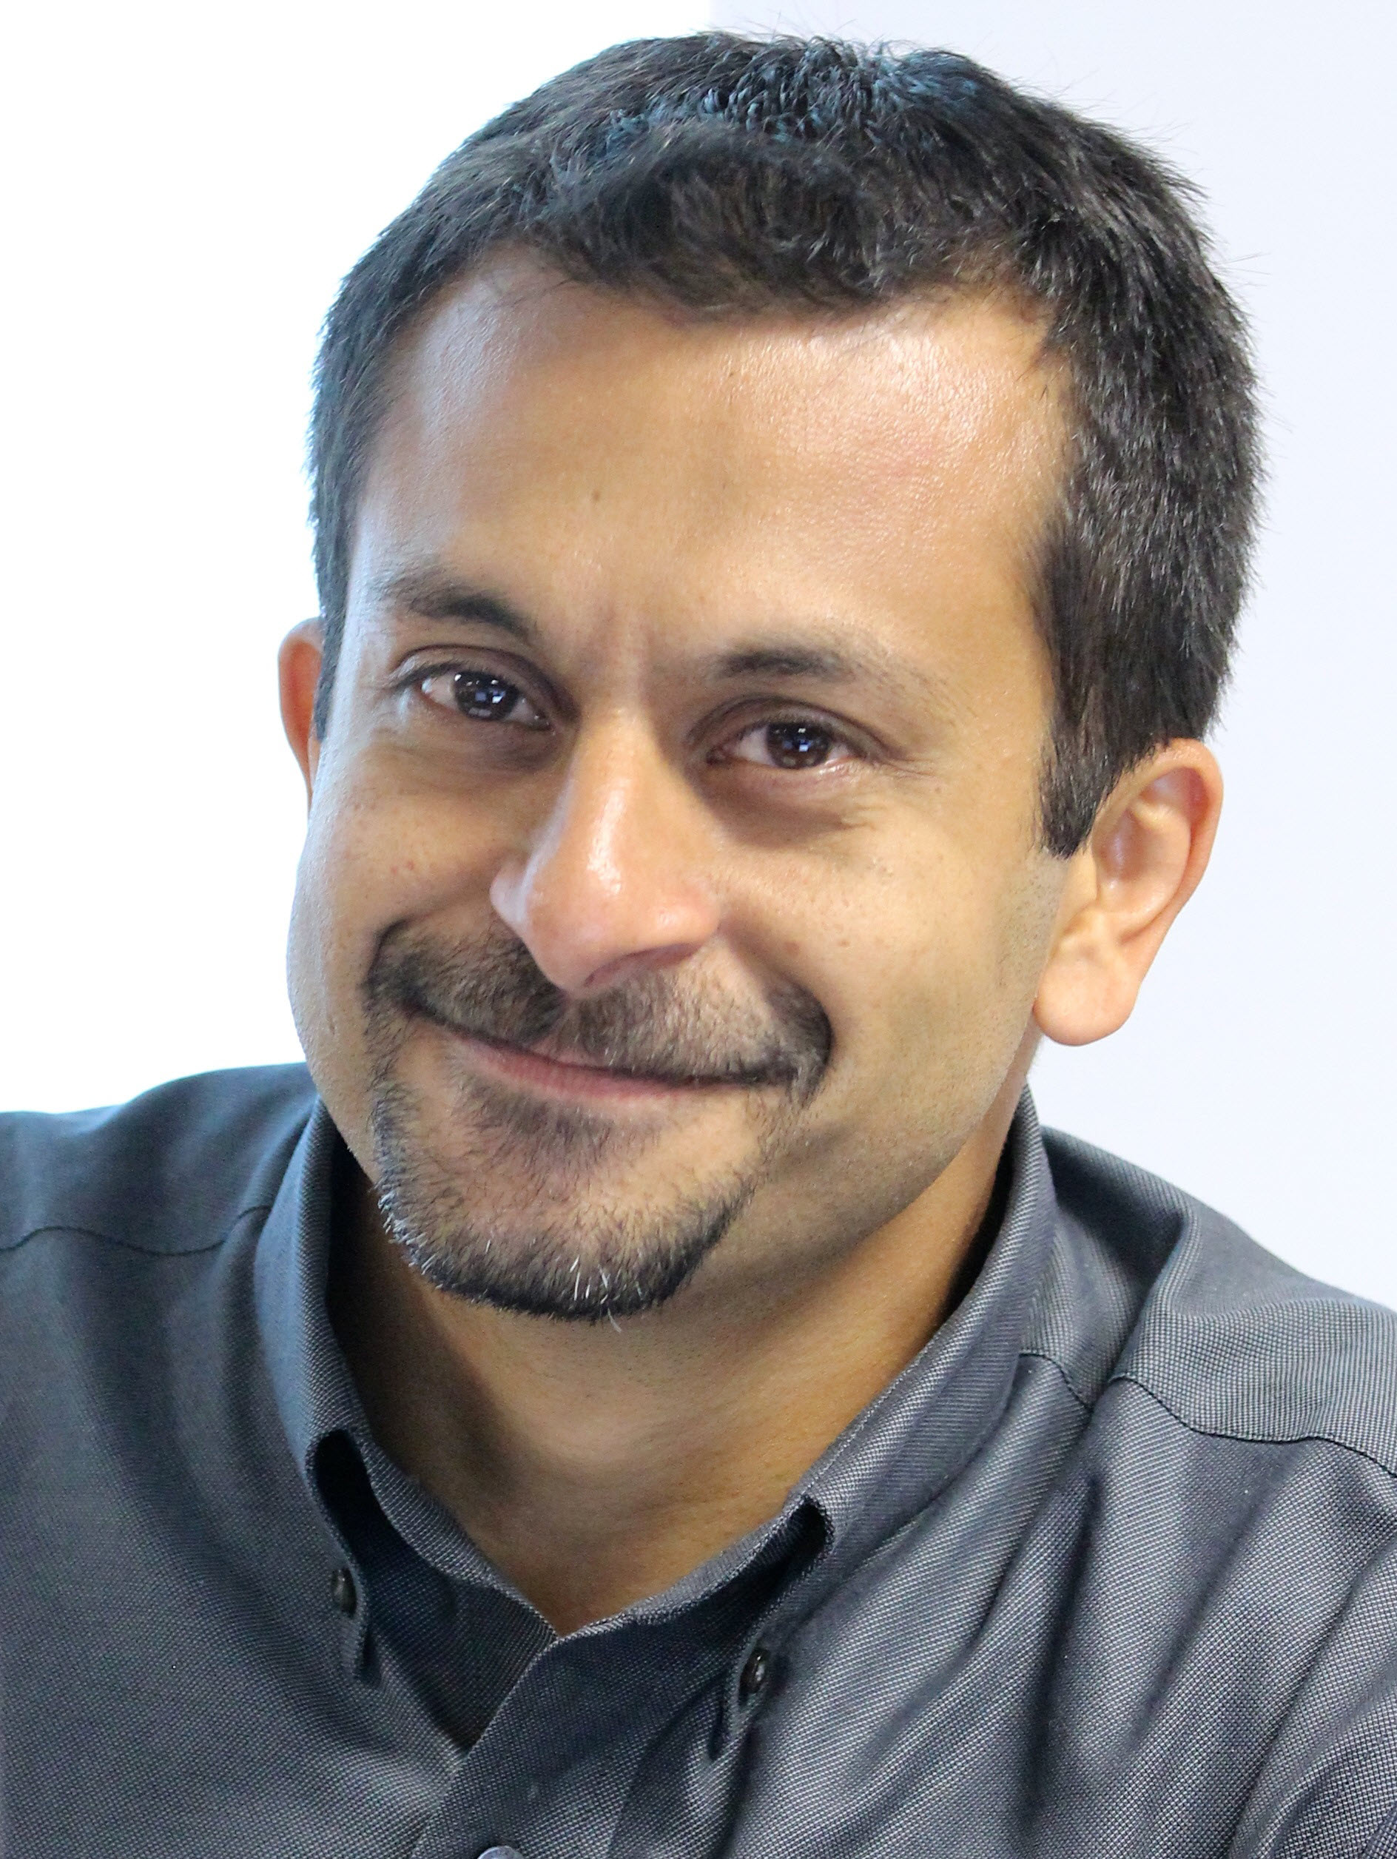
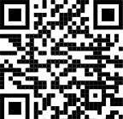
About me - Asif Rehmani
Conference Speaker
Ignite
ESPC
SPTechCon
SP Fest
SPC
TechEd
And many more…
Microsoft MVP
Trainer & Consultant
Founder and CEO
VisualSP
Chicago, USA
Since 2007
Author
My LinkedIn profile
asif@visualsp.com
www.VisualSP.com
Notes:
My name is Asif Rehmani
Founder and CEO of VisualSP.
Been in the Learning business since 2005 as a trainer.
Speak at conferences around the world on end user training, user adoption and performance support.
Authored multiple books on Microsoft technologies for Wiley publications
Microsoft MVP since 2007.
I started my journey and SharePoint back in 2002 (when the software really sucked!). as the software became better and better and better and more popular in companies, I stuck with it training, consulting , mentoring and writing about it.
In 2016, I turned my focus to SharePoint online and then to Microsoft Office 365.
All along the way, my interactions have been with administrators, power users and end users of the software throughout the world. I see my job as empowering these folks to get the best use out of the software That their companies have invested in.
end user adoption is near and dear to my heart. I strongly believe that without proper usage of the software, it is all for nothing. Getting users on board and having them see what's in it for them is the Holy Grail that all of us should be chasing to make sure we get it right!

Slide 3
My story of training end users in Chicago
Notes:
Let me share with you a story about an experience I had.
Back in 2009, I was invited to teach a two day end users class in my hometown of Chicago to employees of an organization that was in the business of providing secondary educational institutions (so colleges, universities) with insurance.

Slide 4
Notes:
I taught the class to 30 folks over a 2 day period.
(No, this is not the actual class and no, that is not me at the front of the class ☺ )

Slide 5
Topics Covered
Lists
Libraries
Pages
Security
Web components
Notes:
This was a SharePoint focused class so I taught them all about SharePoint as a power user and end user.
We went over all the basics like how to use pages, lists, libraries, set up permissions, use web parts and a lot of other goodies present in SharePoint.

Slide 6
Notes:
After the two days of training was over, the person who hired me invited me to stay for one extra day. They would pay me to just sit in a nice corner office with a beautiful view of the Chicago river and all I would have to do is to answer any questions that people had. I said sure. That’s easy enough. I have already taught them everything that they needed to know over the last couple of days. I'm sure there will be little to no questions ….

Slide 7
Notes:
Boy was I wrong ….
there was a line out the door the whole day of people with questions. Questions about how they get their job done using the technology that I had taught them about. Now I was explaining to them one on one what I just taught them the last two days.
I felt pretty ashamed. My first thought was that I must have been a horrible teacher. If all of them have questions regarding what I just taught them. that means I did not do a good job teaching in the last two days because if I did, they should remember everything I taught them and know how to do it. Right…?
After that experience in Chicago, I thought about this some more. Do end users really want to be trained? Is that the best way for us to empower them to help them do their job?

Slide 8
I realized Traditional training doesn’t work for end users
Notes:
My conclusion was:
Thoroughly training end users doesn't really work.
Traditional classroom and binge learning just doesn’t work for end users. And it Never has!
We are not preparing employees to take a test. We are preparing them to help them do their job.

Slide 9
Average number of applications used by knowledge workers in a week
12
Notes:
An average knowledge worker is expected to jump around between multiple applications to do their job.
Do we really expect our users to be thoroughly trained in all of the applications they need to use? Do we expect them to remember everything when they actually need it?

Slide 10
What do end users need?
Notes:
What do end users really need for them to be successful if not getting thoroughly trained?
How can we help them be successful with their jobs?

Slide 11
End users want to be Supported at their Moment-of-Need
Users want answers to their questions and be supported while they are working
Notes:
This begs the question: Do end users really want to be trained or do they want to be helped? That's the real question I think we should be asking ourselves.
When an employee approaches you when they're struggling with some process , are they asking “Can you train me on…” or they say “Can you help me with…” ?
People want answers to their questions and want to feel supported while they are working.
Meaning employees don’t want to be trained. They want help at their moment of need to get their job done - and not only when it's convenient for us to teach them a class.
Currently the training is provided by organizations keeping organization metrics in mind. How many people have completed a course ? How many are certified in a certain discipline? The current learning that's provided is not with the intent of helping users perform. That needs to change if you want you organize your workers too truly be supported when they need support.
It has to be a win-win situation where the users understand exactly what's in it for them also and not just what's in it for the organization

Slide 12
What are the options to deliver Organizational Learning?
Notes:
How can we effectively deliver organizational learning to our users?
What are the ways in which learning can be delivered?
What are the tools needed to deliver that learning?

Slide 13
Learning delivery options
Macrolearning
Learning in the Flow of Work
Microlearning
Contextual Microlearning
Notes:
Learning in a deep dive fashion
When an employee needs to learn something new, deep learning is the best option.
Deep learning is accomplished through a Macrolearning event.
Macrolearning is destination learning – an employee goes to a destination (physical or virtual) to get fully trained in a subject area - ex: classroom training (physical or virtual), self guided courses through LMS, LXP, etc.
Learning in the flow of work
It involves accessing, quickly and easily, an answer or a short piece of learning content while you're working.
When an employee needs help “now”, he gets help directly in the flow of work.
Learning in the flow of work is accomplished through Microlearning.
There are two types of Microlearning:
1) Traditional Microlearning
2) Contextual Microlearning
Traditional Microlearning means still going to a learning destination to learn something - ex: YouTube, Online Search, etc.
A step further is Contextual Microlearning
Contextual microlearning focuses on the last mile of content delivery - to deliver the content and information to users wherever they are at their moment of need in the flow of their work and in context of their environment. Basically, the learning comes to the learner instead of the learner going to the learning.
That's done by a context sensitive digital coach or a digital help platform.

Slide 14
Business Benefits achieved using Learning in the Flow of Work
Reducing support tickets
Better efficiency and time savings
Low error rates
Improve user experience
Enhanced adoption through better process
Reduce training costs
Notes:
The business value that this type of support brings is in the form of
reducing support tickets and costs as a result of contextual help within the application
better efficiency and time savings through increased user productivity
low error rates due to support in completing processes
improve user experience and user satisfaction scores
enhanced adoption through better process completion and engagement
reduce training costs through faster content creation and in the work content delivery
By implementing learning in the flow of work, we can produce self sufficient and self-reliant employees. Highly engaged employees who are able to get to what they need within a couple of clicks and few seconds to solve their problems and stay ahead of change.

Slide 15
Organizational learning mechanisms
Classroom training (physical or virtual)
Ongoing learning events (webinars, orientation sessions, etc.)
Learning Systems (LMS, LXP, Training hub, etc.)
Digital coach (train, inform & support users at moment-of-need)
Notes:
Classroom training, ongoing learning events and learning systems are already well known.
A digital coach brings learning to the learner instead of learner to the learning. It’s always present to help users in context of their own digital environment.
A digital coach provides contextual experiences for the user. For example: embedded video on a page, inline help, quick reference tooltips, informational banners, interactive guides and walkthroughs.

Slide 16
Can you combine it all together for maximum effect?
Notes:
Do you have to pick one or the other in terms of which tools and methodologies to use to provide learning?
Can you use a combination or all of them to provide organizational learning?

Slide 17
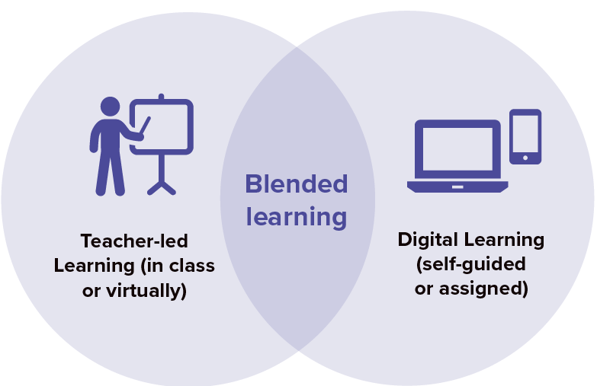
Provide Blended Learning makes use of multiple organizational learning approaches
Notes:
You can use the concept of Blended Learning to provide synchronous and asynchronous ways of learning to your users.
This can be a combination of a couple or more of the learning mechanisms described earlier to achieve desired goals.

Slide 18
A Blended Learning Approach
70:20:10 Model of Learning
Digital Coach / Learning Events
Courses
Notes:
The 70:20:10 formula is about how the learning takes place.
70% in the flow of work
20% through collaboration with others
10% in formal training environment.
Many times learning starts in a formal manner but that's not always the case. Sometimes you just dive in and learn something as you go along.
The 10% formal learning is usually implemented with formal methods such as learning management systems and knowledge hubs. Very necessary but it's only 10% of the story.
The 20% of learning is all social, informal and ongoing. That's happening all along while we are talking with peers and mentors along our journey.
70% of it is happening on the job. Learning in the flow of work or also known as workflow learning. This is done through some sort of on the job assistance. Now if the job is on digital systems such as computers then usually it's done using a digital coach.
Once the formal learning has been implemented, the digital coach spreads across all phases / moments of need.
Putting it all together is how you implement a blended learning approach. Learning that encompasses all the moments of need phases for an employee.
70% VisualSP or similar digital coach - learning while doing in the workflow
20% peer collaboration - discussions with others
10% LMS and Knowledge hubs like Viva Learning - formal training

Slide 19
Macrolearning or Microlearning or Contextual Microlearning
Let’s play a game
Notes:
In the following slides, see if you can figure out if the type of learning that is taking place is Macrolearning, Microlearning or Contextual Microlearning.

Slide 20
Learning in a class
Notes:
A teacher teaching a class (physically or virtually) – a synchronous event
Macrolearning

Slide 21
Finding answers to a question through search
Notes:
Finding answers to a question through search
Microlearning

Slide 22
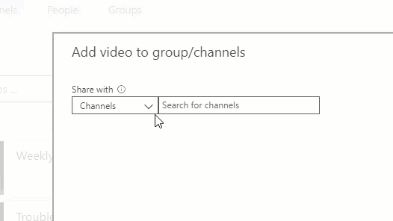
Inline icon next to a form field
Notes:
Inline icon next to a form field explaining its use
Contextual Microlearning

Slide 23
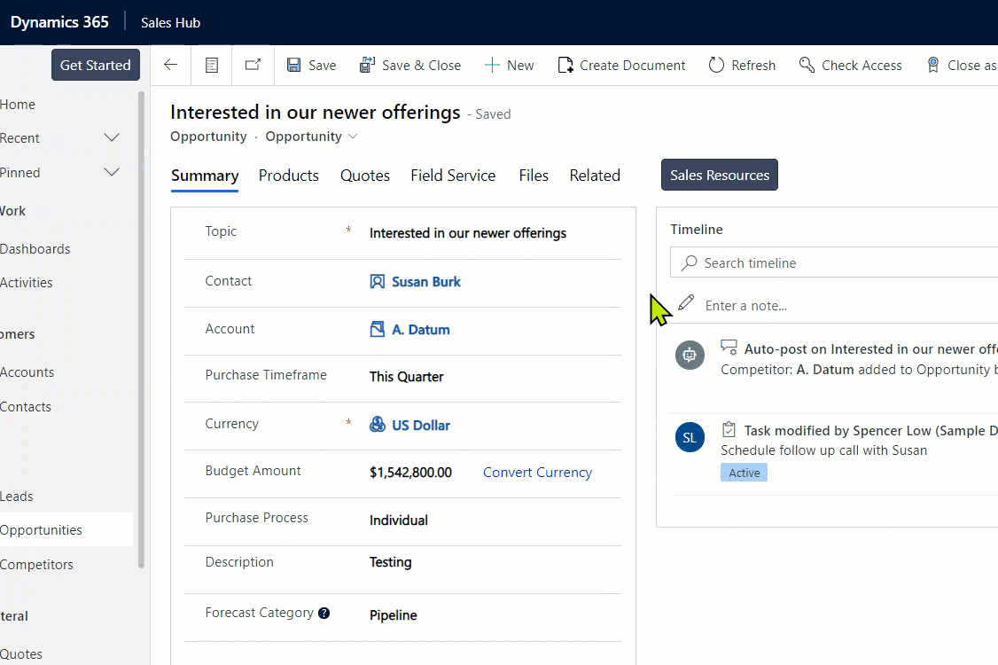
Hover over tooltip
Notes:
Hover over tooltip
Contextual Microlearning

Slide 24
Watching how-to video on YouTube or Stream
Notes:
Navigating to Stream library or YouTube to watch a how-to video
Microlearning

Slide 25
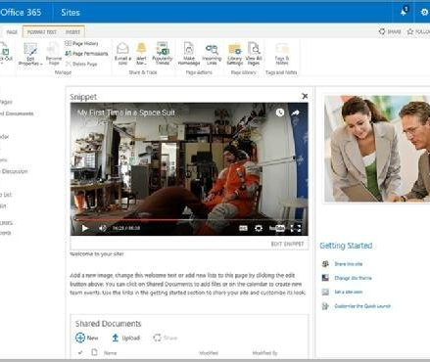
An embedded video in SharePoint
Notes:
An embedded video in SharePoint showing a procedure
Contextual Microlearning

Slide 26
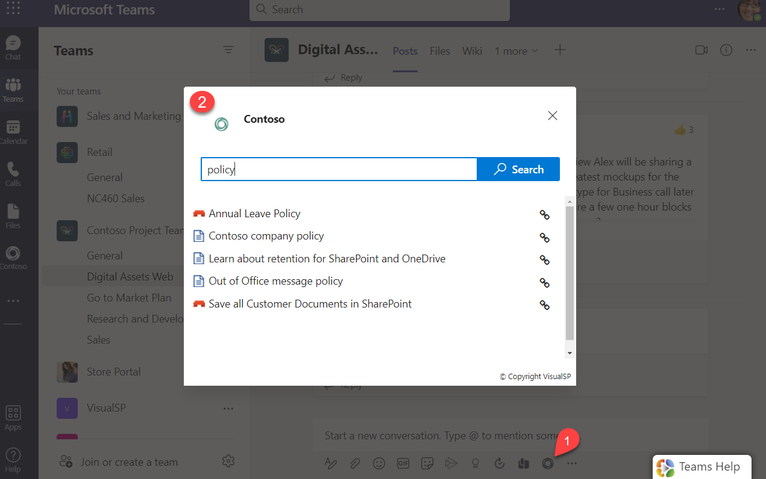
Fetching an answer to a question when in a Teams chat or conversation
Notes:
Pulling up an answer to a question when in a Teams chat or conversation
Contextual Microlearning

Slide 27
Taking a course on a learning system
Notes:
Taking a course in a learning system
Macrolearning

Slide 28
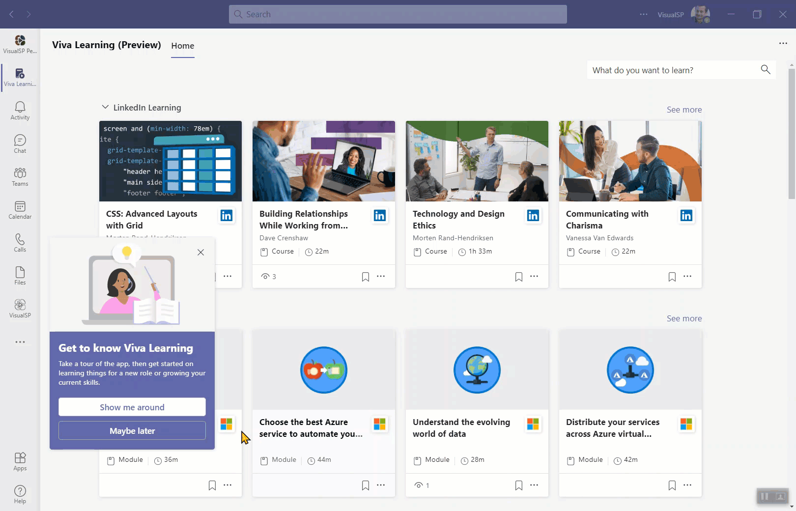
Interactive step by step guided walkthrough
Notes:
Interactive step by step guided walkthrough
Contextual Microlearning

Slide 29
Banner for announcements
Notes:
A banner to inform or announce something
Contextual Microlearning

Slide 30
When do you provide the learning?
Notes:
It’s not just important to know what type of learning to provide. It’s equally important to understand when to provide what type of learning to your users.

Slide 31
Employee phases of learning
Learning something new - learning something for the first time
Learning in the flow of work - expanding the breadth and depth of what has been learned through work experiences
Problem solving / troubleshooting - solving problems or resolving issues when things don't work the way they should
Retraining / upskilling when things change – learning new ways of doing something to adapt to the change
Notes:
There are 4 phases of employee learning. Let’s go over each one.
The first phase is when someone is hired or joins a new department on you team and they're learning something for the first time. They are brand new to the information.
The second one is when you are digging in and expanding your knowledge base. You might refer to that as deep learning Into a particular subject area.
The third one is problem solving. Problems arise. That's a fact of life. How do you resolve issues when they come up . Test the fourth phase.
The fourth one is when things change. Change and transformation happens everywhere. The question here becomes how do you react to it and adapt to new ways of doing things while unlearning things you already know.

Slide 32
What are the components of Blended Learning?
Notes:
So what are the exact components of blended learning?

Slide 33
Blended Learning components
Booster Macrotraining events
Ongoing learning opportunities
Microlearning
and
Contextual Microlearning
Measure what matters

Slide 34
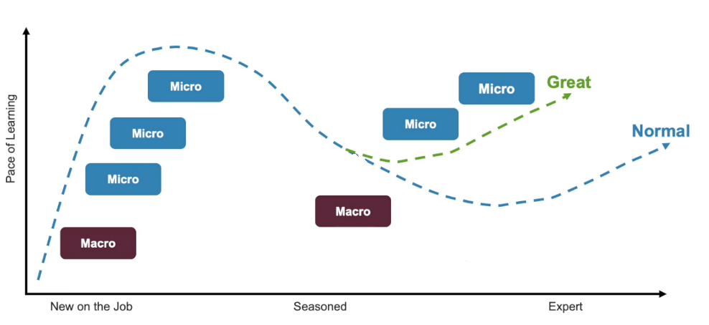
Employee learning journey

Slide 35
How do you quantify success with end user training and support?
Notes:
Without quantifying success, you're just shooting in the dark and hoping things will work out. That's not an effective way to measure success. We have to agree upon specific metrics of success.

Slide 36
Calculating Return On Investment (ROI) of Organizational Learning
Return on Investment is calculated using one or more of the following metrics:
Monetary value creation
Amount of money saved
Amount of time saved
Notes:
Return on investment is usually calculated in terms of:
Monetary value creation
Time value creation
Amount of time saved
Amount of money saved
It’s best to keep in mind the metrics that really matter to You!
You must be able to prove that things are working towards the right direction otherwise you're just doing “stuff”.

Slide 37
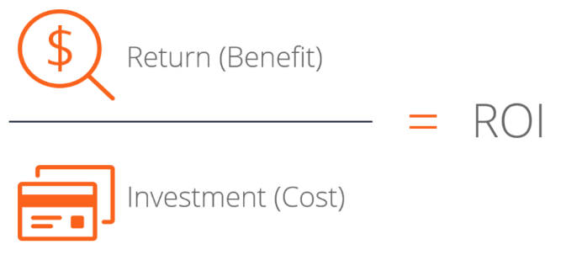
Measuring learning effectiveness The Macrolearning formula
Notes:
Macrolearning calculation is simple. The return (benefit) of your total investment (cost) has to be greater than 100%
An example formula would be:
Return (Benefit) = $2,000
Investment (Cost) = $1,000
ROI = 200%

Slide 38
Measuring learning effectiveness The Microlearning formula
Number of hours saved in productivity (x) =
(# of microlearning assets accessed * 15 mins¹) / 60 mins per hour
Money saved in productivity =
x * $26 Dollars²
Notes:
¹15 minutes = average time to find an answer and get back to task at hand
²$26 = average hourly rate in USA
Notes:
The Microlearning formula for ROI is just a bit more complicated.
Microlearning can be calculated in the following way:
First calculate how many help and training items are being used?
9,807
Then multiply those number of items with 15 minutes of time that could have been needed to solve each of those problems on average to come up with the person minutes saved. Then convert that into hours
9,807*15=147,105 minutes
147,105/60=2,451.75 hours
Then take the average USA (or whichever country you reside in) hourly salary and calculate how much money saved from those number of hours that were saved in productivity
2,451.75*26=$63,745.50
The ROI measurement should never stop. It should be ongoing and preferably automatic, so you always have your finger on the pulse of your organizational learning effectiveness.

Slide 39
Summary
End users want to be helped when needed and not heavily trained
Support users at their moment-of-need
Implement Learning in the Flow of Work using a Blended Learning approach
Measure ROI continuously

Slide 40
Next Steps
Reach out to me with your questions
asif@visualsp.com
@asifrehmani
Download this and my other presentations
http://bit.ly/AsifConference
Notes:
Feel free to reach out to me at my email address or message me on Twitter or LinkedIn. I Love hearing from like minded folks.
The long URL where I upload All of my presentations:
https://info.visualsp.com/download-conference-presentations-1

