Slide 1
Context Sensitive Learning and Support to Employees
Presented by:
Asif Rehmani, MVP
CEO at VisualSP
Notes:
The URL to download all my presentations:
https://info.visualsp.com/download-conference-presentations-1
Traditional methods of training are just not enough to prepare end users to be successful working efficiently with enterprise applications.
we have to think out of the box and provide learning, information and support at the moment of need, in context of the user’s environment and within the flow of their work.
This presentation will show exactly what context sensitive learning and support for employees looks like. How it can be executed. And how many other companies have been benefiting Applying these methods.

Slide 2
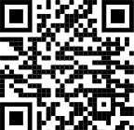
About me - Asif Rehmani
Conference Speaker
Ignite
ESPC
SPTechCon
SP Fest
SPC
TechEd
And many more…
Microsoft MVP
Trainer & Consultant
Founder and CEO
VisualSP
Chicago, USA
Since 2007
Author
My LinkedIn profile
asif@visualsp.com
www.VisualSP.com
Notes:
My name is Asif Rehmani
Founder and CEO of VisualSP.
Been in the Learning business since 2005 as a trainer.
Speak at conferences around the world on end user training, user adoption and performance support.
Authored multiple books on Microsoft technologies for Wiley publications
Microsoft MVP since 2007.
I started my journey and SharePoint back in 2002 (when the software really sucked!). as the software became better and better and better and more popular in companies, I stuck with it training, consulting , mentoring and writing about it.
In 2016, I turned my focus to SharePoint online and then to Microsoft Office 365.
All along the way, my interactions have been with administrators, power users and end users of the software throughout the world. I see my job as empowering these folks to get the best use out of the software That their companies have invested in.
end user adoption is near and dear to my heart. I strongly believe that without proper usage of the software, it is all for nothing. Getting users on board and having them see what's in it for them is the Holy Grail that all of us should be chasing to make sure we get it right!

Slide 3
My story of training end users in Chicago
Notes:
Let me share with you a story about an experience I had.
Back in 2009, I was invited to teach a two day end users class in my hometown of Chicago to employees of an organization that was in the business of providing secondary educational institutions (so colleges, universities) with insurance.

Slide 4
Notes:
I taught the class to 30 folks over a 2 day period.
(No, this is not the actual class and no, that is not me at the front of the class ☺ )

Slide 5
Topics Covered
Lists
Libraries
Pages
Security
Web components
Notes:
This was a SharePoint focused class so I taught them all about SharePoint as a power user and end user.
We went over all the basics like how to use pages, lists, libraries, set up permissions, use web parts and a lot of other goodies present in SharePoint.

Slide 6
Notes:
After the two days of training was over, the person who hired me invited me to stay for one extra day. They would pay me to just sit in a nice corner office with a beautiful view of the Chicago river and all I would have to do is to answer any questions that people had. I said sure. That’s easy enough. I have already taught them everything that they needed to know over the last couple of days. I'm sure there will be little to no questions ….

Slide 7
Notes:
Boy was I wrong ….
there was a line out the door the whole day of people with questions. Questions about how they get their job done using the technology that I had taught them about. Now I was explaining to them one on one what I just taught them the last two days.
I felt pretty ashamed. My first thought was that I must have been a horrible teacher. If all of them have questions regarding what I just taught them. that means I did not do a good job teaching in the last two days because if I did, they should remember everything I taught them and know how to do it. Right…?
After that experience in Chicago, I thought about this some more. Do end users really want to be trained? Is that the best way for us to empower them to help them do their job?

Slide 8
I realized Traditional training doesn’t work for end users
Notes:
My conclusion was:
Thoroughly training end users doesn't really work.
Traditional classroom and binge learning just doesn’t work for end users. And it Never has!
We are not preparing employees to take a test. We are preparing them to help them do their job.

Slide 9
What do end users need?
Notes:
What do end users really need for them to be successful if not getting thoroughly trained?
How can we help them be successful with their jobs?

Slide 10
Average number of applications used by knowledge workers in a week
12
Notes:
An average knowledge worker is expected to jump around between multiple applications to do their job.
Do we really expect our users to be thoroughly trained in all of the applications they need to use? Do we expect them to remember everything when they actually need it?

Slide 11
End users want to be Supported at their Moment-of-Need
Users want answers to their questions and be supported while they are working
Notes:
This begs the question: Do end users really want to be trained or do they want to be helped? That's the real question I think we should be asking ourselves.
When an employee approaches you when they're struggling with some process , are they asking “Can you train me on…” or they say “Can you help me with…” ?
People want answers to their questions and want to feel supported while they are working.
Meaning employees don’t want to be trained. They want help at their moment of need to get their job done - and not only when it's convenient for us to teach them a class.
Currently the training is provided by organizations keeping organization metrics in mind. How many people have completed a course ? How many are certified in a certain discipline? The current learning that's provided is not with the intent of helping users perform. That needs to change if you want you organize your workers too truly be supported when they need support.
It has to be a win-win situation where the users understand exactly what's in it for them also and not just what's in it for the organization

Slide 12
Instead of training, provide Learning in the Flow of Work
Learning in the flow of work involves accessing, quickly and easily, an answer or a short piece of learning content while you're working.
Notes:
let's provide true learning in the flow of work when employees need it instead of training them ahead of time and trying to fill up their brain with information that they need to access months or years down the line.
now before we dive into learning in the flow of work , let's look at the definition of what the phrase really means.
Learning in the flow of work involves accessing, quickly and easily, an answer or a short piece of learning content while you're working.
Once again to put it simply, learning in the flow of work means while working as an employee, I have information that I need that I can access without stopping my work.

Slide 13
Learning delivery options
Macrolearning
Learning in the Flow of Work
Microlearning
Contextual Microlearning
Notes:
Learning in a deep dive fashion
When an employee needs to learn something new, deep learning is the best option.
Deep learning is accomplished through a Macrolearning event.
Macrolearning is destination learning – an employee goes to a destination (physical or virtual) to get fully trained in a subject area - ex: classroom training (physical or virtual), self guided courses through LMS, LXP, etc.
Learning in the flow of work
It involves accessing, quickly and easily, an answer or a short piece of learning content while you're working.
When an employee needs help “now”, he gets help directly in the flow of work.
Learning in the flow of work is accomplished through Microlearning.
There are two types of Microlearning:
1) Traditional Microlearning
2) Contextual Microlearning
Traditional Microlearning means still going to a learning destination to learn something - ex: YouTube, Online Search, etc.
A step further is Contextual Microlearning
Contextual microlearning focuses on the last mile of content delivery - to deliver the content and information to users wherever they are at their moment of need in the flow of their work and in context of their environment. Basically, the learning comes to the learner instead of the learner going to the learning.
That's done by a context sensitive digital coach or a digital help platform.

Slide 14
Organizational learning mechanisms
Classroom training (physical or virtual)
Ongoing learning events (webinars, orientation sessions, etc.)
Learning Systems (LMS, LXP, Training hub, etc.)
Digital coach (train, inform & support users at moment-of-need)
Notes:
Classroom training, ongoing learning events and learning systems are already well known.
A digital coach brings learning to the learner instead of learner to the learning. It’s always present to help users in context of their own digital environment.
A digital coach provides contextual experiences for the user. For example: embedded video on a page, inline help, quick reference tooltips, informational banners, interactive guides and walkthroughs.

Slide 15
Employee phases of learning
Learning something new - learning something for the first time
Learning in the flow of work - expanding the breadth and depth of what has been learned through work experiences
Problem solving / troubleshooting - solving problems or resolving issues when things don't work the way they should
Retraining / upskilling when things change – learning new ways of doing something to adapt to the change
Notes:
There are 4 phases of employee learning. Let’s go over each one.
The first phase is when someone is hired or joins a new department on you team and they're learning something for the first time. They are brand new to the information.
The second one is when you are digging in and expanding your knowledge base. You might refer to that as deep learning Into a particular subject area.
The third one is problem solving. Problems arise. That's a fact of life. How do you resolve issues when they come up . Test the fourth phase.
The fourth one is when things change. Change and transformation happens everywhere. The question here becomes how do you react to it and adapt to new ways of doing things while unlearning things you already know.

Slide 16
A Blended Learning Approach
70:20:10 Model of Learning
Digital Coach
LMS / Knowledge Hub
Notes:
The 70:20:10 formula is about where the learning takes place.
70% in the flow of work
20% through collaboration with others
10% in formal training environment.
Many times learning starts in a formal manner but that's not always the case. Sometimes you just dive in and learn something as you go along.
The 10% formal learning is usually implemented with formal methods such as learning management systems and knowledge hubs. Very necessary but it's only 10% of the story.
The 20% of learning is all social, informal and ongoing. That's happening all along while we are talking with peers and mentors along our journey.
70% of it is happening on the job. Learning in the flow of work or also known as workflow learning. This is done through some sort of on the job assistance. Now if the job is on digital systems such as computers then usually it's done using a digital coach.
Once the formal learning has been implemented, the digital coach spreads across all phases / moments of need.
Putting it all together is how you implement a blended learning approach. Hybrid learning that encompasses all the five moments of need phases for an employee.
70% VisualSP or similar digital coach - learning while doing in the workflow
20% peer collaboration - discussions with others
10% LMS and Knowledge hubs like Viva Learning - formal training

Slide 17
Live Demo
The “Digital Coach”
Notes:
Demos – use Jamie’s example
Applications to show:
SharePoint, Teams, OneDrive, Dynamics 365, HR application
components to show:
hover over tips, onboarding tasks, announcement banner, inline help, searching for answers in the panel

Slide 18
Meet Jamie
Just got hired by Contoso
Has 10 years of Salesforce experience
Member of the Sales team
Contoso uses Microsoft technologies
Working from home
Notes:
Meet Jamie.
She has been hired by Contoso corporation.
She's an experienced salesperson and has been using Salesforce for 10 years along with Google for email and other collaboration.
Jamie is being hired by the Sales team at Contoso corporation.
At Contoso, they don’t use Salesforce or Google. They are a Microsoft shop. They use Microsoft Dynamics 365 for their sales and SharePoint, Microsoft Teams and other Microsoft 365 apps for their document management and collaboration.

Slide 19
1. Learning New Information
Getting started with the new team
Learning Teams, Microsoft 365, Dynamics 365
Notes:
Since Jamie is new to the team and new to the systems that the team uses, her manager at contoso has prepared a welcome message for her that she sends her through email.
Jamie receives the welcome email from her team lead with a link to the Dynamics 365 sales system that her team uses to manage contacts, accounts and opportunities.
She clicks on the email and is taken to the Dashboard of Dynamics 365 Sales where a welcome walkthrough automatically kicks off
This tour welcomes Jamie to the Dynamics 365 sales team. It shows her around the Dynamics 365 sales interface.
The tour starts with a splash page video on top of the Dashboard page from the CEO welcoming the new member, Jamie, to the team.
The next step here clicks on the + icon automatically on top right of Dynamics and points to it letting her know that she can create any record from there
The next step points to the navigation on the left and tells her that she can navigate Dynamics sales using the navigation sidebar. It also shows her an image showing the Nav bar and all of its components.
Then it shows a splash screen that says let me take you to the leads screen to show you leads assigned to you to start with.
In the next step, the Leads on the nav bar is automatically clicked and now she's on the leads screen.
Then it shows her a splash screen that tells her that these are her leads and tells her that she can create new leads following the example in the animated gif below.
The splash screen also has a link at the bottom so if Jamie needs help, she can contact support.
The splash screen also provides her with an orange Action button in the same step which says she can learn how to Convert a Lead if she wants.
If she clicks on the convert a lead action button, it opens up a video coming from the learning management system showing how she can do that.
-----------------
Jamie has been given access to a SharePoint document library where she will manage her team's documents. One day, she sees an Announcement banner and it informs her that there is a Microsoft Teams channel for her team where she can collaborate with everyone easily. She clicks on the Take Me There button and it brings her to that channel within Microsoft Teams.
While Jamie is using Microsoft Teams to collaborate with her colleagues, she notices the Viva learning app that's present and digs into the courses recommended to her by her manager:
Time Management: Working from Home
Building Relationships While Working from Home

Slide 20
2. Applying What You’ve Learned
Learning while doing
Notes:
Jamie has been told that there's a digital coach that's present on top of Dynamics 365 as well as SharePoint and other Microsoft 365 apps that Contoso corporation has. So meaning wherever she goes, she should expect to find overlaid help with different tasks that she would need help with.
When she navigates to a specific opportunity within dynamics 365 sales, she sees buttons, links , inline icons and also tab that says dynamics help. It just all makes sense because it's all right there in the flow of her work. So she experiments by clicking on those things to see how it helps her.
While in the document library, Jamie sees various job aids . First one is a button which when clicked provides her a tour of the library. that's helpful because she is not familiar with the library. Another is an inline help icon on top of the wording all documents which when clicked provides her a couple of reference tips about what that is. And the third is a link on the page that lets her know that if she needs to contact support she can click on that. if she did click on it, it would invite to take her to the support desk which in her case exists in a Microsoft Teams channel. All of these experiences are driven by the digital coach.
Jamie remembers learning something about how she can create a new column in a document library with specific formatting. She learned it in training so she knows it's possible to do but doesn't remember the steps.
She navigates to the document library and brings up the Digital Coach and asks about format columns. She sees an animated image showing her exactly how to create the formatted choice column and she goes ahead and follows the example step by step to create the new column.

Slide 21
3. Problem Solving
Solving challenges as they arise
Accessing support desk as needed
Notes:
Now Jamie has been at her job for six months. She knows a lot of the things already. However problems arise which they always do. So let's look at an example of how she deals with that.
Jamie goes to the New Opportunity screen in Dynamics 365 sales to create an opportunity and sees that there is a field called Forecast Category. She's not familiar with this field. She doesn't know exactly what to pick in that field. So she clicks on the inline help icon next to it and that tells her exactly what that field is all about.
Jamie Needs to upload some files as part of this opportunity so she clicks on the Files tab but can't figure out why there are no files there and needs to ask someone. Jamie decides that she needs to contact support so using the digital coach, she goes ahead and clicks on talk to support and gets routed directly to the support channel within Microsoft Teams.

Slide 22
4. Retraining / Upskilling when things change
Responding to change
Notes:
The fifth and last moment of need is when things change as they inevitably do.
As part of the new rules and regulations at Contoso , an essential training on Workplace Harassment needs to be taken by all employees and that needs to be communicated to everyone. All employees have been emailed but many have not taken this training still. Since most are remote workers, it's hard to get this information in front of them through other methods.
The company turns to the use of digital coach to get their information to the right people.
As Jamie is in the HR system filing a leave of absence, a popup comes up. The pop up informs her that her company needs everyone to take this essential training by Nov 12th.
It has two buttons. The first orange button says Take the Training. The second blue button says I'll Do It Later.
She is ready right now and knows this is essential so clicks on the orange button and is taken directly to the training in a pop up box right on top of her environment. The training is coming from her learning management system.
She quickly goes ahead and finishes the training and now the transcript for it will be recorded in her records.

Slide 23
Headquarters in Chicago, IL
Founded: 2005
Technology focus areas
Microsoft 365, SharePoint, Dynamics 365
Enterprise web applications
Notes:
VisualSP was founded in July 2005.
We used to focus on running in person classes and training administrators and developers.
Our customers asked for our help to support their end users.
The majority of a company's employees are end users (some of whom are more motivated than others and are referred to as power users). These folks are the ones who are really going to make or break the company and they need the answers on demand and at their moment of need.
So in 2012, we shifted the company to start focusing on end users. Then non IT people to help companies boost their return on investment of their enterprise software.
The company is based in Chicago, IL with personnel spread out all over the globe in places such as Colorado, Texas, Illinois, New York, UK, and South Africa.
VisualSP has catered to over 200 Enterprise Customers and more than 2 Million end users have been exposed to VisualSP help system.
VisualSP has been providing contextual help for SharePoint on premises since 2012 and starting with 2017 we opened it up for Office 365 and now Teams as well. In 2019, we also started supporting Dynamics 365 and other web based enterprise applications.
VisualSP now primarily focuses on provideing context sensitive help to end users as an overlay on top of their own environment.
VisualSP is 99% a product company.

Slide 24
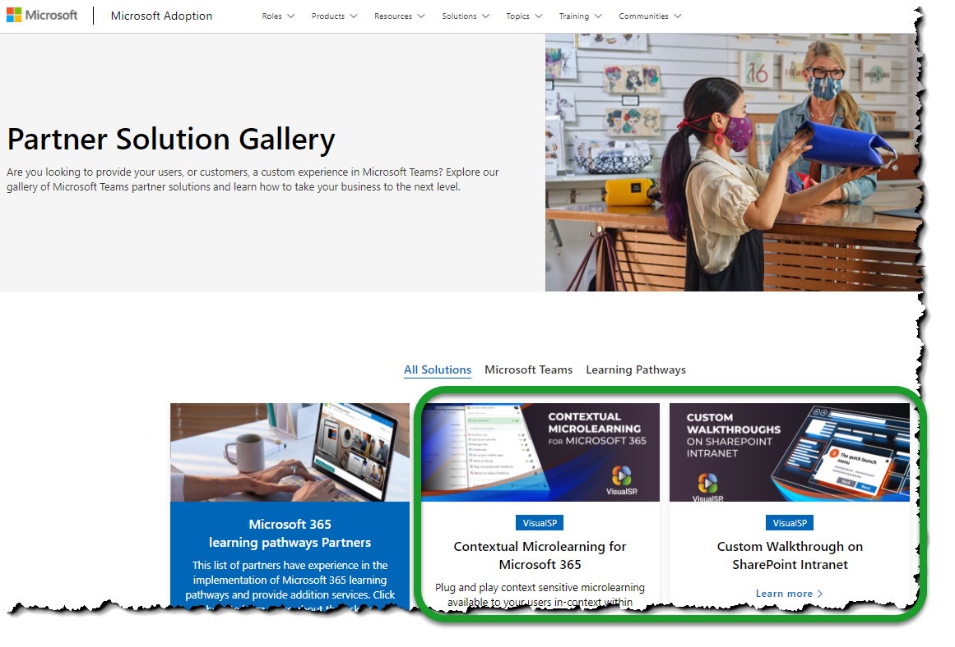
VisualSP is a recognized Microsoft Partner
Notes:
Our company, VisualSP, has been recognized as a premier Microsoft partner and appears in the partner solution gallery of the Microsoft adoption site.
Partner Solution Gallery – Microsoft Adoption

Slide 25
Business Benefits achieved using Learning in the Flow of Work
Reducing support tickets
Better efficiency and time savings
Low error rates
Improve user experience
Enhanced adoption through better process
Reduce training costs
Notes:
The business value that this type of support brings is in the form of
reducing support tickets and costs as a result of contextual help within the application
better efficiency and time savings through increased user productivity
low error rates due to support in completing processes
improve user experience and user satisfaction scores
enhanced adoption through better process completion and engagement
reduce training costs through faster content creation and in the work content delivery
By implementing learning in the flow of work, we can produce self sufficient and self-reliant employees. Highly engaged employees who are able to get to what they need within a couple of clicks and few seconds to solve their problems and stay ahead of change.

Slide 26
VisualSP is already serving hundreds of great brands around the world
And many More…
Notes:
VisualSP does business globally with companies in government, healthcare, finance, manufacturing and many more industries

Slide 27
Call to Action
Learn more at www.visualsp.com
Reach out to setup a private demo for you and your team
Asif Rehmani
asif@visualsp.com

