Slide 1
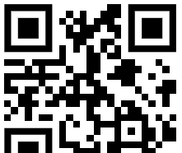
Download all my presentations and video recordings
http://bit.ly/AsifConference
Notes:
My conference topics include:
Organizational change management
Learning in the flow of work
Making the best use out of Microsoft Office 365
Introduction to Dynamics 365 for the Microsoft 365 guy or gal
Microsoft Viva: what are the components of vva and why you should care

Slide 2
Are you thinking about any of the following?
I put so much work in making our SharePoint / Microsoft 365 environment great, but end users don’t seem to care
We have been doing ‘adoption’ type activities for a while without seeing much benefits
We have provided so much training and content to people, but I don’t see people using it. They are still always coming to me for help
If Yes, Great! This session is for You!
Notes:
If any of these points or similar is true then this is the right presentation for you.

Slide 3
5 steps to driving sustainable Microsoft 365 & SharePoint adoption
Presented by:
Asif Rehmani, MVP
CEO at VisualSP
Notes:
The URL to download all my presentations Including many recordings of presentations :
https://info.visualsp.com/download-conference-presentations-1
What you’ll get from this presentation:
True stories of successes as well as failures related to user training and adoption
5 things that have shown to drive sustainable user adoption in many organizations around the world
Tips on specific programs that have worked for me in the past

Slide 4
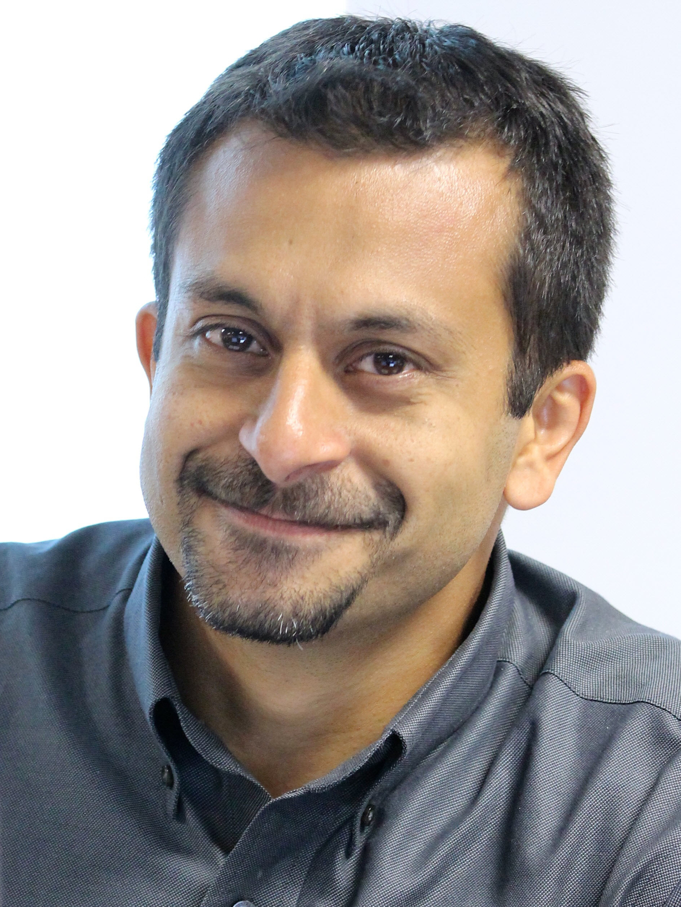
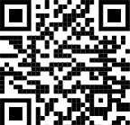
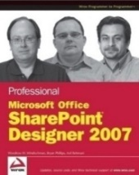
About me - Asif Rehmani
Conference Speaker
Ignite
ESPC
SP Fest (EduCon)
SPC
TechEd
Learning Conferences
And many more…
Microsoft MVP
CEO
Founder and CEO
VisualSP
Chicago, USA
Since 2007
Digital Coach
Author
My LinkedIn profile
asif@visualsp.com
www.VisualSP.com
Notes:
My name is Asif Rehmani
Founder and CEO of VisualSP – a Digital Coach providing Contextual Microlearning.
Been in the Learning business since 2005 as a trainer.
Speak at conferences around the world on end user training, user adoption and performance support.
Authored multiple books on Microsoft technologies for Wiley publications
Microsoft MVP since 2007.
I started my journey and SharePoint back in 2002 (when the software really sucked!). as the software became better and better and better and more popular in companies, I stuck with it training, consulting , mentoring and writing about it.
In 2016, I turned my focus to SharePoint online and then to Microsoft Office 365.
All along the way, my interactions have been with administrators, power users and end users of the software throughout the world. I see my job as empowering these folks to get the best use out of the software That their companies have invested in.
end user adoption is near and dear to my heart. I strongly believe that without proper usage of the software, it is all for nothing. Getting users on board and having them see what's in it for them is the Holy Grail that all of us should be chasing to make sure we get it right!

Slide 5
Why not just 1 silver bullet for increasing adoption instead of 5 things?
Notes:
You might be thinking why can't there just be one silver bullet to increase adoption of all applications? Wouldn't that be awesome …..

Slide 6
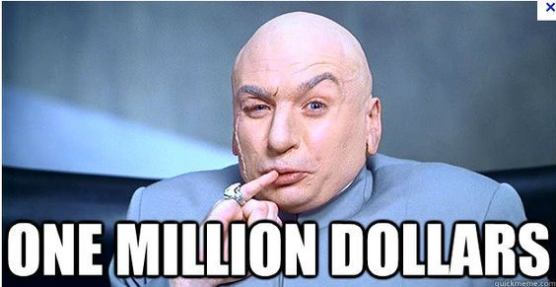
The offer
Notes:
Well my offer to you is that I'll give you 1 Million Dollars if you are able to provide me with that silver bullet instead if you ever find it. Send it to me here: asif@visualsp.com
It’s besides the point that I don’t have 1 Million in cash. I will beg, borrow and get it to you
Why would I be willing to pay you so much or this silver bullet you ask?
because I can just turn around and sell that one silver bullet to companies like Microsoft, IBM , SAP, Oracle, Salesforce, HubSpot, and so many others for billions of dollars. 😀
The fact of the matter is that there is no one silver bullet that we can use to increase user adoption of our applications.
However, there are definitely many copper bullets that we can use to make dents in our effort to increase user adoption. At least that gets us closer to our goal . So let's talk about those instead.

Slide 7
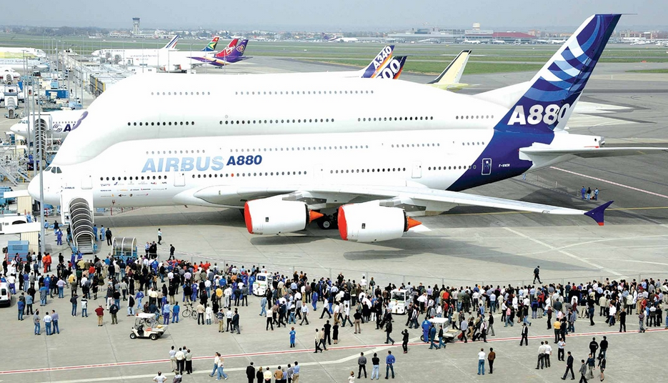
The ‘Jumbo’ problem we are trying to solve
What’s wrong with these pictures?
Notes:
Buying SharePoint or Microsoft 365 and not getting the users onboard is like buying a Jumbo Jet, learning to fly it and then flying around in it without passengers. What's the point?
That’s what happens when end users are not provided the support they need when they need it! Beautiful looking from the outside, but ‘empty’ seats inside thus no user traction.

Slide 8
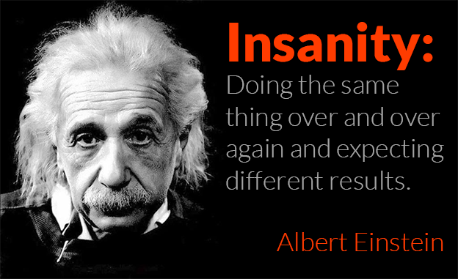
Let’s not make the same mistakes again
Notes:
You already tried training them.
You already tried providing great resources to people.
You tried threatening them ;-)
Nothing has worked. So no point in repeating the same things.
But, what else is there to try...?

Slide 9
User adoption does not have a Begin and End date
Notes:
User adoption is not a project. You can't just tackle user adoption within a set period of time.
User adoption is an ongoing effort. But it's worth it. If you are consistent in your quest to increase user adoption, users will love you for it because you will be showing them What’s In It For Them and why they should care.

Slide 10
“User adoption is a journey, not a destination. If you stop investing and engaging your users, adoption will slow and eventually die out”
Sarah Haase
Corporate Collaboration Evangelist at U.S. Bank
Notes:
Treat the user adoption service like a product - it gives you a more holistic view of all the interconnected pieces.
Be an evangelist.
Instead of just answering a question, send short videos or other type of training / help items to users. that's been successful.
Use a minimalist approach when deploying solutions by telling users about only a few features instead of overwhelming them.

Slide 11
User Adoption as a Service (UAaaS)
Treat User Adoption as a Service and not as a Project
Notes:
UAaaS (yes… I’m aware how that sounds 😆) is an ongoing way of supporting users to help them do their job.
The more you can automate, the better it will be … for You and for Them.

Slide 12
First, make sure you have executive support
Notes:
Without executive sponsorship, you might as well forget about your initiative to achieve sustainable adoption. It just doesn’t work if you don’t have at least one executive sponsor.

Slide 13
Look for and Solve a Critical Problem
It’s Always about WIIFM -
What’s In It For Me?
Notes:
Radio station WIIFM (What’s In It For Me).
Everyone is listening to it all the time. That’s the truth!
Finding and solving the critical problem of users is what it's all about .

Slide 14
Story of my dad and the iPhone
Notes:
Finding the critical “want”
Back around 2012, I was trying to get my dad to get an iPhone. I knew that it would help him a lot checking weather, booking flights, and other apps that were getting popular around that time.
he resisted the idea and said that he was fine with his flip phone. It could let him message and make calls. He didn’t need the complexity of the iPhone and was resistant to the change.
Then one day, a cousin of mine created a WhatsApp group. He put all of our extended family members into that WhatsApp group.
We have a large extended family. We're talking about more than 70 people. Everyone was added to this group who had a smart phone. All of the adults by this time had a smartphone except my dad. And my dad happened to be the oldest of 11 brothers and sisters and has always felt that he is the patriarch of the family.
So guess what … FOMO hit hard with him. He wanted to be in this group once he found out about it.
My dad's request to me (or more like a demand ☺):
“Asif, get me Whatsapp!”
Keep the distinction in mind here. He was still not asking about an iPhone or smartphone. He wanted WhatsApp because that's what attracted him. He could still care less about the actual device that got him access to WhatsApp as long as he had access to that particular application.
When I explained to him that he would have to get a smart phone to get WhatsApp, it was a much easier sell this time around. He had no problem going the smartphone route this time since that got him what he wanted.
of course, once he got a smart phone, he automatically started discovering other features such as checking email, browsing for news, booking flights and more. I did not have to train nor motivate him to discover these things that I was telling him about for quite some time. The adoption of the smartphone itself was automatic once he got what he wanted, WhatsApp, along with the phone.
there's a lesson to be learned here IMHO.
we need to get our users what they want. and that one or two specific things did they really want need to be placed on the top of a platform where we need them to be. User adoption will take care of itself automatically after that.

Slide 15
The story of the secretary in Tennessee
Notes:
The perception of the target customer could be very different than yours
My team and I were contracted to perform an IT assessment of operations at a Department of Defense run facility based in Tennessee. This was around 2009 if I remember correctly.
Money was no object to these guys. They had more than enough funding and were just looking to create efficient processes within their teams.
They had licensing for all of the Microsoft software that you can imagine. That was going to be our main focus. To look at how we can take their existing processes and enhance them using the Microsoft software on hand.
This facility had two buildings which were separated by a couple of hundred feet or less. The first building housed executives. While the second building had program managers, engineers and secretaries.
We started with the second building to see what opportunities we could find there because that's where the technical work was being done.
There was a secretary that sat not far from the entrance of the building. Her job was to run some reports in excel every single day. Once the reports were run and the figures were tabulated, she would write up the comments from the engineers and then print out the reports from a printer that sat behind her at her desk.
This secretary would then take these paper reports and walk to the first building where the executives sat to deliver these reports to them personally. When she was there, she would talk to the executives , answer any questions they had and then she would return to her desk in the second building. This was a routine every single day and it took half of her day to do this.
Our team saw this as an excellent opportunity to make this process more efficient.
We drew up plans for how we could use excel services so that the figures needed would be automatically fetched and tabulated on the server. as soon as the figures were ready, reporting services would kick in to create the reports and dashboards. then when the reports were done, alerting services would alert the executives but the reports were ready so they could see the reports using their web browser immediately. Not only that but they would also have access to previous reports in electronic format should I could see and compare previous data.
All of this would take minutes instead of half a day. And the cost of us implementing this process would not be that long since most of these were no code functionalities that we could configure.
We compiled the plans and showed them to our first stakeholder: the secretary.
Her response was not as enthusiastic. She did not see the benefit of this new process. Her comments were: I'm not sure what the problem is with the current process. It's been working fine.
We kind of expected to hear something like this from her since this process was half of her work day. What would she do if she did not do this? This was her job security. On top of that, it got her consistent exposure with the executives. This was not a pain point nor a priority for her to change this process.
Then we took the same plans and showed them to our second stakeholder: one of the executives in the first building.
We were confident that of course the executives would see the benefit in this new process that we were suggesting.
What happened next blew our mind.
The executive politely thanked us first for compiling these plans. He said that he definitely sees the technical efficiencies that this process would achieve.
However, he mentioned another side of this process that we had not considered. He said that whenever this secretary comes to deliver these reports, she brings with her a lot more than factual information that is in the reports. She brings with her the news of the morale and culture in this second building where the project managers and engineers are doing their work. Everyday, the executives find out firsthand exactly what the feeling in the second building is. If there are any issues, they hear about it directly from this secretary instead of never finding out about them or getting the news too late when nothing can be done.
So this executive told us that if we went the route of automating these reports, which definitely save time and money in technical efficiencies, it could never possibly replace the other nontangible benefit that they got from this secretary coming to their building everyday. And that benefit was very important to them.
What our team thought was an obvious pain point was never a pain point at all to our stakeholders. If we had gone about and built this solution without talking to the stakeholders, they would have just ignored it and still used the old process because that's what worked for them. Even though the new process would have been faster, no one was looking for a faster solution. Time was not a problem where this process was concerned.
This was a very important lesson we learned that day. Your perception of a problem Or a pain point could be very different compared to how others perceive it.

Slide 16
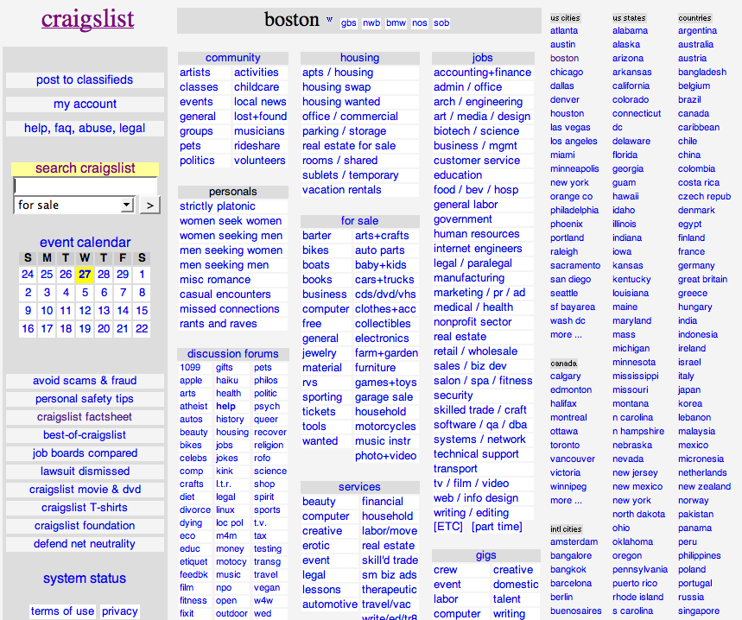
Terrible looking website
but…. Great adoption rate!
Notes:
Craigslist used to be Very popular in United States. Simple classifieds – small advertisements organized in categories.
Not because of the way it looks of course.. Because the benefit it provides connecting buyers and sellers.
Started in 1995 as a way to get information to people – simply, easily and fast!
Site grew as the demand grew. They ‘listened’ to what people wanted and provided it.
$694 Million in revenue (as of 2016).

Slide 17
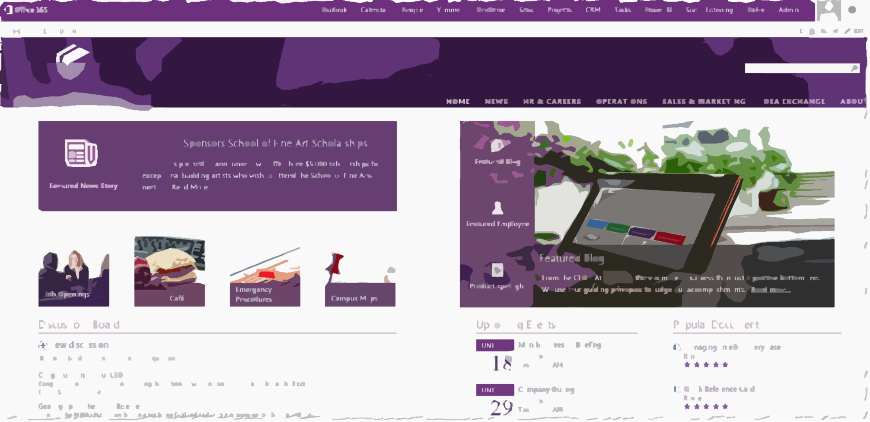
Sony Case Study
Find the Nearest Printer web part
CEOs weekly message
Notes:
Sony First, they used pictures of Spiderman to get people's attention about the upcoming launch of the new intranet Printing to the closest printer web part on page. Why..??? Because that was their pain point. Of course other info they wanted the end users to know also went on the site.

Slide 18
Solution that can be built in days or weeks
This solution Must solve a Real challenge and Delight your team.
Formula for creating: Believers/Champions/Evangelists
Notes:
Doing it quickly matters!

Slide 19
Identify and support Champions and Evangelists in each department
Notes:
Influencers run the world.
People like to emulate other smart and successful people’s behavior.

Slide 20
Why do you need Champions?
There’s just one of You!
Need ownership and accountability across departments
Champions help create and sustain excitement
Feedback on what is and is not working and overall sentiment regarding the changes you are implementing
Notes:
You can’t do everything. You need your own MVPs, champions, evangelists.
Decentralized Support should be provided ‘locally’ by each department/team/region, not globally by one or a couple SharePoint guys and gals.
Power Users in each group already exist that everyone looks to. Reach out and make them the champions.
Influencers always create excitement and you can get feedback from them of how things are going.
If not everyone is bought in to the idea, you will not be able to accomplish your goals. That’s why champions are needed in every business unit.

Slide 21
No need to create champions. Discover existing influencers and get them on your side.
Notes:
There’s always a person already in each department/team that is an influencer. It's best to identify that person instead of trying to get someone to become an influencer.

Slide 22
Why would anyone want to be a ‘Champion’? (additional possible titles: Champions, Evangelists, MVPs)
Money alone rarely ever truly motivates people
Increased visibility to senior management
Help define and shape business and technology roadmap
Visible distinction of honor (Bragging rights!)
Notes:
Studies have shown that money is not the main motivator for most.
Provide opportunities for exposure to senior management. Reports that go to upper management have their name on it as a contributor.
Influence technical platforms in their teams.
Impact on defining business policies throughout the company

Slide 23
Incentivize desired behavior
Notes:
Remember WIIFM…?

Slide 24
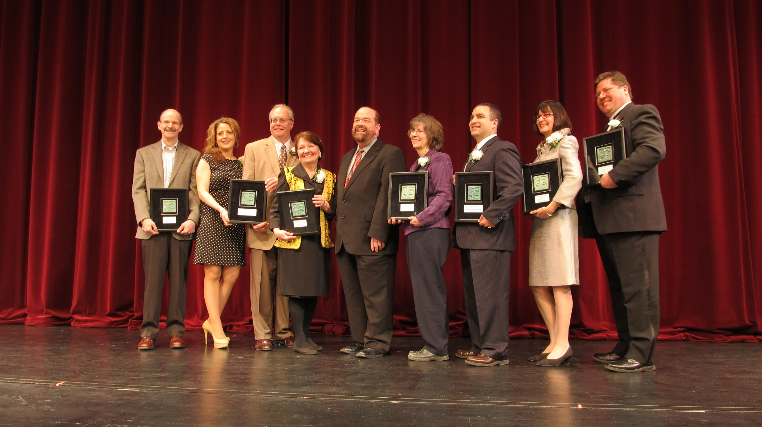
Hold an Award ceremony
(Combine with an existing event if needed)
Notes:
People love getting recognition and awards no matter how old they get.
If possible, make sure they are separated from the group when being recognized (hopefully climbing some stairs ) instead of sitting in their regular seat.

Slide 25
Award Categories
Most participation in Teams/Yammer/Discussion Boards
Most active in document collaboration
Most shares of content
Most helpful to colleagues

Slide 26
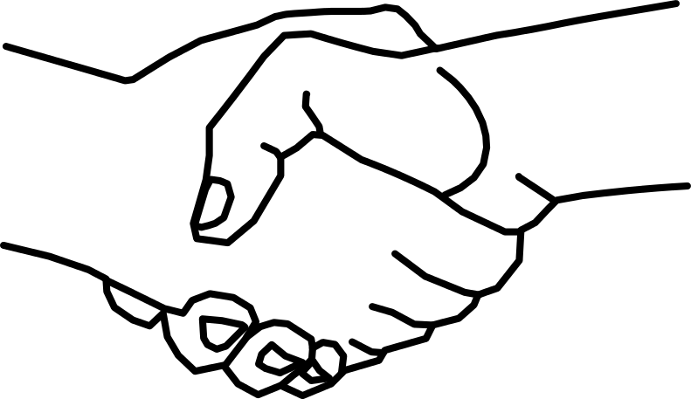
Even simple gestures go a long way
Notes:
You would be surprised how even a handshake or a pat on the back can motivate someone (although things are a bit different now in the post COVID world but you get what I mean ☺)

Slide 27
Peer-to-Peer Learning
Notes:
Social learning is key in today’s world.
But first… let’s talk about traditional end user training.

Slide 28
My story of training end users in Chicago
Notes:
Let me share with you a story about an experience I had.
Back in 2009, I was invited to teach a two day end users class in my hometown of Chicago to employees of an organization that was in the business of providing secondary educational institutions (so colleges, universities) with insurance.
I taught the class to 30 folks over a 2 day period.
(No, this is not the actual class and no, that is not me at the front of the class ☺ )
This was a SharePoint focused class so I taught them all about SharePoint as a power user and end user.
We went over all the basics like how to use pages, lists, libraries, set up permissions, use web parts and a lot of other goodies present in SharePoint.
After the two days of training was over, the person who hired me invited me to stay for one extra day. They would pay me to just sit in a nice corner office with a beautiful view of the Chicago river and all I would have to do is to answer any questions that people had. I said sure. That’s easy enough. I have already taught them everything that they needed to know over the last couple of days. I'm sure there will be little to no questions ….
Boy was I wrong ….
there was a line out the door the whole day of people with questions. Questions about how they get their job done using the technology that I had taught them about. Now I was explaining to them one on one what I just taught them the last two days.
I felt pretty ashamed. My first thought was that I must have been a horrible teacher. If all of them have questions regarding what I just taught them. that means I did not do a good job teaching in the last two days because if I did, they should remember everything I taught them and know how to do it. Right…?
After that experience in Chicago, I thought about this some more. Do end users really want to be trained? Is that the best way for us to empower them to help them do their job?

Slide 29
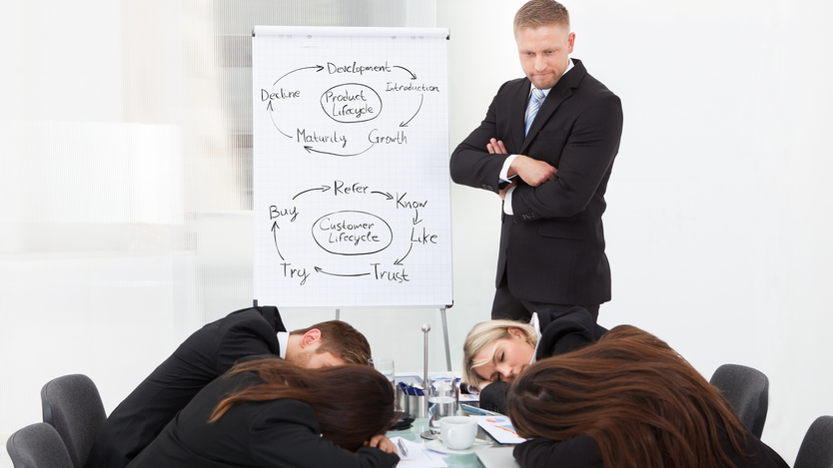
Challenge Traditional training doesn’t work for end users
Notes:
My conclusion was:
Thoroughly training end users doesn't really work.
Traditional classroom and binge learning just doesn’t work for end users. And it Never has!
We are not preparing employees to take a test. We are preparing them to help them do their job.

Slide 30
Users cannot be made to do things they don’t want to do
Notes:
Users cannot be made to do things they don’t want to do… Unless you want to take extreme measures – which for the record, I definitely do not recommend 😬

Slide 31
Do end users want to be trained… or helped?
Notes:
Do end users usually ask “Can you train me…?”
Or
“Can you help me with…?” And “Can I ask you a question…?”
The exact question and the tone of it should provide us all the information we need to know about what our end users are looking for and what they truly need.

Slide 32
Conduct Awareness sessions instead of Training
Notes:
Empathize with your users. Understand that typically end users don’t enjoy long training sessions especially when not everything pertains to their job.
Sony designed and implemented an awareness session, along with help from Asif, with the following components:
Orientation sessions delivered at the time of a new launch or a major change.
Session never exceeds 4 hours each.
Focus areas for the session:
What is changing?
Why is it changing?
How does it affect each department and various roles (especially Yours) in each department?
Where and how do you get help at your moment of need?

Slide 33
People prefer social and natural learning over formal learning

Slide 34
Encourage
Peer-to-Peer Learning
Notes:
Social learning is key in today’s world.

Slide 35
Lunch and Learn works!
Keys to success:
Facilitated by (but not conducted by) the expert in the room
One person presents what they like And don’t like about their current processes
Held on a regular basis every other week or at least once a month
Focus is on business processes and not technology
Don’t forget the free food sponsored by company ☺
Notes:
Many folks say they have tried lunch and learn sessions in the past and they don’t work. Well, look at the format differently. Reconsider the WIIFM for attendees when conducting the lunch and learn sessions.
We did this at our company, VisualSP, with the use of Planner.
Going from simple Word and Excel sheets for task management and meeting minutes to Planner and OneNote makes things much simpler of course but we wanted to make sure it really sunk in for everyone.
Instead of hiring an expert to do this, one of our team members at VisualSP who was already good on Trello (which is a similar product to Planner) dug in and became “semi good” at Planner and then held a 30 mins orientation session for the rest of the group. It was much better than a ‘boss’ or ‘expert’ conducting this session for others.

Slide 36
Focus on Context not only Content
Access to content is not a challenge anymore
The new challenge is a lack of context
Notes:
The challenge used to be that we did not have access to much content. In the age of information that we live in, that is no longer the challenge. The new challenge is a lack of context:
How do we get the right information at our moment of need quickly and efficiently?
That's what we need to be solving for - for ourselves as well as for our end users.
Too much content is available these days - both good and bad. It's hard to decipher the good content from the bad (or plainly wrong) content.

Slide 37
Fragmented information hurts adoption
Notes:
Google
YouTube
Slideshare
Blogs
Quora
Pages and documents on your Intranet
Challenge:
Users are finding bad practices on how to do things creating more problems that then have to be cleaned up.

Slide 38
Provide visual cues and help in context to the user’s environment
Learning in the Flow of Work

Slide 39
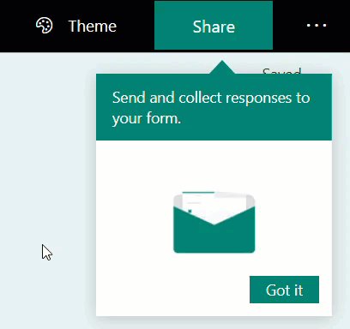
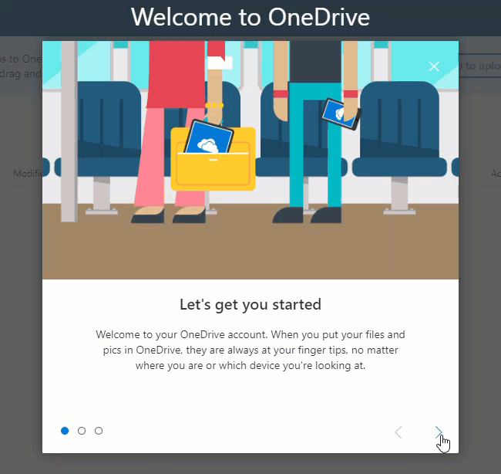
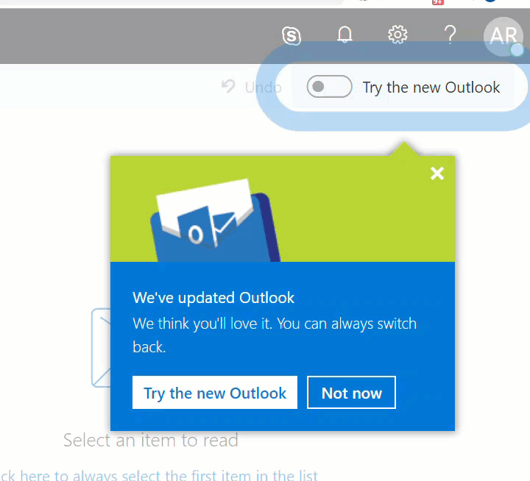
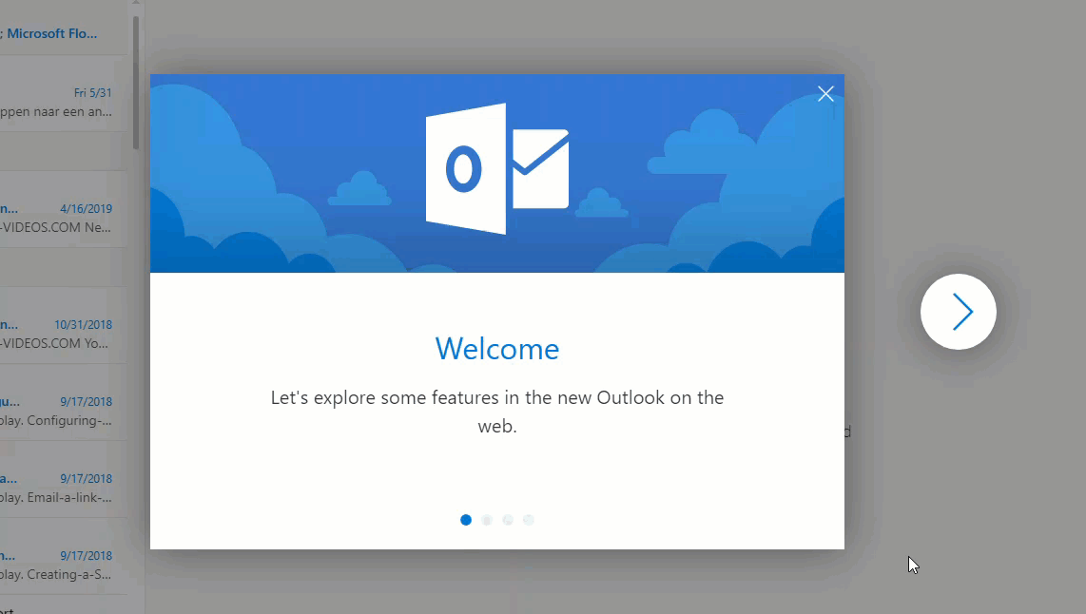
Microsoft

Slide 40
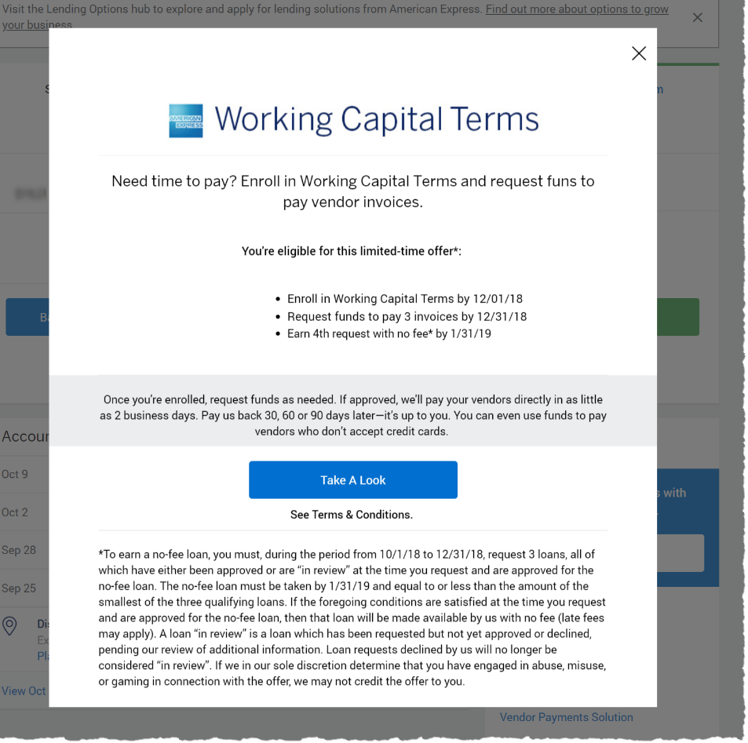
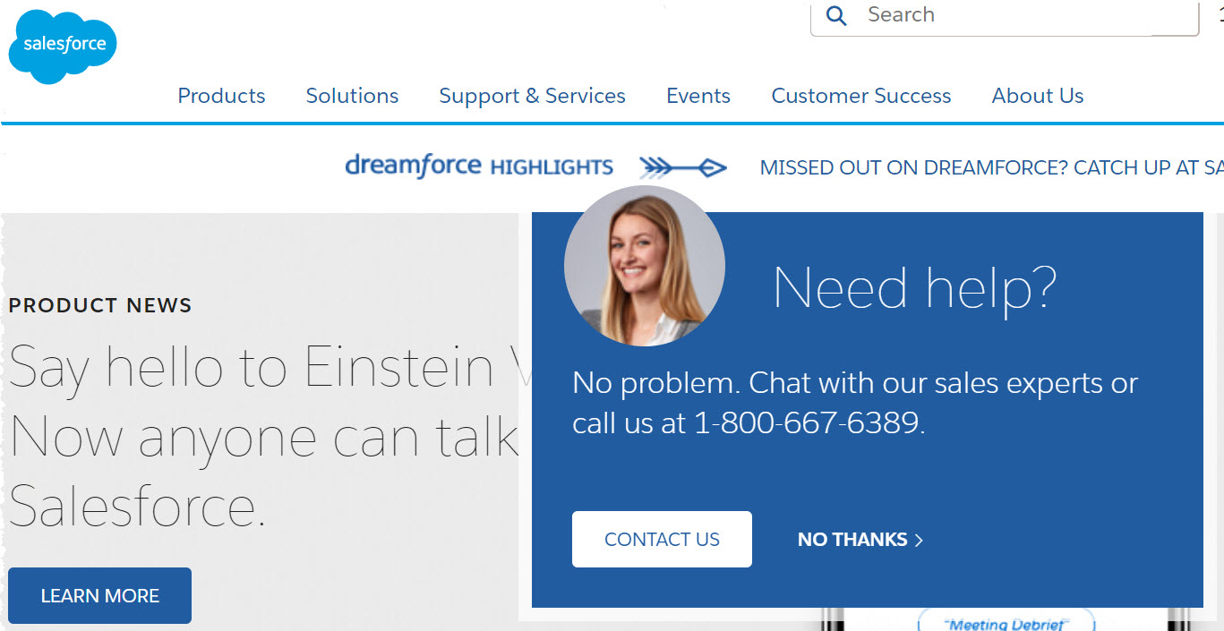
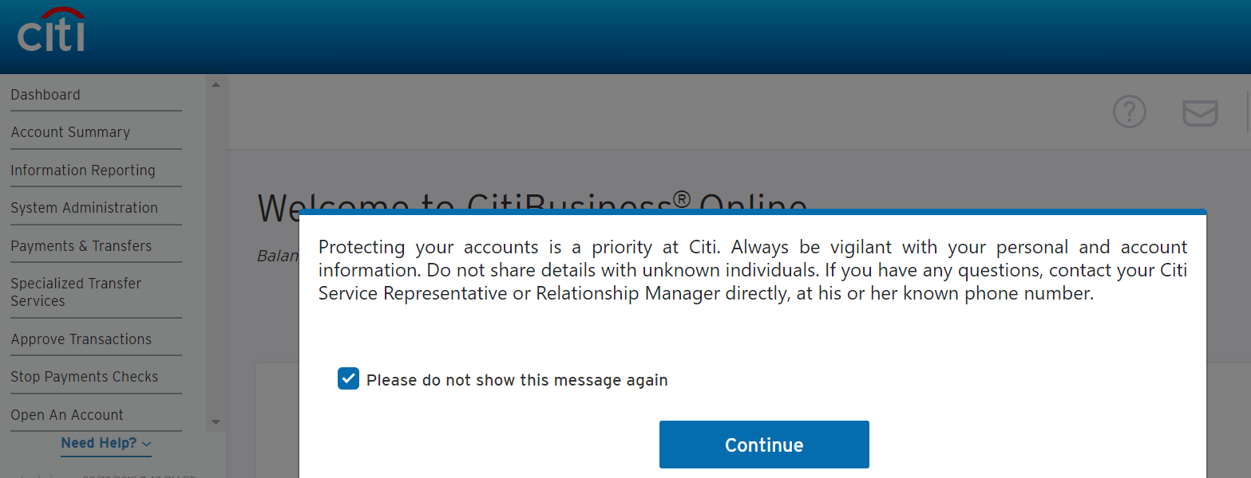
Other company examples
Notes:
Observe what internet sites are already doing and bring the same experiences within your digital workspaces and intranet

Slide 41
End Goal Get information to users as efficiently as possible

Slide 42
Also referred to as “Performance Support”
Helping users get their job done at their moment-of-need
Notes:
https://elearningindustry.com/how-performance-support-tools-different-from-training-3-pst-examples-microlearning

Slide 43
An example of how I received Performance Support
Notes:
“Design Ideas” feature in PowerPoint 2016

Slide 44
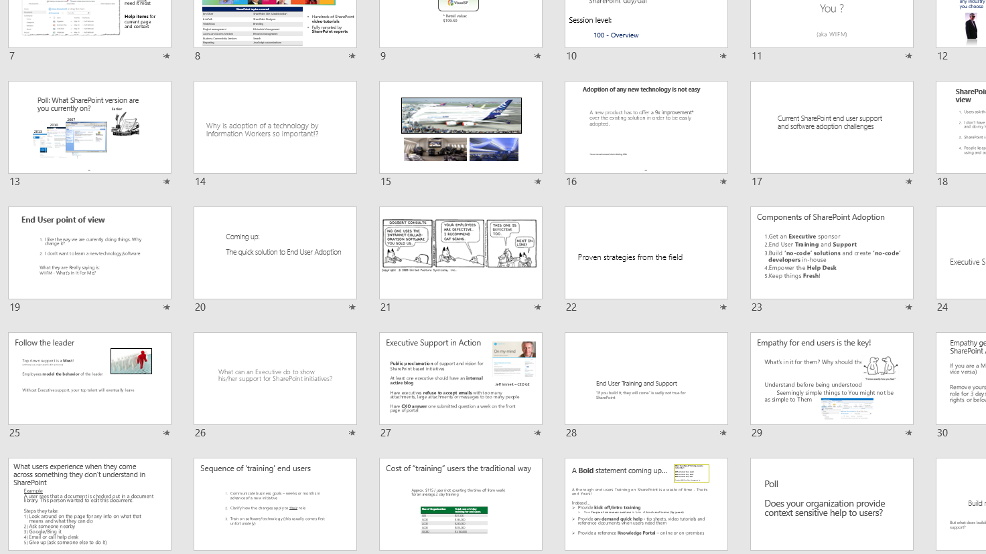
What my presentations used to look like

Slide 45
What my presentations look like now

Slide 46
The story of the Governance Guy
Notes:
My story about the intranet admin who wanted users to follow governance guidelines

Slide 47
Deliver governance, info, support “in context” of the environment
Not a large governance document that no one will look at
But instead through contextual experiences

Slide 48
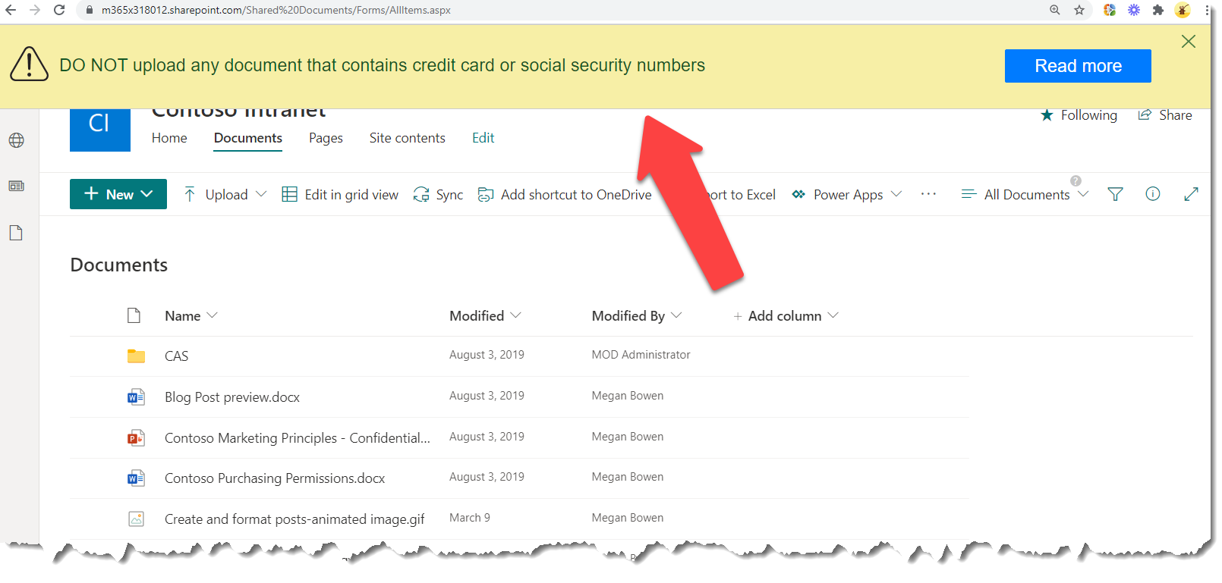
Example: a policy communicated through an announcement banner when users arrive at a library
Notes:
Instead of regular email communication, an announcement banner like this it is impossible to miss when displayed over an application that the users routinely go to.

Slide 49
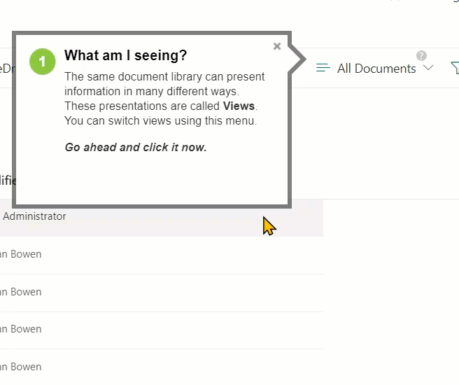
Step by Step walkthrough guidance
Notes:
Step by step interactive walkthrough guiding users at their moment of need is exactly what's needed many times to help the users get their job done.
These types of contextual experiences and more is what VisualSP specializes on:
https://www.visualsp.com

Slide 50
Summary – The 5 things to increase user adoption
1
Solve a critical problem
2
Develop Champions / Evangelists
3
Incentives and awards
4
Offer frequent peer-to-peer learning events
5
Focus on Context instead of just Content
Notes:
Office hours leading to 1-on-1 meeting.
Stability plan. Anchoring.

Slide 51
Next Steps
Reach out to connect if you have questions:
asif@visualsp.com
@asifrehmani
Download this and my other presentations
https://bit.ly/AsifConference
Notes:
Feel free to reach out to me at my email address or message me on Twitter or LinkedIn. I Love hearing from like minded folks.
The long URL for my presentations
https://info.visualsp.com/download-conference-presentations-1

