Slide 1
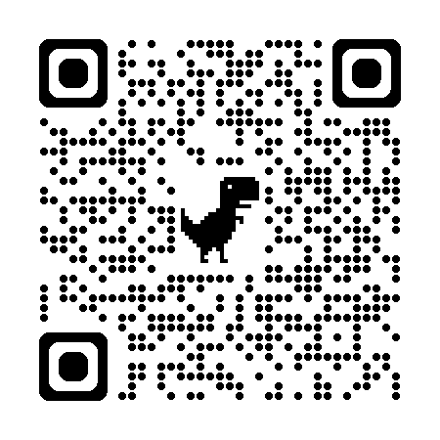
Download all my presentations and video recordings
http://bit.ly/AsifConference
Presentations on:
Sustainable user adoption strategies
Organizational change management
Increase user adoption while decreasing support tickets
Learning in the flow of work
Blended learning
Providing contextual support to users
And more…
Notes:
My conference topics include:
Increase user adoption with contextual support and training
Provide learning in the flow of work to your employees
Contextual micro-learning, the evolution of traditional micro-learning
Reduce support tickets with contextual, sensitive learning and support for employees
Five things for immediate impact on increasing user adoption
Setting up effective onboarding and contextual support for your users
organizational change management , how to migrate your users along with your systems
Cracking the user code, how Microsoft Clarity transforms governance

Slide 2
5 Proven Steps for Driving Sustainable
Copilot Adoption
Presented by:
Asif Rehmani, MVP
VisualSP
Download All of my presentations at:
https://bit.ly/AsifConference
Notes:
The URL to download all my presentations Including many recordings of presentations :
https://info.visualsp.com/download-conference-presentations-1
What you’ll get from this presentation:
True stories of successes as well as failures related to user training and adoption
5 things that have shown to drive sustainable user adoption in many organizations around the world
Tips on specific programs that have worked for me in the past
Sustainable user adoption is a human challenge and not a technology one.

Slide 3
Are you thinking about any of the following?
We bought Copilot licenses — but how do we get people to actually use them?
Usage spiked after launch, then fell off a cliff. How do we make adoption stick?
How do I prove ROI to leadership before the next renewal?
People don’t know what to ask Copilot — how do we teach good prompting at scale?
How do we train thousands of users without pulling them into more training sessions?
Our support team is buried in “how do I…” tickets. How do we reduce that burden?
How do we handle the skeptics, the fear, and the “will this replace my job?” resistance?
What about data security, governance, and oversharing risk?
How do we build champions and executive sponsorship that lasts beyond the pilot?
Which measures actually tell us adoption is working — and which are vanity metrics?
If Yes, Great! This session is for You!
Notes:
If any of these points or similar is true then this is the right presentation for you!

Slide 4
Why not just 1 silver bullet for increasing adoption instead of
5 steps?
Notes:
You might be thinking why can't there just be one silver bullet to increase adoption of all applications? Wouldn't that be awesome …..

Slide 5
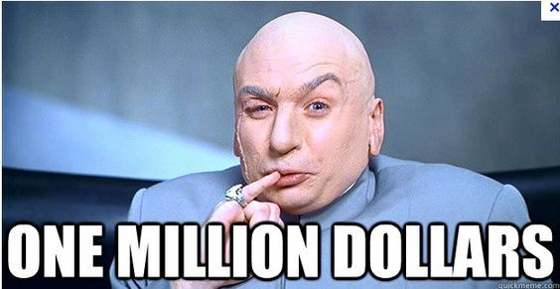
The offer
Notes:
Why not 1 silver bullet instead of 5 steps??
Well, my offer to you is that I'll give you 1 Million Dollars if you are able to provide me with that silver bullet instead. So if you ever find it, send it to me here: asif@visualsp.com
It’s besides the point that I don’t have 1 Million in cash. I will beg, borrow and get it to you.
Why would I be willing to pay you so much or this silver bullet you ask?
because I can just turn around and sell that one silver bullet to companies like Microsoft, IBM , SAP, Oracle, Salesforce, HubSpot, and so many others for billions of dollars because they are all looking for that silver bullet. 😀
The fact of the matter is that there is no one silver bullet that we can use to increase user adoption of our applications.
However, there are definitely many copper bullets that we can use to make dents in our effort to increase user adoption. At least that gets us closer to our goal . So let's talk about those instead.

Slide 6
What to expect in this session
5 concrete things that have created sustainable digital adoption at organizations around the world
Stories / experience share of successes and failures
Notes:
These things go way beyond just Microsoft 365 and power apps user adoption. These strategies and tactics can be used for any systems.

Slide 7
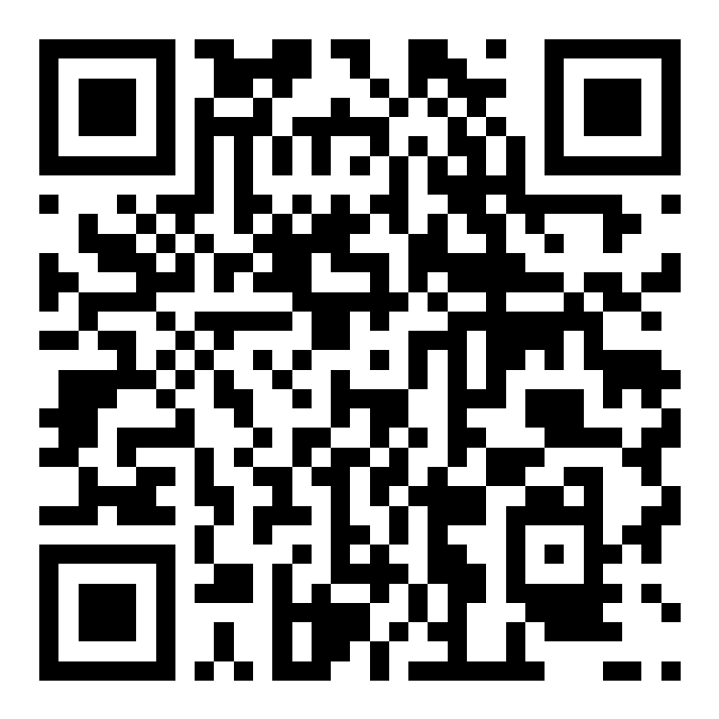
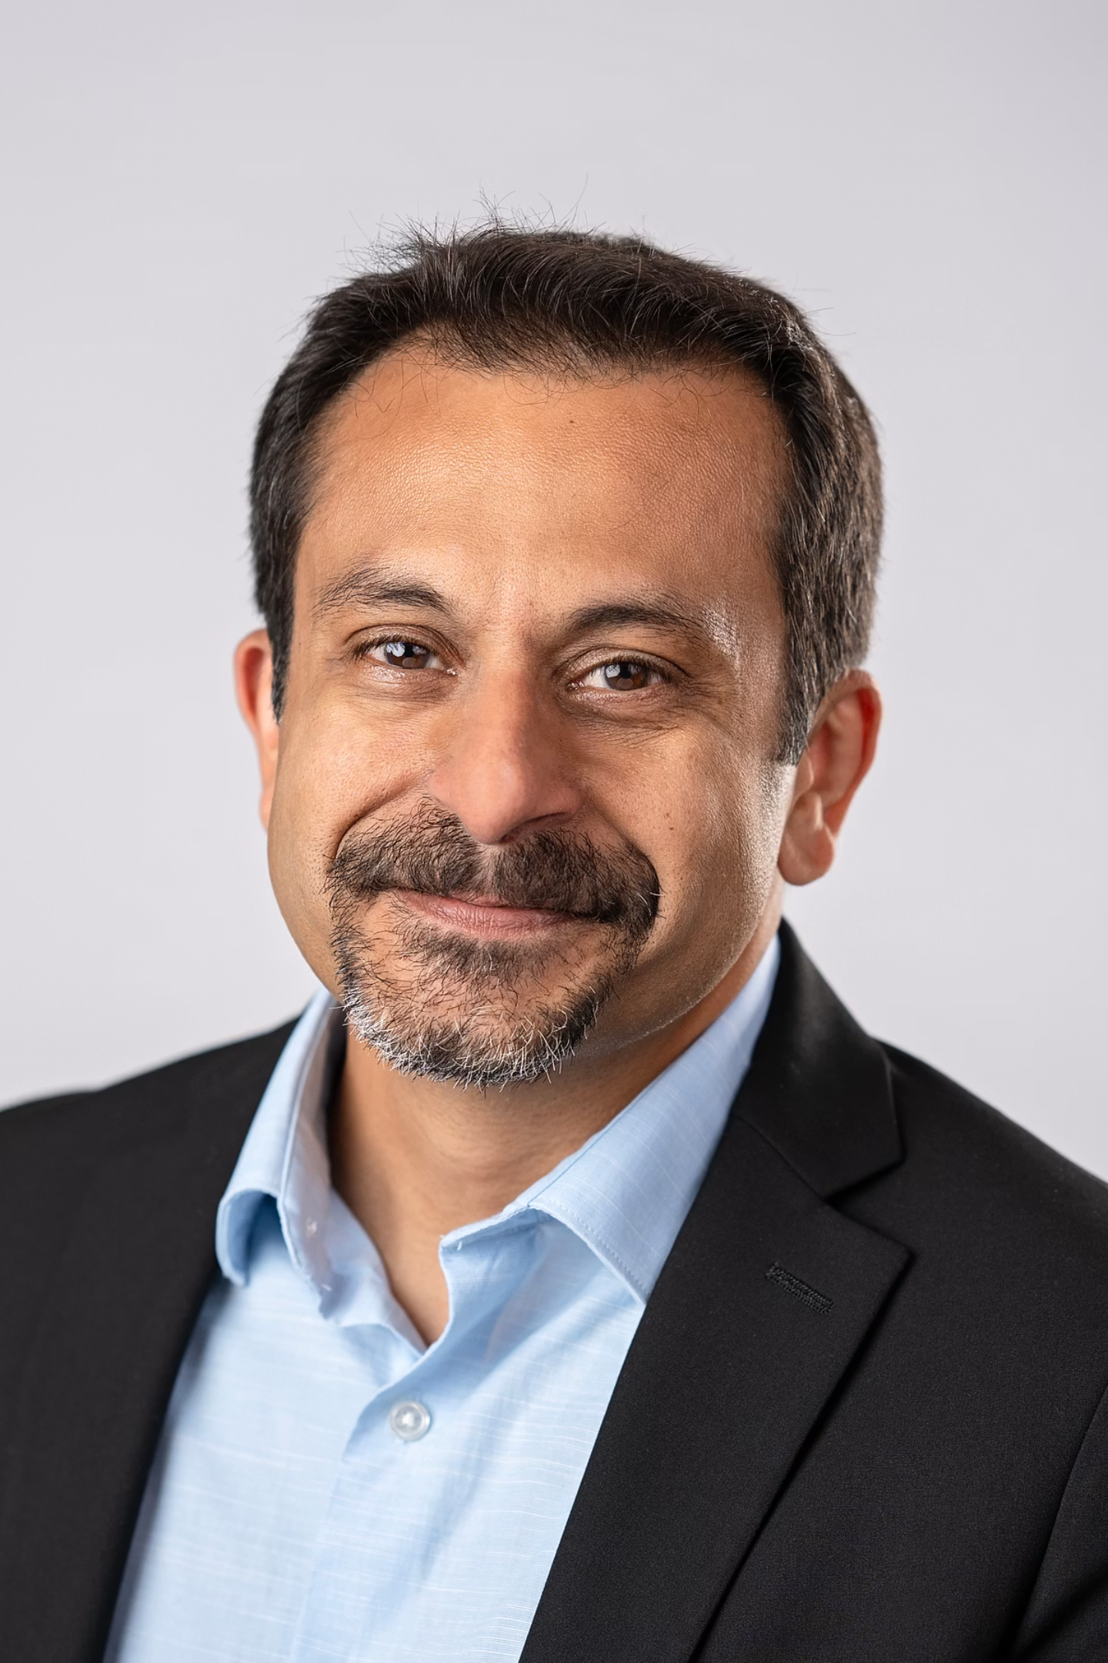

Meet Your Guide:
Asif Rehmani
Founder & CEO | VisualSP
Based in Chicago, IL
Asif@visualsp.com
Connect with me
A 20-year Microsoft MVP, specializing in digital adoption and end-user enablement.
Globally recognized speaker, sharing insights at conferences on maximizing technology investments.
Author of 4 books, dedicated to making technology accessible and productive.
VisualSP is a Digital Adoption Platform - in-app guidance that helps reduce support burden while increasing adoption of Dynamics 365, Copilot, Microsoft 365 and your internal web applications.
Notes:
As I mentioned earlier, my name is Asif Rehmani
I am the founder and CEO of VisualSP which is based in Chicago, Illinois.
You can use this QR code to connect with me online Through LinkedIn or email . Ping me and let me know when you are ready to talk. I would love to connect.
This is my 20th year going into it as a Microsoft MVP. My specialty is helping organizations with user adoption of Microsoft technology specifically such as Copilot
I've spoken at many conferences around the world and continue to love the experience
I've been privileged to write multiple books as well, specifically on adoption of technology and making things sticky for your users
Our company VisualSP Is in the digital adoption platforms category. Our software provides in-app guidance to your users on top of applications such as Dynamics Microsoft Dynamics, Copilot, Microsoft 365, and any of your internal web applications With the intention of reducing your support burden while increasing adoption of these technologies
So again, reach out and connect with me.
I would love to talk with you about how your AI journey is going for you and your company. I’ll also share with you my experiences of what I've been seeing around the world And how other mid-size and large organizations are navigating their AI journeys
Alright let's get into the presentation

Slide 8

The “Why” of
User Adoption
Notes:
Great systems and initiatives die of an ugly death without people actually using them.
A good looking system that does not have users adopting it is worthless.
A bad looking system that has a lot of actual usage is to be emulated.

Slide 9
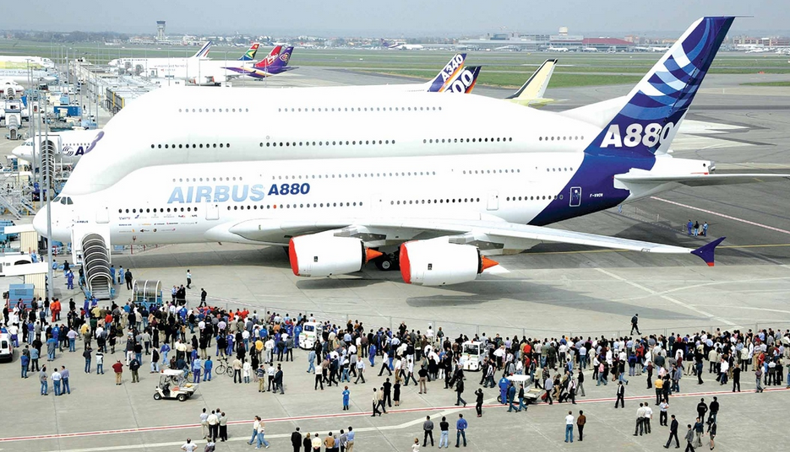


The ‘Jumbo’ problem we are trying to solve
What’s wrong with these pictures?
Notes:
Buying SharePoint or Microsoft 365 and not getting the users onboard is like buying a Jumbo Jet, learning to fly it and then flying around in it without passengers. What's the point?
That’s what happens when end users are not provided the support they need when they need it! Beautiful looking from the outside, but ‘empty’ seats inside thus no user traction.

Slide 10
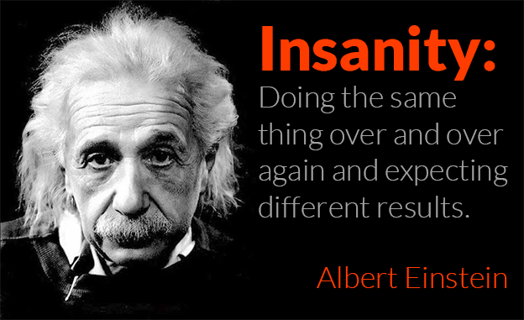
Strive to try new things instead of making same mistakes
Notes:
You already tried training them.
You already tried providing great resources to people.
You tried threatening them ;-)
Nothing has worked. So no point in repeating the same things.
But, what else is there to try...?

Slide 11
User adoption does not have a Begin and End date
Be prepared for the journey…
Notes:
User adoption is not a project. You can't just tackle user adoption within a set period of time.
User adoption is an ongoing effort. But it's worth it. If you are consistent in your quest to increase user adoption, users will love you for it because you will be showing them What’s In It For Them and why they should care.

Slide 12
“User adoption is a journey, not a destination. If you stop engaging your users, adoption will slowly die out”
Notes:
Treat the user adoption service like a product - it gives you a more holistic view of all the interconnected pieces.
Be an evangelist.
Instead of just answering a question, send short videos or other type of training / help items to users. that's been successful.
Use a minimalist approach when deploying solutions by telling users about only a few features instead of overwhelming them.

Slide 13
User Adoption as a Service (UAaaS)
Treat User Adoption as a Service and not as a Project
Notes:
You wouldn’t launch a SaaS product and walk away—so don’t do that with adoption either.
Just like that, UAaaS (yes… I’m aware how that sounds 😆) is an ongoing way of supporting users to help them do their job.
The more you can automate, the better it will be … for You and for Them.
You don’t roll out systems and hope people adopt. You deliver UAaaS—support and success embedded into their daily experience.

Slide 14

Get Executive Buy-In
Notes:
Without executive sponsorship and buy-in, you might as well forget about your initiative to achieve sustainable user adoption. It just doesn’t work if you don’t have at least one executive sponsor.
An executive sponsor needs to be at a pretty high level in the organization – at least a Director or above and a business decision maker

Slide 15
Without an executive sponsor, user adoption is an uphill battle
Notes:
If you don't have an executive sponsor and you're trying to fight this battle all by yourself, you might as well give up now.
Without the proper backup from the higher echelon of the company, it is going to be almost impossible for you to make an impact unfortunately.

Slide 16
Story of the Motivated Influencer

Slide 17

The necessity of an executive sponsor
Prioritization of budget and resources
Embracing the shift in processes and culture
Authority and influence of the sponsor helps break down barriers and overcome resistance
The sponsor can lead by example actively using the software and demonstrating benefits to others
Accountability structure for the initiative
Notes:
Executive buy-in isn’t just a formality, it’s the foundation for everything else we’re going to talk about today.
Without it, user adoption efforts tend to stall out due to lack of visibility, momentum, or support. With it, everything becomes easier because the message is clear: this matters at the top.
When executives prioritize the initiative with budget and resourcing, it signals to the rest of the organization that this isn’t just an IT experiment, it’s a strategic investment.
But money alone isn’t enough. The executive sponsor also has to embrace the cultural shift that comes with new ways of working. That means acknowledging that adopting platforms and tools may disrupt current habits but that this shift is intentional, valuable, and supported at the highest levels.
One of the biggest reasons to secure an engaged sponsor is their ability to influence others. They can knock down barriers, resolve interdepartmental resistance, and push through when change feels hard. Their authority is what gets things unstuck when lower-level change agents hit walls.
Equally important is how they show up. A good sponsor leads by example - sharing updates in Teams/email, approving asking their own reports how they’re using the new tools. When execs use the tech themselves, others follow.
Finally, a strong sponsor creates and enforces an accountability structure. They don’t just approve the initiative and walk away. They expect to see outcomes, and they make it clear that progress will be tracked and reported. That accountability is what turns adoption from a project into a sustainable business function.

Slide 18
Who exactly is considered an executive sponsor?
For smaller companies it's a C-level executive
For larger companies, it can be someone at the director level or above
Notes:
The definition of ‘executive’ in our case is different based on your company size.
If you're in a smaller company, you will need a C level executive backing up your initiative.
If you're in a larger company, it can be someone at least at the director level or above.
At the end of the day, you are looking for an executive that has the power and influence within the company to back up your initiatives.

Slide 19
Create a governance board with the executive sponsor
The composition of the governance board:
The Executive Sponsor
System Administrator(s)
Influencers from each department – sales, marketing, customer service
Notes:
Having a formal designated governance board if possible is a big plus.
The User Adoption Governance Board exists to oversee, support, and accelerate the sustained adoption of the platforms across the organization.
Its core responsibilities include aligning adoption initiatives to business goals, removing organizational roadblocks, prioritizing support and training needs, and ensuring that tool usage is delivering measurable value at every level of the company.
You want representation from the executive sponsor, system administrators, influencers / power users from each department and yourself.

Slide 20
Charter of the governance board
Meet monthly to:
Create and maintain best practices (told with stories ideally)
Assess upcoming product release waves
Assess user behaviors to determine where they are getting stuck
Evaluate Microsoft provided or third-party solutions that would facilitate user adoption
Notes:
It would be best for this governance board to meet monthly.
The agenda of the governance board has to be grounded in what is going on currently and what's coming up on the horizon.
You want this team to decide on future direction way before it's time to execute so you are not in reactive mode.
The governance board also should be collecting stories of best practices demonstrated by individuals or teams in the company. These stories should be documented and available to others so they can learn from example.
For example, how a deal worth $60,000 that was lost years ago was revived by a salesperson looking at the meticulous notes that were kept by the previous salesperson about when the timing would be right for the buyer.
How a customer service person was able to delight a customer because of the readily available resources on hand produced by her team.
How a marketing person created a dozen e-mail templates based on best practices in the industry that resulted in $1,000,000 in revenue over 3 years.
Stories like these exist everywhere and that's what inspires people.
This board also needs to find ways to extend their Microsoft implementation for better user adoption and support with either homegrown solutions or third party solutions.
Recommended Methodology: "Plan – Execute – Measure – Adjust" (PEMA)
You don’t need to overcomplicate this with a heavy framework like ITIL or Six Sigma. Use something lean and business-friendly:
1. Plan
Review current adoption priorities by business area
Set the agenda for the month based on org needs + data insights
2. Execute
Assign ownership to new initiatives (campaigns, trainings, automations)
Ensure department influencers are rolling out agreed efforts
3. Measure
Review analytics (ex: Teams usage, SharePoint activity, Power Apps engagement, support tickets)
Collect qualitative feedback from influencers
4. Adjust
Refine priorities
Add/remove enablement tools
Tweak communication or rollout tactics

Slide 21

Identify a Critical Problem to Solve
It’s Always about WIIFM -
What’s In It For Me?
Notes:
You could roll out the best system in the world but if users don't understand what's in it for them then nothing will matter.
When designing the system, it cannot be based on what the IT department think is best. The interfaces and processes have to be laid out to be the most conducive for the users of the system.
Radio station WIIFM (What’s In It For Me).
Everyone is listening to it all the time. That’s the truth!
Finding and solving critical problems of users is what it's all about .

Slide 22
The story of the secretary in Tennessee
Notes:
The perception of the target customer could be very different than yours
My team and I were contracted to perform an IT assessment of operations at a Department of Defense run facility based in Tennessee. This was around 2009 if I remember correctly.
Money was no object to these guys. They had more than enough funding and were just looking to create efficient processes within their teams.
They had licensing for all of the Microsoft software that you can imagine. That was going to be our main focus. To look at how we can take their existing processes and enhance them using the Microsoft software on hand.
This facility had two buildings which were separated by a couple of hundred feet or less. The first building housed executives. While the second building had program managers, engineers and secretaries.
We started with the second building to see what opportunities we could find there because that's where the technical work was being done.
There was a secretary that sat not far from the entrance of the building. Her job was to run some reports in excel every single day. Once the reports were run and the figures were tabulated, she would write up the comments from the engineers and then print out the reports from a printer that sat behind her at her desk.
This secretary would then take these paper reports and walk to the first building where the executives sat to deliver these reports to them personally. When she was there, she would talk to the executives , answer any questions they had and then she would return to her desk in the second building. This was a routine every single day and it took half of her day to do this.
Our team saw this as an excellent opportunity to make this process more efficient.
We drew up plans for how we could use excel services so that the figures needed would be automatically fetched and tabulated on the server. as soon as the figures were ready, reporting services would kick in to create the reports and dashboards. then when the reports were done, alerting services would alert the executives but the reports were ready so they could see the reports using their web browser immediately. Not only that but they would also have access to previous reports in electronic format should I could see and compare previous data.
All of this would take minutes instead of half a day. And the cost of us implementing this process would not be that long since most of these were no code functionalities that we could configure.
We compiled the plans and showed them to our first stakeholder: the secretary.
Her response was not as enthusiastic. She did not see the benefit of this new process. Her comments were: I'm not sure what the problem is with the current process. It's been working fine.
We kind of expected to hear something like this from her since this process was half of her work day. What would she do if she did not do this? This was her job security. On top of that, it got her consistent exposure with the executives. This was not a pain point nor a priority for her to change this process.
Then we took the same plans and showed them to our second stakeholder: one of the executives in the first building.
We were confident that of course the executives would see the benefit in this new process that we were suggesting.
What happened next blew our mind.
The executive politely thanked us first for compiling these plans. He said that he definitely sees the technical efficiencies that this process would achieve.
However, he mentioned another side of this process that we had not considered. He said that whenever this secretary comes to deliver these reports, she brings with her a lot more than factual information that is in the reports. She brings with her the news of the morale and culture in this second building where the project managers and engineers are doing their work. Everyday, the executives find out firsthand exactly what the feeling in the second building is. If there are any issues, they hear about it directly from this secretary instead of never finding out about them or getting the news too late when nothing can be done.
So this executive told us that if we went the route of automating these reports, which definitely save time and money in technical efficiencies, it could never possibly replace the other nontangible benefit that they got from this secretary coming to their building everyday. And that benefit was very important to them.
What our team thought was an obvious pain point was never a pain point at all to our stakeholders. If we had gone about and built this solution without talking to the stakeholders, they would have just ignored it and still used the old process because that's what worked for them. Even though the new process would have been faster, no one was looking for a faster solution. Time was not a problem where this process was concerned.
This was a very important lesson we learned that day. Your perception of a problem Or a pain point could be very different compared to how others perceive it.

Slide 23
Look for Real pain points examples of pain points heard from salespeople
Too many meetings
Too much administrative work
Too much time handling customer Technical Support inquiries
Lack of standard processes
Lack of qualified leads
Lack of sufficient training and support while doing the actual work
Notes:
You want to look for real pain points and not assumed pain points. Here are some of the examples of pain points on the slide that are heard from actual salespeople.
Salespersons often ask: “you want me to be out selling or doing administrative work and putting data into the CRM system? Because I can't do both”
Salespeople don't want to lose the personal touch with their customers.
Many times salespeople just feel that the CRM solution is too complicated - doesn't matter if it’s Dynamics or something else

Slide 24
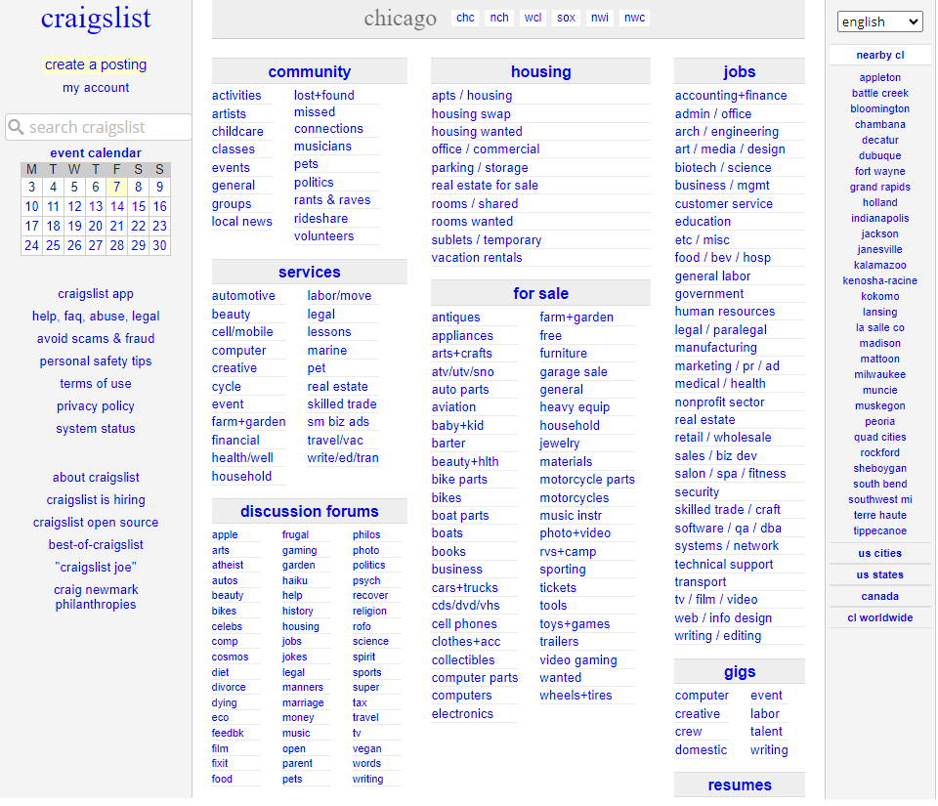
Solving for Real needs
Terrible looking site but…. Great adoption rate!
Notes:
Craigslist used to be Very popular in United States. Still is pretty popular even after so many years and so much competition.
Not because of the way it looks of course. It's a really busy looking interface and almost entirely covered with links.
It became popular because of the benefit it provides connecting buyers and sellers.
Providing simple classifieds – small advertisements organized in categories.
It started in 1995 as a way to get information to people – simply, easily and fast!
Site grew as the demand grew. They ‘listened’ to what people wanted and provided it.
With this type of an interface, they have $694 Million in revenue (as of 2016).

Slide 25
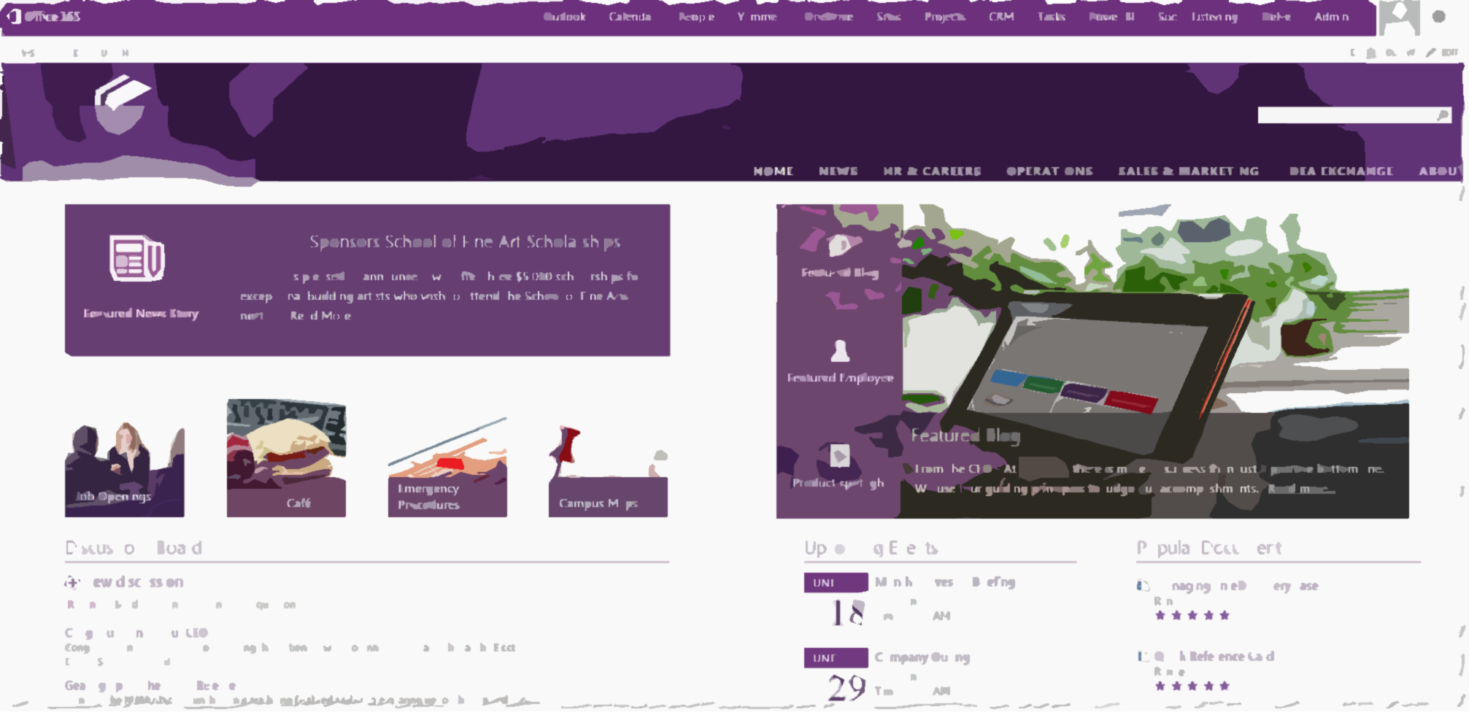
Sony Case Study
Find the Nearest Printer web part
CEOs weekly message
Notes:
Sony
First, they used pictures of Spiderman to get people's attention about the upcoming launch of the new intranet
Printing to the closest printer web part on page. Why..??? Because that was their pain point. Of course other info they wanted the end users to know also went on the site.

Slide 26
A sample challenge:
Move users from Dropbox to OneDrive
Empathize with the user
Become a Dropbox user yourself
Make a list of pros and cons of why you would switch from Dropbox to OneDrive
Communicate the pros of switching
Examples:
Easily promote documents from OneDrive to SharePoint Document Library to share with others
Native support for automatically saving documents in OneDrive as you work on them
Tighter integration of Office applications to OneDrive

Slide 27
Solution that can be built in days or weeks
This solution Must solve a Real challenge and Delight your team.
Formula for creating: Believers/Champions/Evangelists
Notes:
Gone are the days when your users told you their requirements and then you delivered a solution months or years after. That waterfall type of development is a thing of the past.
All creation of solutions these days is agile in nature. You want to create and develop low code or preferably no code solutions quickly and get it in front of your users. That's the only way you will build user confidence in your initiatives and thus in return have believers and champions backing up your initiatives.

Slide 28

Incentivize Desired Behavior of Champions and Evangelists
Notes:
Remember WIIFM…?
Let's put that in perspective and see how that helps incentivize the behavior of champions and evangelists for your initiatives.

Slide 29
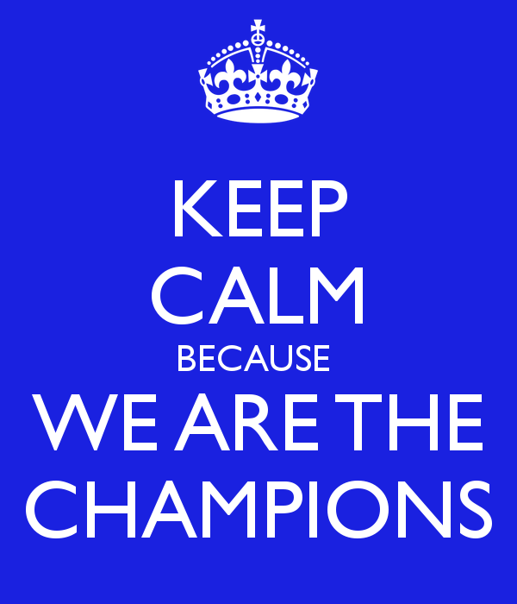

Why do you need Champions?
There’s just one of You!
Need ownership and accountability across departments
Champions help create and sustain excitement
Feedback on what is and is not working and overall sentiment regarding the changes you are implementing
Notes:
You can’t do everything. You need your own MVPs, champions, evangelists.
Decentralized Support should be provided ‘locally’ by each department/team/region, not globally by one or a couple SharePoint guys and gals.
Power Users in each group already exist that everyone looks to. Reach out and make them the champions.
Influencers always create excitement and you can get feedback from them of how things are going.
If not everyone is bought in to the idea, you will not be able to accomplish your goals. That’s why champions are needed in every business unit.

Slide 30
No need to create champions.
Discover existing influencers and get them on your side.
Notes:
There’s always a person already in each department/team that is an influencer. It's best to identify that person instead of trying to get someone to become an influencer.

Slide 31

Why would anyone want to be a ‘Champion’?
(additional possible titles: Champions, Evangelists, MVPs)
Money alone rarely ever truly motivates people
Increased visibility to senior management
Help define and shape business and technology roadmap
Visible distinction of honor (Bragging rights!)
Notes:
Studies have shown that money is not the main motivator for most people.
Provide opportunities for exposure to senior management. Reports that go to upper management have their name on it as a contributor.
Influence technical platforms in their teams.
Impact on defining business policies throughout the company

Slide 32
Reward the behaviors you wish to see
Notes:
Identify the specific behaviors you want to see in your users.
Select individuals that exhibit each of these behaviors.
Recognize them in front of their colleagues.

Slide 33

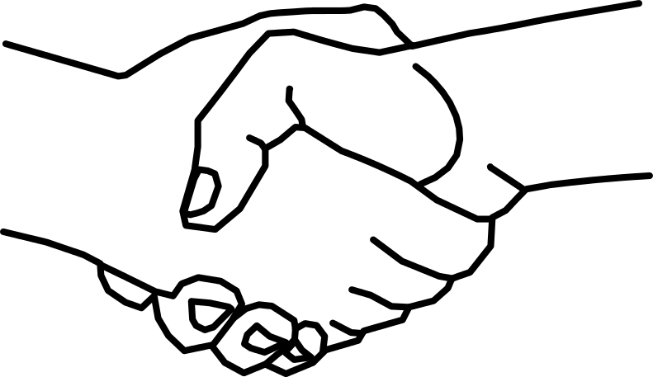
Even simple gestures go a long way
Notes:
You would be surprised at how even a handshake or a pat on the back can motivate someone. Just make sure to do it publicly and have their colleagues see the recognition they are receiving.

Slide 34

Facilitate
Peer-to-Peer Learning
Notes:
Social learning is key in today’s world.
But first… let’s talk about traditional end user training…

Slide 35
My story of training end users in Chicago
Notes:
Let me share with you a story about an experience I had.
Back in 2009, I was invited to teach a two day end users class in my hometown of Chicago to employees of an organization that was in the business of providing secondary educational institutions (so colleges, universities) with insurance.
I taught the class to 30 folks over a 2 day period.
(No, this is not the actual class and no, that is not me at the front of the class ☺ )
This was a SharePoint focused class so I taught them all about SharePoint as a power user and end user.
We went over all the basics like how to use pages, lists, libraries, set up permissions, use web parts and a lot of other goodies present in SharePoint.
After the two days of training was over, the person who hired me invited me to stay for one extra day. They would pay me to just sit in a nice corner office with a beautiful view of the Chicago river and all I would have to do is to answer any questions that people had. I said sure. That’s easy enough. I have already taught them everything that they needed to know over the last couple of days. I'm sure there will be little to no questions ….
Boy was I wrong ….
there was a line out the door the whole day of people with questions. Questions about how they get their job done using the technology that I had taught them about. Now I was explaining to them one on one what I just taught them the last two days.
I felt pretty ashamed. My first thought was that I must have been a horrible teacher. If all of them have questions regarding what I just taught them. that means I did not do a good job teaching in the last two days because if I did, they should remember everything I taught them and know how to do it. Right…?
After that experience in Chicago, I thought about this some more. Do end users really want to be trained? Is that the best way for us to empower them to help them do their job?

Slide 36
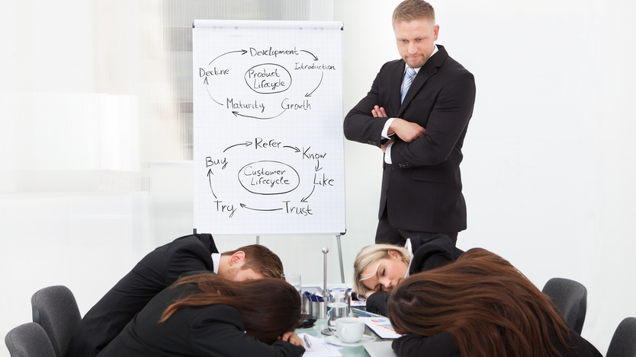
Challenge
Traditional training doesn’t work for end users
Notes:
My conclusion was:
Thoroughly training end users doesn't really work.
Traditional classroom and binge learning just doesn’t work for end users. And it Never has!
We are not preparing employees to take a test. We are preparing them to help them do their job.

Slide 37

Users cannot be made to do things they don’t want to do
Notes:
Users cannot be made to do things they don’t want to do… Unless you want to take extreme measures – which for the record, I definitely do not recommend 😬

Slide 38
Do end users want to be trained… or helped?
Notes:
Do end users usually ask “Can you train me…?”
Or
“Can you help me with…?” And “Can I ask you a question…?”
The exact question and the tone of it should provide us all the information we need to know about what our end users are looking for and what they truly need.

Slide 39
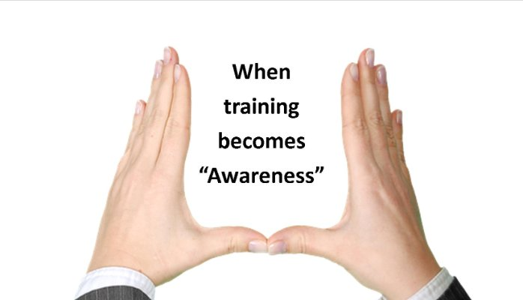
Conduct Awareness sessions instead of Training
Notes:
Empathize with your users. Understand that typically end users don’t enjoy long training sessions especially when not everything pertains to their job.
Sony designed and implemented an awareness session, along with help from Asif, with the following components:
Orientation sessions delivered at the time of a new launch or a major change.
Session never exceeds 4 hours each.
Focus areas for the session:
What is changing?
Why is it changing?
How does it affect each department and various roles (especially Yours) in each department?
Where and how do you get help at your moment of need?

Slide 40
People prefer social and natural learning over formal learning

Slide 41
Encourage
peer-to-peer learning
Notes:
Social learning is key in today’s world.

Slide 42


An example of peer-to-peer learning
Keys to success:
Facilitated by (but not conducted by) the expert in the room
One person presents what they have learned and like And what they don’t like about a current process
Held on a regular basis - every other week or at least once a month
Focused on business processes and not technology
Don’t forget the free food sponsored by the company ☺
Notes:
Many folks say they have tried lunch and learn sessions in the past and they don’t work. Well, look at the format differently. Reconsider the WIIFM for attendees when conducting the lunch and learn sessions.
We did this at our company, VisualSP, with the use of Planner.
Going from simple Word and Excel sheets for task management and meeting minutes to Planner and OneNote makes things much simpler of course but we wanted to make sure it really sunk in for everyone.
Instead of hiring an expert to do this, one of our team members at VisualSP who was already good on Trello (which is a similar product to Planner) dug in and became “semi good” at Planner and then held a 30 mins orientation session for the rest of the group. It was much better than a ‘boss’ or ‘expert’ conducting this session for others.

Slide 43

Focus on Context
Not Only Content
Access to content is not a challenge anymore
The new challenge is a lack of context
Notes:
The challenge used to be that we did not have access to much content. In the age of information that we live in, that is no longer the challenge. The new challenge is a lack of context:
How do we get the right information at our moment of need quickly and efficiently?
That's what we need to be solving for - for ourselves as well as for our end users.
Too much content is available these days - both good and bad. It's hard to decipher the good content from the bad (or plainly wrong) content.

Slide 44
End Goal
Get information and support to users as efficiently as possible
Contextual delivery of information
Notes:
The actual information that a user needs should be brought as close as possible to them.
The information should not be on a SharePoint site or a separate portal where the user has to go looking for it.
Learning comes to the learner instead of the learner going to the learning.

Slide 45

Get user insights using the free Microsoft Clarity
A digital experience analytics tool
Provides insights into user behavior on your site
Features: session recordings, heat maps, dead clicks, rage clicks, JavaScript issues, etc
Fully GDPR and CCPA compliant
Notes:
Have you heard of Microsoft Clarity? If you haven't, don't feel bad. Even many Microsoft employees don't know what it is.
If you have heard of or used products like Crazy Egg, Hotjar, etc. to understand user behavioral analytics for your website, this is exactly the same thing.
The difference being that Clarity is a Microsoft product, it's completely free and it's fully GDPR and CCPA compliant!

Slide 46
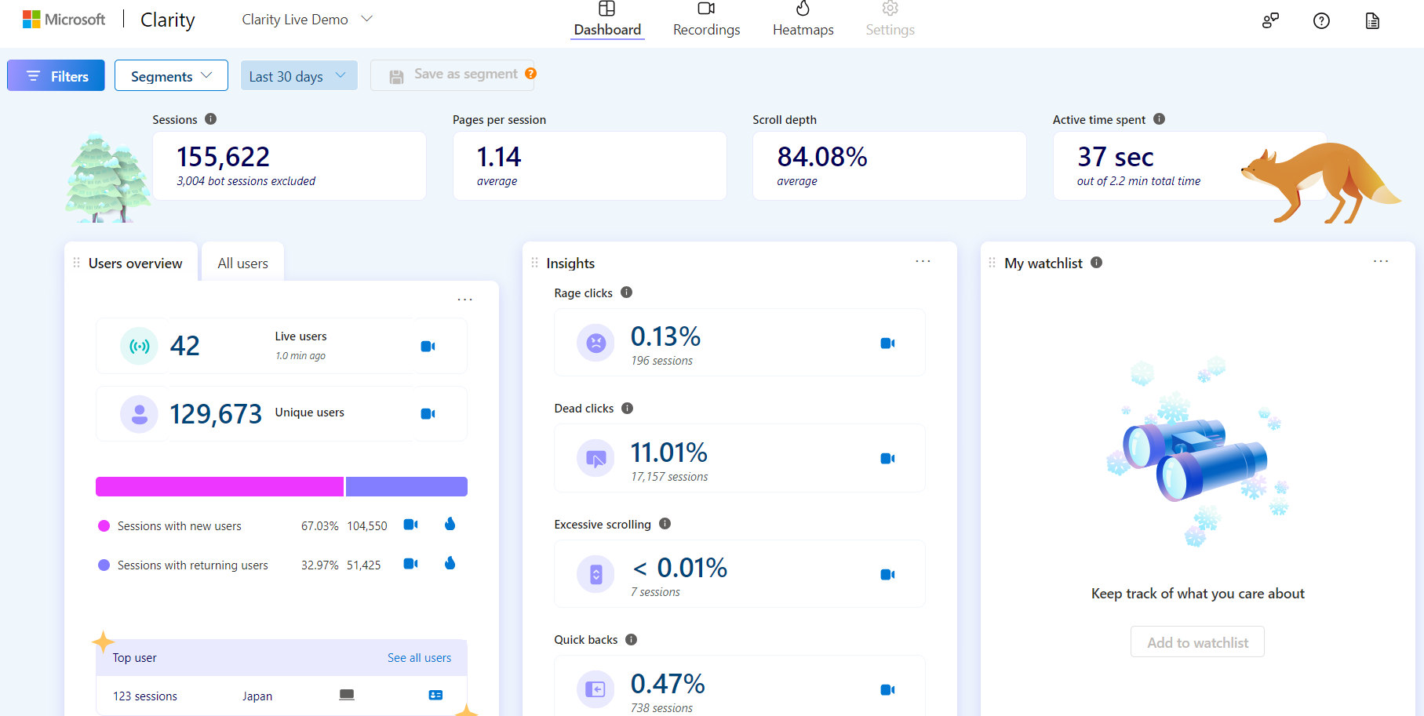
User behavior analytics dashboard
(using Microsoft Clarity)
Notes:
This is a screenshot from an actual Microsoft Clarity dashboard showing the top insights into a website.

Slide 47
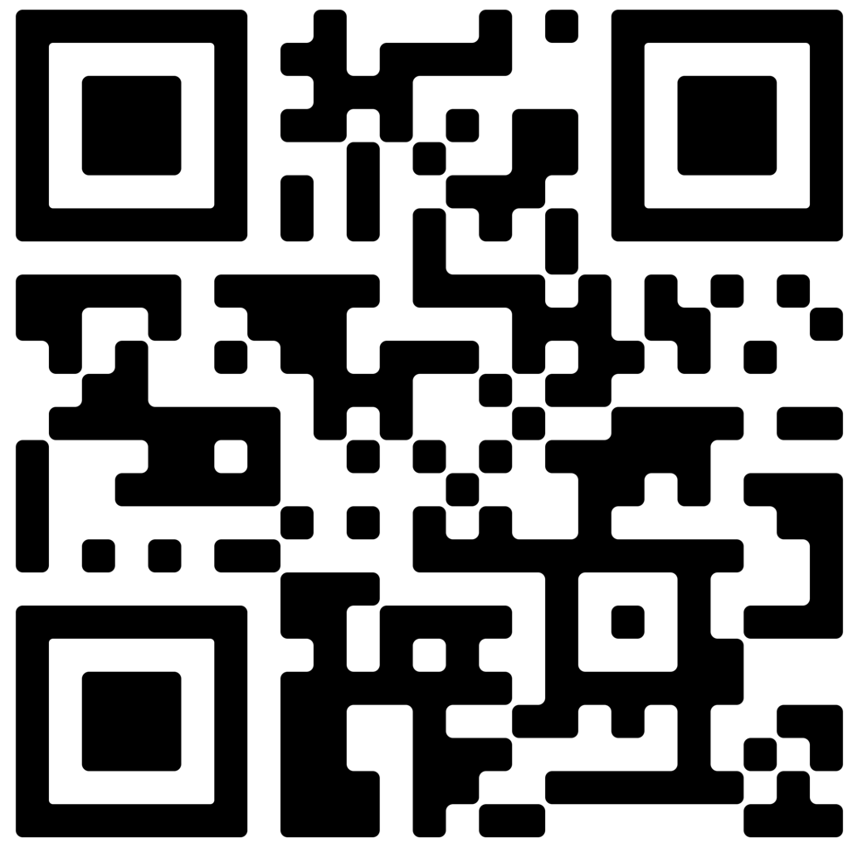
Get started with the Microsoft Clarity guide and checklist
Scan QR code →
Notes:
Start by grabbing the Microsoft Clarity guide and checklist using the QR code on this slide.
Feel free to reach out to me, Asif Rehmani, at my email address or message me on LinkedIn. I Love hearing from like minded folks.
The long URL where I upload All of my presentations:
https://info.visualsp.com/download-conference-presentations-1

Slide 48
















Fragmented information hurts adoption
Notes:
Google
YouTube
Slideshare
Blogs
Quora
Pages and documents on your Intranet
Challenge:
Users are finding bad practices on how to do things creating more problems that then have to be cleaned up.

Slide 49

The story of the Governance Guy
Notes:
My story about the intranet admin who wanted users to follow governance guidelines

Slide 50
Context switching hurts productivity and adoption
Traditional learning and microlearning requires switching context.
Context switching constantly can cost up to 40% drop in productivity
Notes:
When an employee has to switch context to find something, it hurts productivity as well as adoption of the process that she was working on.
Context switching usually has an impact on the average of about 15 minutes when looking for the information and trying to get back in context of what you were initially working on. That's a pretty high switching cost and should be avoided whenever possible.
The company Okta, which a lot of big employers use to make it easy to get to enterprise applications, reported that at large employers they have 187 different applications deployed and 30% of them are just duplicative or add new value. That is a really large number!
A study of 20 teams across three big employers found that workers toggled between different apps and websites 1,200 times each day. That's just under 4 hours a week or roughly 5 weeks a year spent just toggling back and forth hitting the alt-tab key combination basically.
It's been dubbed by these researchers as the toggling tax - the same thing we are talking about here with context switching.
Aside from the obvious hit in productivity, this behavior makes it very hard to focus and over time it stresses people out.
Reference for 40% drop in productivity due to context switching:
https://www.psychologytoday.com/us/blog/brain-wise/201209/the-true-cost-multi-tasking

Slide 51
Deliver governance, info, support “in context” of the environment
Not a large governance document that no one will look at
But instead through contextual experiences
Notes:
Contextual Experiences are elements such as:
Inline help (in the form of icons, buttons, links) that are on the interface to be discovered as needed by the user
Interactive walkthroughs that appear automatically to guide the user to perform a task or give them a tour of a new interface they are not familiar with
Announcement banners at the top or bottom of the page that appear automatically targeted to the appropriate users to inform them about important information, events, etc.
A widget on the page that provides the user a way to explore their company’s knowledgebase of information
These are all types of context sensitive elements that support users naturally when they need support within their own application interface.

Slide 52
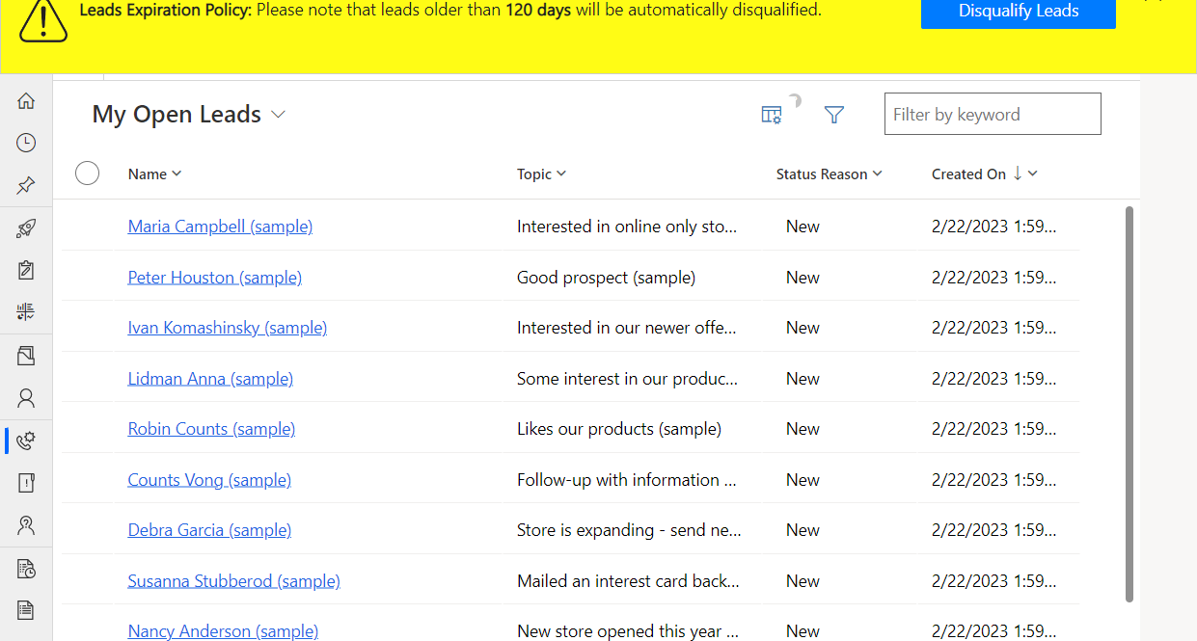
Example: Informing salespeople that their leads are set to auto expire
Notes:
It can be displayed on top of any web application. It this case, it’s showing the policy in the banner on top of Dynamics 365 CRM.

Slide 53
Provide visual cues and help in context to the user’s environment
Information in the Flow of Work
Notes:
Visual cues in the production environment that are just… there. Ready to help you at your ‘moment-of-need’.

Slide 54
Also referred to as “Performance Support”
Helping users get their job done at their moment-of-need
Notes:
The Performance Support discipline has been around for decades. It just has not been popularized yet in the Microsoft ecosystem so not many people know about it yet.
https://elearningindustry.com/how-performance-support-tools-different-from-training-3-pst-examples-microlearning

Slide 55
An example of how
I received
Performance Support

Slide 56
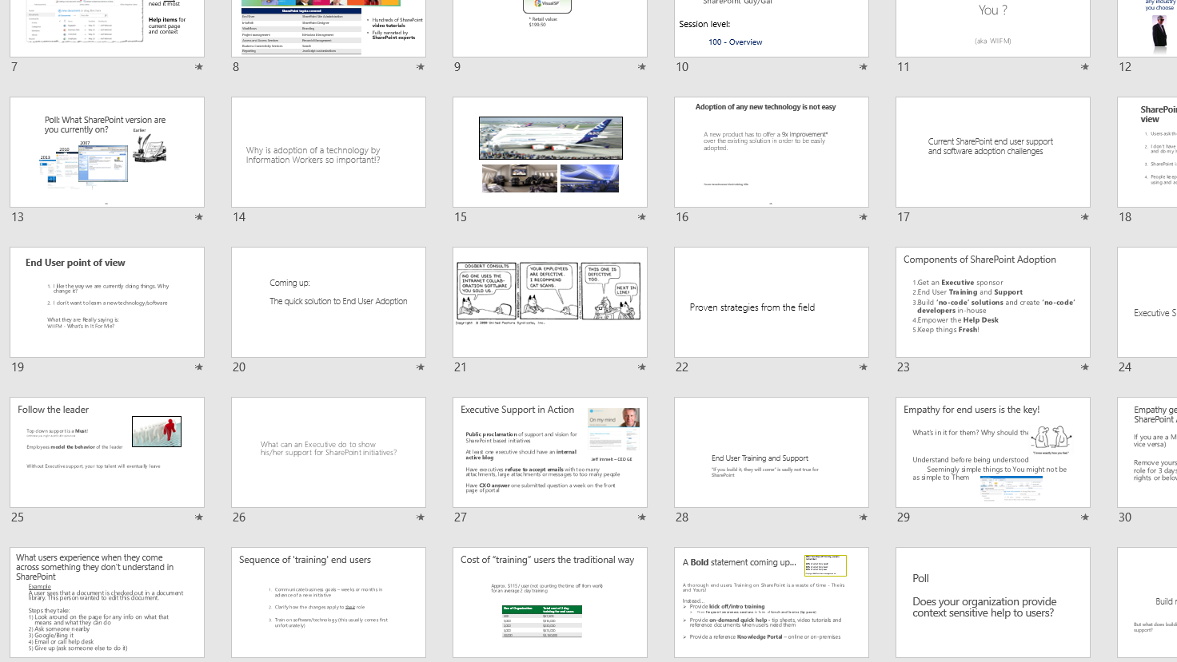
What my presentations used to look like

Slide 57
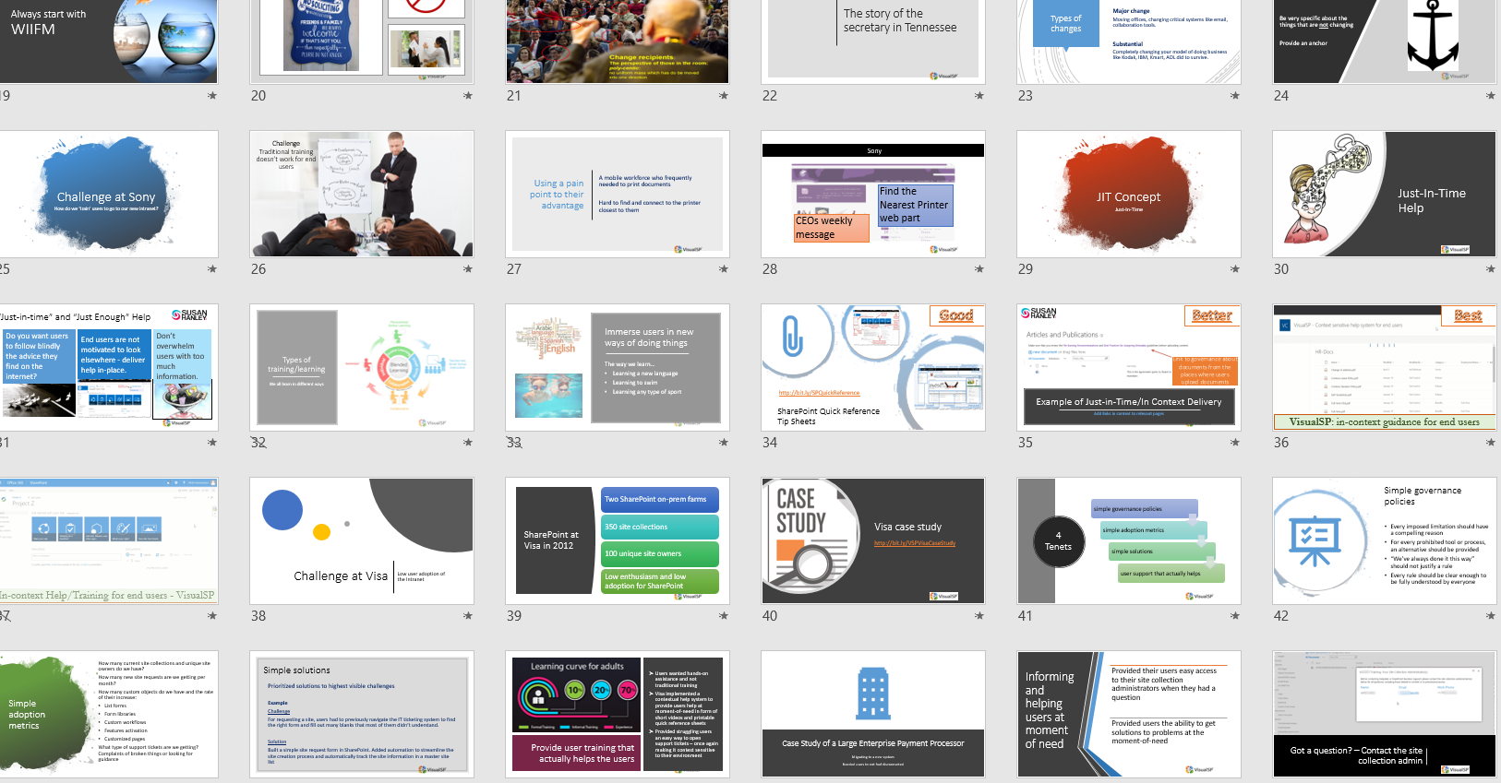
What my presentations look like now
Notes:
All thanks to the ‘Designer’ feature in PowerPoint that just presented itself to me one day.

Slide 58
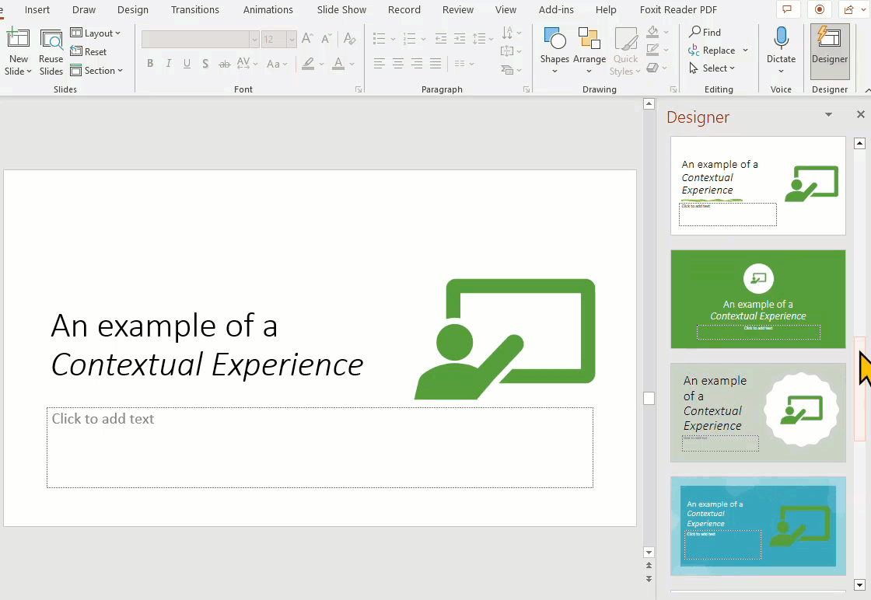
All thanks to the Designer feature in PowerPoint
Notes:
The feature I have to thank for is the Designer feature in PowerPoint. Formerly known as Design Ideas.
One day as I was working on my PowerPoint and as I placed an image on a slide, automatically the designer feature popped up and showed me various options for designs of my slide. That was it. From that day forward, I was hooked on this feature.
Not only me, but you'll see many many presenters using this feature.
This is a great example of contextual experience provided in the flow of work.

Slide 59
Implement contextual support and training for your users
Deliver information to your users within
2 clicks and 10 seconds
Notes:
The 2 clicks and 10 seconds formula was developed by a renowned learning strategist named Dr. Conrad Gottfredson.
It has been proven that when you get info to the user within 2 clicks and 10 seconds, they experience a positive emotion and satisfaction in their amygdala.
This feeling of satisfaction and pride encourages them to try self support again next time they need help.

Slide 60
Contextual micro-assistance in action
Notes:
VisualSP
https://www.visualsp.com
Context sensitive support and training platform for Dynamics 365 (and a whole lot more…)

Slide 61
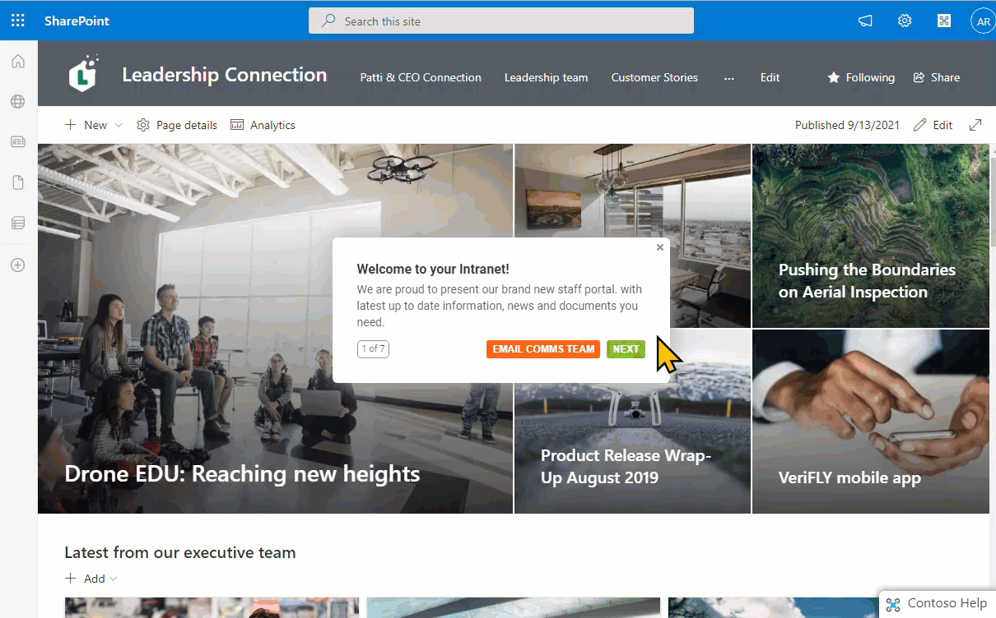
Step by step walkthrough guidance
Notes:
Create no-code walkthroughs on your intranet and any other web application using VisualSP

Slide 62
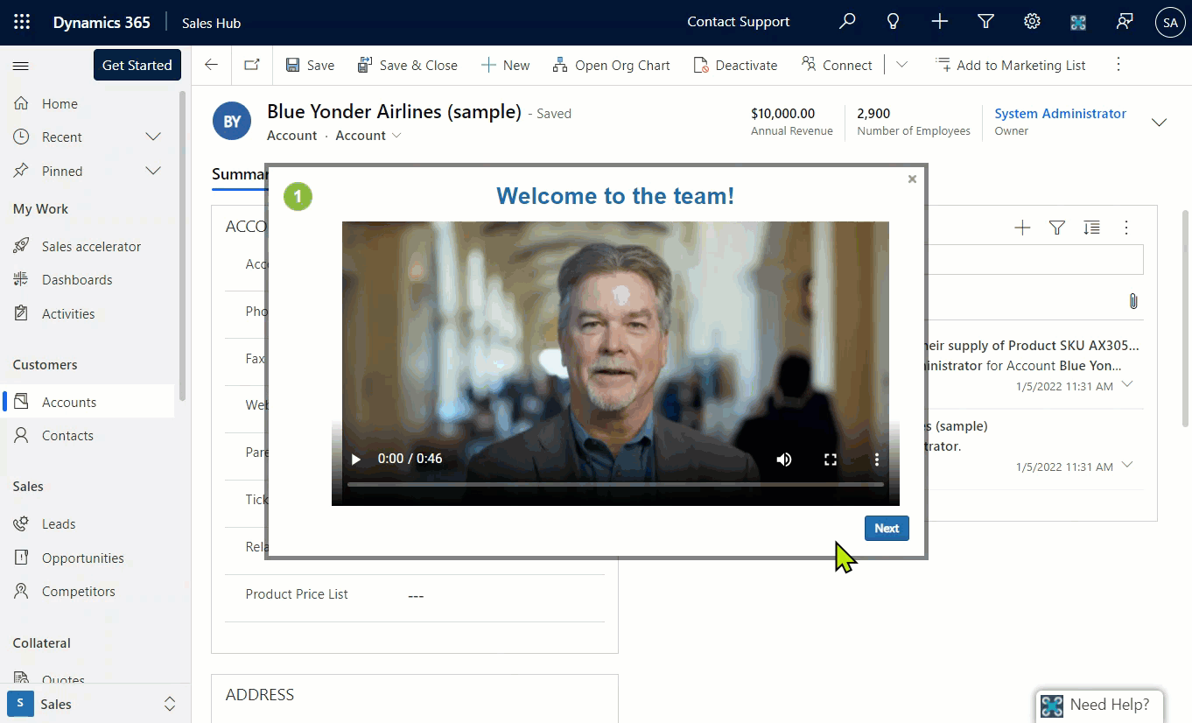
Onboarding New Users Efficiently
Notes:
Onboard your users the right way with interactive guided multi-step walkthroughs.
Reach out to us at VisualSP if you would like to learn more about how to implement this type of a Digital Coach.

Slide 63
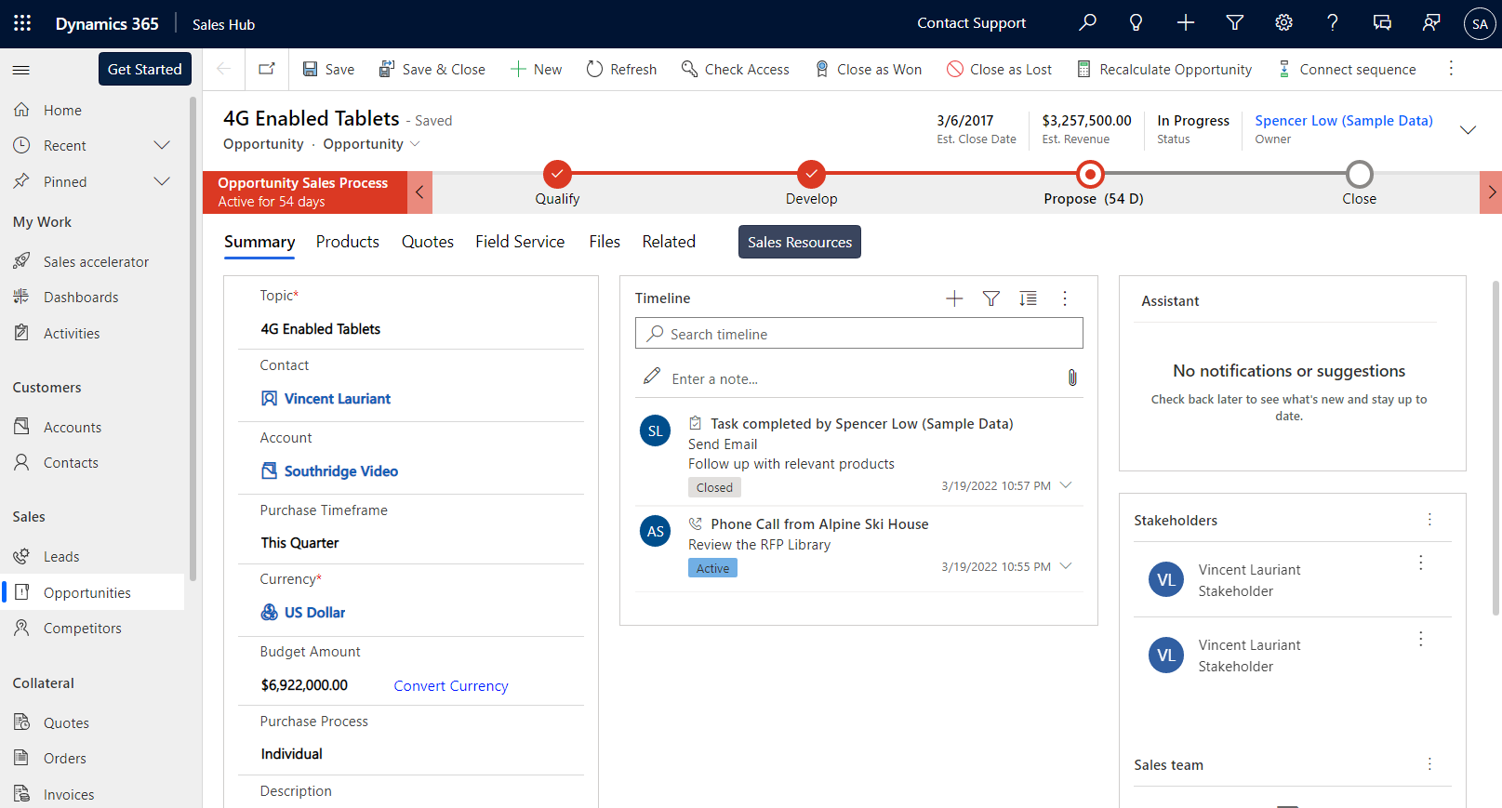
Closing Complex Sales course is now available. Take this 10 mins course to earn your Complex Sales certification
Start Course
Notes:
Scenario
A salesperson is visiting one of her opportunities in Microsoft Dynamics. A banner appears automatically on top of the page letting her know that a new course on Closing Complex Sales is available that she might be interested in and it will provide her the Complex Sales certification. The banner is persistent so it doesn’t block her work. When she is ready, she clicks on the Start Course button in the banner.

Slide 64
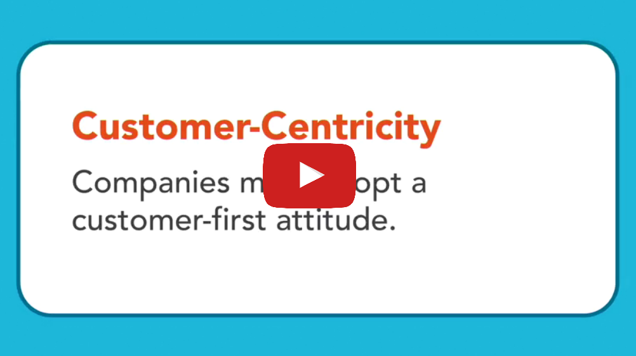
Closing Complex Sales course is now available. Take this 10 mins course to earn your Complex Sales certification
Start Course
Notes:
The course starts in a dialog box in the middle of the page. It does not switch her context from the application she is in which is Very important for the user since it doesn’t take them out of the flow of their work.
When she is done with the course, she closes the window and goes back to her work. By doing this, she gets credit for taking the course and it’s reflected in the LMS.

Slide 65
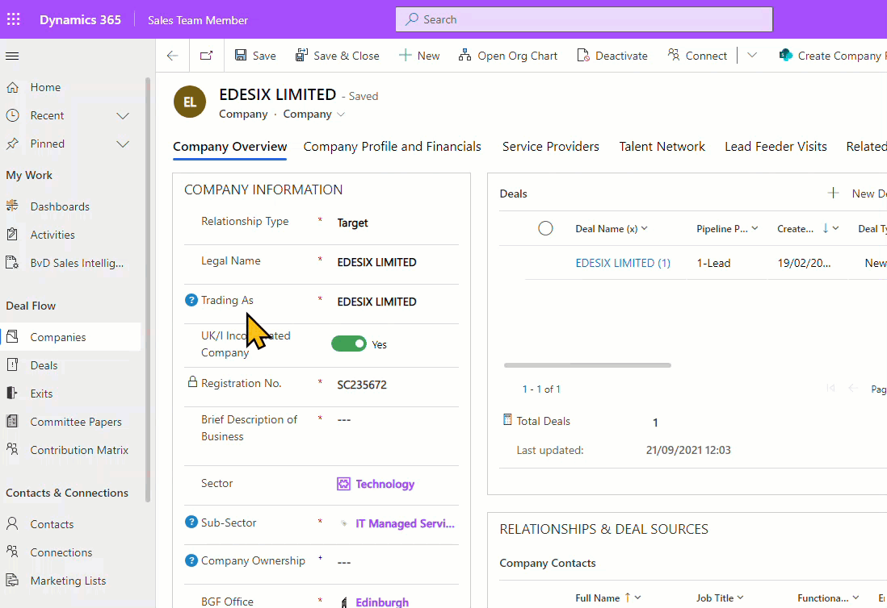
Inline Help Throughout Your Interfaces
Notes:
Provide tooltips / inline help to users so they always have the info they need and never frustrated.
These type of contextual experiences you want to consider strongly to implement into your blended learning and support for Microsoft Dynamics users

Slide 66
Summary – The 5 steps to increasing user adoption
1
Get executive buy-in
2
Identify a critical problem to solve
3
Incentivize desired behavior of evangelists
4
Offer frequent peer-to-peer learning events
5
Focus on context instead of just content

Slide 67
Get started with the Microsoft Clarity guide and checklist
Scan QR code →
Notes:
Start by grabbing the Microsoft Clarity guide and checklist using the QR code on this slide.
Feel free to reach out to me, Asif Rehmani, at my email address or message me on LinkedIn. I Love hearing from like minded folks.
The long URL where I upload All of my presentations:
https://info.visualsp.com/download-conference-presentations-1

Slide 68
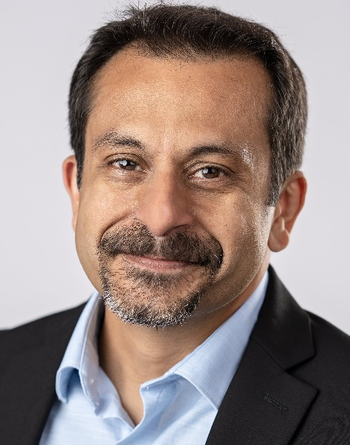

Next Steps
Reach out to me with your questions on context sensitive support and training
  asif@visualsp.com
Download this and my other presentations
  http://bit.ly/AsifConference
Digital Adoption Platform for All web applications
Notes:
Feel free to reach out to me at my email address or message me on LinkedIn. I Love hearing from like minded folks.
The long URL where I upload All of my presentations:
https://info.visualsp.com/download-conference-presentations-1

