Slide 1



10 Microsoft Copilot Scenarios That Deliver Real ROI
Turning AI from shelfware into measurable impact for your information workers
Presented by: Asif Rehmani, Author of CopilotTrainingPackage.com
Scan QR code to email Asif for the slides with notes
Notes:
• Welcome everyone to our session on 10 Microsoft Copilot Scenarios That Deliver Real ROI.
• My name is Asif Rehmani - the author of the Copilot Training Package
• I will be sharing how you can turn AI from shelfware into measurable impact for your information workers.
• Over the next hour, we'll explore 10 specific use cases where Copilot can drive real business value and ROI for your organization.
• From boosting productivity and collaboration to streamlining processes and enhancing decision-making, Copilot has the potential to transform the way your teams work.
• Let's dive in and uncover the power of this transformative AI technology.

Slide 2


Scenario 1. From Resume to Interviewer in Seconds
The Problem:
The Copilot Solution:
Recruiters spend hours mapping resumes to job descriptions and devising personalized interview questions.
Use Copilot to analyze a PDF resume and generate 5 behavioral interview questions tailored to the specific role.
ROI Impact: Reduces interview prep time by 80% and ensures higher quality candidate vetting.
Notes:
Today, we'll explore a common scenario faced by recruiters - the challenge of efficiently mapping resumes to job descriptions and crafting personalized interview questions.
Recruiters often spend hours sifting through resumes and trying to devise relevant questions for each candidate. This can be a time-consuming and labor-intensive process.
This Copilot solution offers a streamlined approach to this challenge. By analyzing a candidate's PDF resume, Copilot can automatically generate 5 tailored behavioral interview questions specific to the role.
This not only reduces the time spent on interview preparation by up to 80%, but also ensures a higher quality of candidate vetting, leading to better hiring decisions.
The key benefit here is increased efficiency and effectiveness in the recruitment process, allowing recruiters to focus on other important tasks.
The Ready-to-Use Prompt
I have uploaded a candidate's resume and the job description. Compare this resume against the job description.
List the top three strongest matches between their experience and our requirements.
Identify two potential experience gaps or 'yellow flags' I should investigate.
Generate five behavioral interview questions that specifically target those gaps and the core technical skills needed for this role.
For each question, tell me what a 'good' versus 'great' answer looks like.

Slide 3

Scenario 2. Kill the "Blank Page" Problem in Word
The Problem:
The Copilot Solution:
Starting a draft is the slowest part of any project.
Provide a brief prompt or reference an internal file to generate a first draft of a project proposal or policy update.
ROI Impact: Moves employees from "creating" to "editing" which is a much faster cognitive process.
Notes:
The blank page problem is a common challenge that slows down the start of any writing project
Employees often struggle to get started, leading to delays and frustration
Copilot can help by providing a brief prompt or reference to an internal file
This allows employees to quickly generate a first draft, then focus on editing and refining the content
This shift from "creating" to "editing" is a much faster cognitive process, leading to significant time savings
The ROI impact is that this approach helps move projects forward more efficiently, boosting productivity
Non-specific Prompt: Create a course for training people on cybersecurity.
Better Prompt: Create an outline for a module for training people on cybersecurity. This is an introduction module talking about the importance of cybersecurity, what cybersecurity is, what it is not, and key takeaways. Create a document of an outline for 10 PowerPoint slides (or less). For each slide, give me the title of the slide and three to five content bullets. Space out each slide in a section by itself.

Slide 4

Scenario 3. Word to PowerPoint Transformation
The Problem:
Turning a long report or dense document into a visual deck is tedious manual work.
The Copilot Solution:
Use the "Create presentation from file" feature in PowerPoint. Copilot builds the slides, adds imagery, and organizes the flow based on your Word doc.
ROI Impact: Saves 2 to 4 hours per presentation.
Notes:
This slide outlines a common problem that many of us face - the tedious process of turning a long report or dense document into a visually appealing presentation.
Fortunately, PowerPoint's "Create presentation from file" feature provides a solution. It allows Copilot to automatically build the slides, add relevant imagery, and organize the flow based on the content of your Word document.
This feature can save you 2 to 4 hours per presentation, which can have a significant ROI impact on your work.
I'll walk you through how to use this feature and share some best practices to ensure your presentations are polished and impactful.

Slide 5

Scenario 4. Summarizing and Enhancing PowerPoint
The Problem:
The Copilot Solution:
Reviewing a dense slide deck quickly to prepare for a meeting is challenging.
Use Copilot to summarize key themes of a deck or ask it to "Add a slide about our Q3 goals" based on your data.
ROI Impact: Increases executive speed to insight.
Notes:
This slide sets up a common challenge that executives face - quickly reviewing dense slide decks to prepare for meetings.
Copilot is the solution to help summarize key themes or add new slides based on your data.
Copilot can increase the speed at which executives can gain insights from presentation materials.

Slide 6


Scenario 5. Outlook Coaching for Better Communication
The Problem:
High stakes emails often come across as blunt or unclear.
The Copilot Solution:
Use "Coaching by Copilot" before hitting send. It analyzes sentiment, clarity, and tone to suggest improvements.
ROI Impact: Reduces workplace friction and minimizes back and forth clarification emails.
Notes:
• The slide introduces a scenario about using Outlook Coaching for better communication in high-stakes emails.
• It highlights the problem that such emails can often come across as blunt or unclear.
• The Copilot solution is to use the "Coaching by Copilot" feature, which analyzes the sentiment, clarity, and tone of the email and suggests improvements before hitting send.
• This can help reduce workplace friction and minimize the need for back-and-forth clarification emails, providing a good ROI impact.
• The key points to emphasize are the problem with unclear high-stakes emails, the Copilot solution to analyze and improve them, and the benefits in terms of reduced friction and clarification.

Slide 7



Scenario 6. Your Unique Voice via Custom Instructions
The Problem:
The Copilot Solution:
ROI Impact:
AI often sounds generic or robotic.
Set custom instructions in Outlook to reflect your specific writing style and professional persona.
Maintains authenticity while scaling your communication output.
Notes:
The key problem we're addressing is that AI often sounds generic or robotic when generating content
The solution is to set custom instructions in Outlook that reflect your unique writing style and professional persona
This allows you to maintain authenticity and a personal touch, even as you scale your communication output
The custom instructions help the AI understand your voice and preferences, so the content it generates feels more natural and aligned with your brand
By customizing the AI, you can ensure your communications have the right tone and style, even as you increase your productivity
Suggested Custom Instructions:
Tone & Voice:
Use a friendly, conversational tone that feels approachable and professional. Avoid overly formal or robotic language—write like I’m talking to someone I know.
Greeting Style:
Start with a warm greeting such as:
“Hi [Name],”
Avoid stiff openings like “Dear Sir/Madam.”
Email Length:
Keep emails concise and clear—usually 2–4 short paragraphs. Prioritize clarity and action; avoid unnecessary fluff.
Structure:
Begin with context or purpose in the first sentence. Use short paragraphs and bullet points for lists. End with a friendly closing such as:
“Thanks,” “Best regards,”
Personal Style Notes:
Use contractions (e.g., “I’m,” “we’ll”) for a natural flow. Keep sentences straightforward and avoid jargon. When suggesting next steps, be polite but confident (e.g., “Let me know what works best for you” or “Looking forward to your thoughts”).

Slide 8

Scenario 7. Instant Data Transformation in Excel
The Problem:
Most users struggle with complex formulas and pivot tables.
The Copilot Solution:
Ask Copilot for things like: "Highlight top performers" or "Create a growth trend formula" using natural language.
ROI Impact: Democratizes data analysis. You no longer need to be an Excel expert to get insights.
Notes:
• Copilot can help users transform data in Excel using natural language commands.
• The problem is that most users struggle with complex formulas and pivot tables in Excel. This makes it difficult for non-experts to get insights from their data.
• Copilot solves this by allowing users to ask for things like "Highlight top performers" or "Create a growth trend formula" using natural language.
• This democratizes data analysis, so you no longer need to be an Excel expert to get valuable insights from your data.
• The ROI impact is that Copilot makes it much easier for anyone to analyze and transform their data, without needing advanced Excel skills.
Excel Prompt options:
Summarize total Net Sales by region for 2025 and highlight which region performed the best.
Identify any unusual spikes or outliers in Net Sales by month and region, and explain possible causes.
Highlight any rows where Gross Margin % is below 5% and explain why margins might be so low

Slide 9
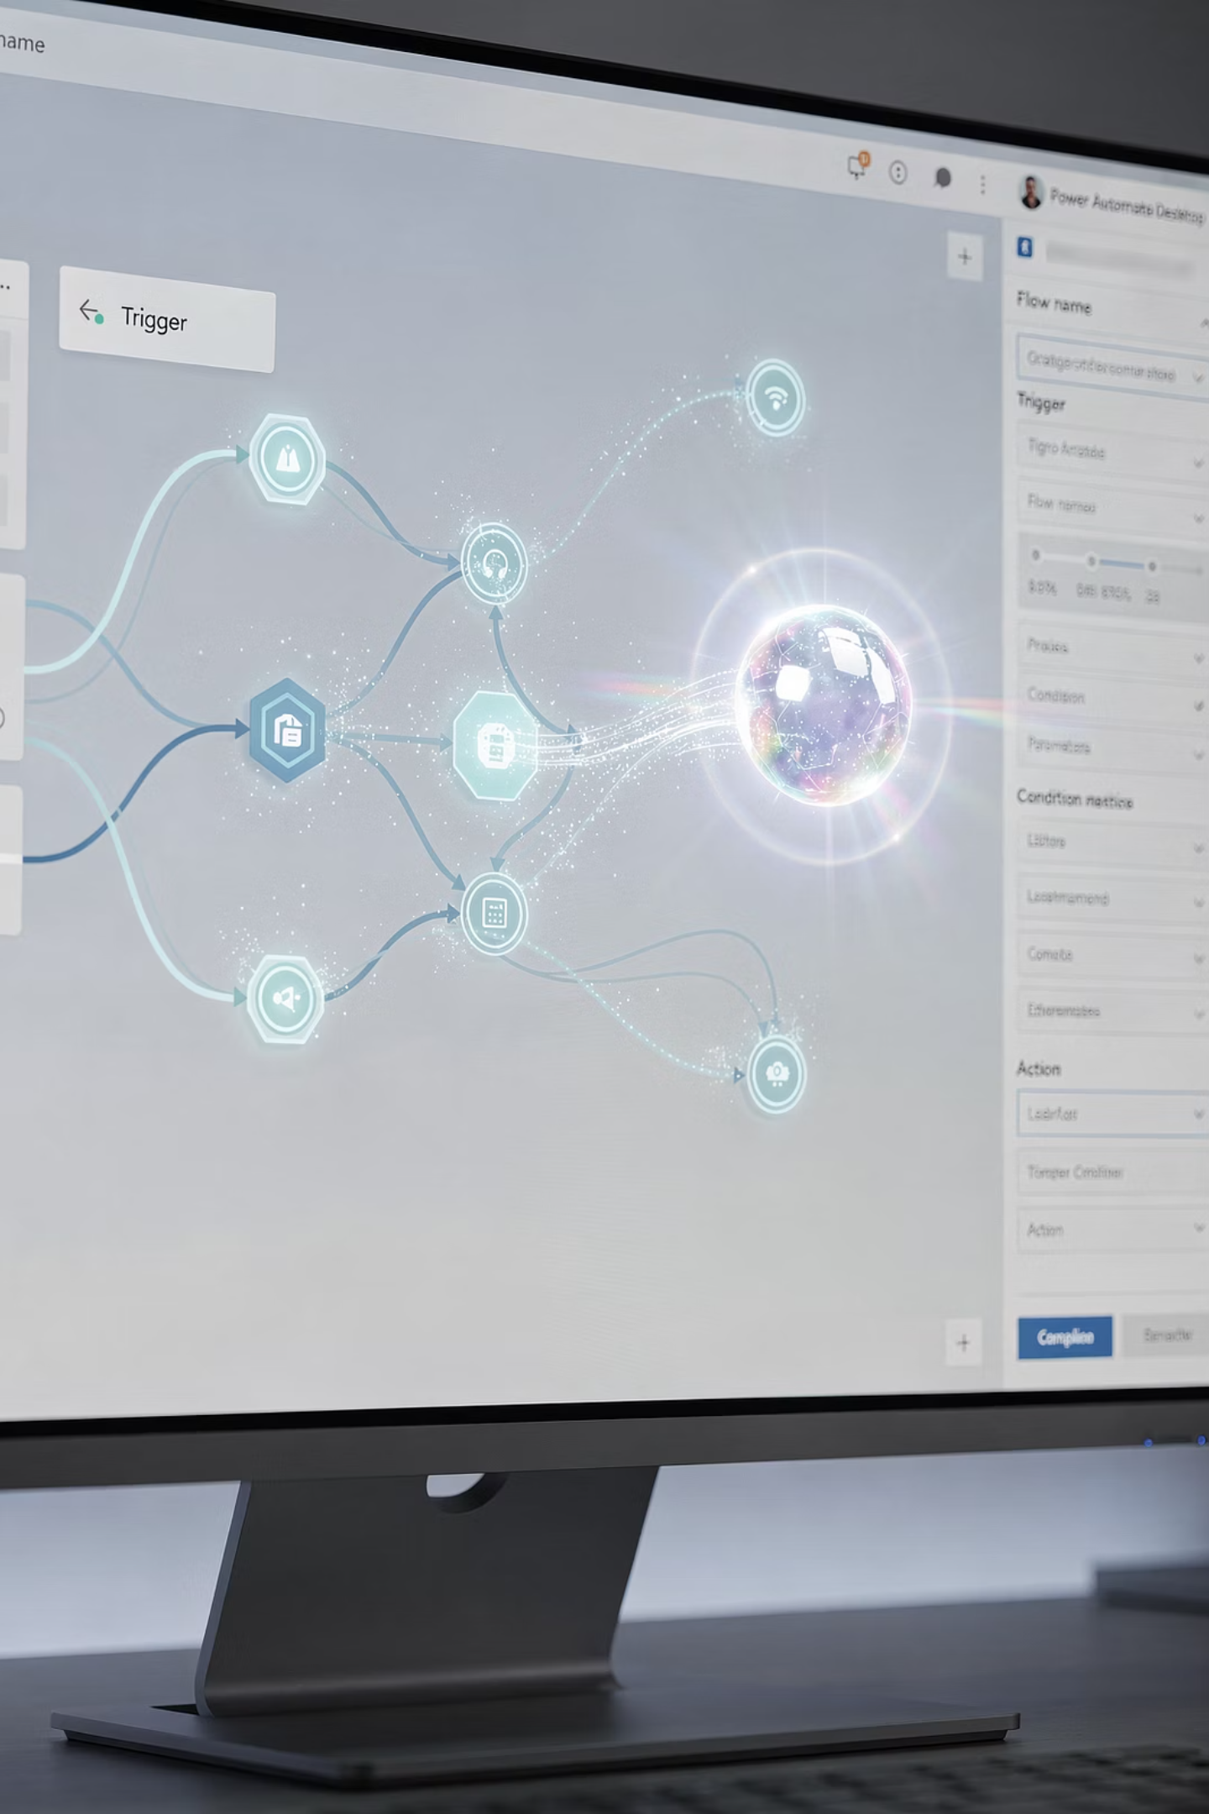
Scenario 8. Automate Your Prompts
01
02
The Problem:
The Copilot Solution:
Repeating the same prompts daily is inefficient.
Schedule specific prompts to run automatically.
03
ROI Impact:
Shifts Copilot from a reactive tool to a proactive assistant that handles recurring tasks.
Notes:
The key problem is that repeating the same prompts daily is inefficient.
The Copilot solution is to schedule specific prompts to run automatically, turning it into a proactive assistant.
This shift in how we use Copilot can have a significant ROI impact by handling recurring tasks without manual intervention.
This scenario demonstrates how we can leverage AI and automation to boost productivity and free up time for more strategic work.
Prompt to schedule for daily execution:
Summarize all unread emails and Teams messages from the last 24 hours. List them in a table with three columns: Sender, Key Request, and Deadline. Highlight any items that require a direct response from me today.

Slide 10
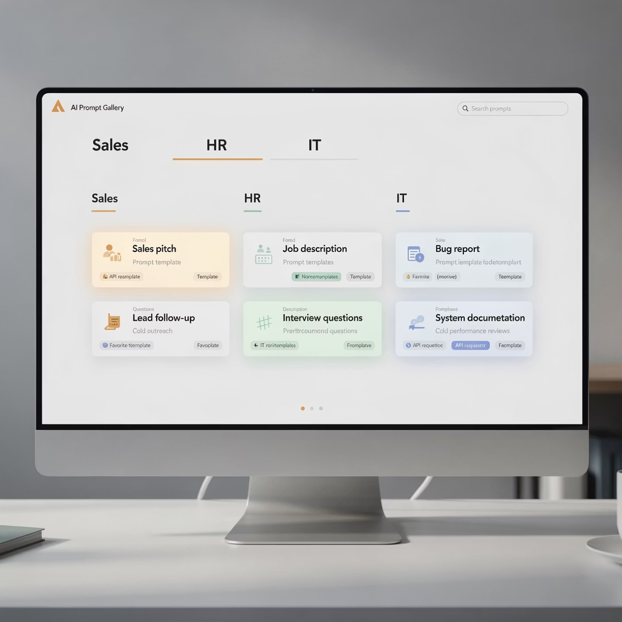

Scenario 9. Using the Prompt Gallery
The Problem:
Users don't know what to ask the AI.
The Copilot Solution:
Leverage the built-in Prompt Gallery to find starters for your specific department like Sales, HR, or IT.
ROI Impact: Accelerates the learning curve and reduces prompt fatigue.
Notes:
The slide introduces a scenario where users don't know what to ask the AI assistant
The Copilot solution is to leverage the built-in Prompt Gallery, which provides pre-made prompts for specific use cases like Sales, HR, and IT
This can help accelerate the learning curve and reduce prompt fatigue for users
The Prompt Gallery offers a convenient way to find relevant prompts to get started, rather than having to come up with prompts from scratch
This feature can improve productivity and make it easier for users to get value from the AI assistant

Slide 11




Scenario 10. Notebooks and AI Podcast Recaps
The Problem:
Extracting value from massive datasets is time consuming.
The Copilot Solution:
Use Copilot Notebooks to focus only on the content you have "gathered" in that specific notebook.
ROI Impact: Reduce research time by centering Copilot on your trusted data.
Notes:
The key problem we're addressing is that extracting value from massive datasets is time-consuming
The Copilot solution is to use Notebooks to focus only on the content you've gathered in that specific notebook
This allows you to reduce research time by centering Copilot on your trusted data
The ROI impact is that you can save time by not having to sift through irrelevant information - Copilot keeps you focused on the data that matters

Slide 12



Measuring Real World ROI of AI
How to track the impact:
Time Saved:
Quality Lift:
Cost Avoidance:
Track minutes saved per task.
Blind testing of Copilot output versus manual output.
Calculate the reduction in outsourced content or data analysis services.
Measurement Tip: Focus on Saved Hours Reinvested. If an employee saves 2 hours, where did that time go?
Notes:
Time Saved - Track the minutes saved per task through user surveys
Quality Lift - Conduct blind testing of AI-generated output versus manual output
Cost Avoidance - Calculate the reduction in outsourced content or data analysis services
The key tip is to focus on "Saved Hours Reinvested" - if an employee saves 2 hours, where did that time get reinvested?
This provides a framework for measuring the tangible business impact of AI investments.

Slide 13

Building Momentum and Adoption
The Secret to Culture Change:
Leadership First: Executives must share their own Copilot Wins in Town Halls.
Champion Networks: Identify power users in every department to coach peers.
The 30/30 Rule: Encourage 30 minutes of experimentation for every 30 hours of work.
Gamification: Run Prompt Off competitions to find the best workflows.
Notes:
As leaders, it's critical that we share our own successes with Copilot to inspire the rest of the organization.
Identify key power users in every department who can coach and encourage their peers to adopt Copilot.
We want to foster a culture of experimentation, where people feel empowered to spend 30 minutes a day exploring new ways to use Copilot.
Running Prompt Off competitions is a fun way to gamify the process and identify the most innovative workflows.
By taking these steps, we can build real momentum and widespread adoption of Copilot across the company.

Slide 14






Call to Action:
Turn Your Team Into Copilot Power Users with Copilot Training Package
Live Training for Leaders
Multiple Curriculum Modules
By Asif Rehmani, an industry expert
For internal Copilot training
Dozens of Training Videos
90-Day Copilot Adoption Playbook
On-demand learning for all skill levels
Structured guidance for rapid integration
Unleash Your Team's Potential: CopilotTrainingPackage.com
Connect with me
Notes:
Check out CopilotTrainingPackage.com for a complete list of Copilot curriculum modules, training videos, live training options, and more

