Slide 1
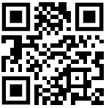
Download all my presentations and video recordings
http://bit.ly/AsifConference
Presentations on:
Organizational Change Management
Increasing user adoption while decreasing support tickets
Learning in the flow of work
Blended learning
Microsoft Viva Learning
And many more…
Notes:
My conference topics include:
Organizational change management
Ways to increase user adoption
Learning in the flow of work
Introduction to Dynamics 365 for the Microsoft 365 guy or gal
Microsoft Viva: what are the components of Viva and why you should care

Slide 2
Intro to Microsoft Dynamics 365 for the Microsoft 365 Guy / Gal
Presented by:
Asif Rehmani, MVP
VisualSP
Download All of my presentations at:
https://bit.ly/AsifConference
Notes:
The intent of this presentation is to introduce a Microsoft 365 person to the Dynamics 365 world. In doing so, I will share my findings as well as thoughts about how to proceed within the Dynamics world.
If you have been in the SharePoint and the Microsoft 365 world for a long time, you are aware of the common pitfalls that we have had to deal with in terms of migration as well as user adoption challenges along the way. Some of the same challenges exist in the Dynamics world as well which I'll be talking about in this presentation.
The URL to download all my presentations:
https://info.visualsp.com/download-conference-presentations-1

Slide 3
Agenda
How I fell into Dynamics
What is Dynamics 365
A brief history of Dynamics
What are the different products in the Dynamics family
Why should You care about Dynamics
What are the integration points of Dynamics and Microsoft 365
What are the challenges with Dynamics and how you solve for them

Slide 4
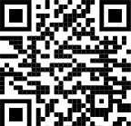
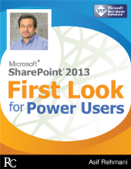
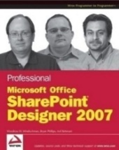
About me - Asif Rehmani
Conference Speaker
MS Ignite
Dynamics Summit
DynamicsCon
ESPC
365 EduCon
TechEd
Learning Conferences
And many more…
Microsoft MVP
CEO
Founder and CEO
VisualSP
Chicago, IL
Since 2007
Digital Adoption Platform (DAP) for M365 & D365
Author
My LinkedIn profile
asif@visualsp.com
www.VisualSP.com
Notes:
My name is Asif Rehmani
Founder and CEO of VisualSP – a Digital Adoption Platform (DAP) providing Contextual Microlearning to Dynamics 365 users to increase user adoption by 3X and reduce support tickets by 50%.
Been in the Learning business since 2005 as a trainer.
Speak at conferences around the world on end user training, user adoption and performance support.
Authored multiple books on Microsoft technologies for Wiley publications
Microsoft MVP since 2007.
I started my journey and SharePoint back in 2002 (when the software really sucked!). as the software became better and better and better and more popular in companies, I stuck with it training, consulting , mentoring and writing about it.
In 2016, I turned my focus to SharePoint online and then to Microsoft Office 365.
All along the way, my interactions have been with administrators, power users and end users of the software throughout the world. I see my job as empowering these folks to get the best use out of the software That their companies have invested in.
end user adoption is near and dear to my heart. I strongly believe that without proper usage of the software, it is all for nothing. Getting users on board and having them see what's in it for them is the Holy Grail that all of us should be chasing to make sure we get it right!

Slide 5
Story of how I fell into Microsoft Dynamics
Notes:
Back in 2019, our VisualSP customers started using VisualSP on top of Dynamics. They told us that they needed VisualSP to help support and train their users and increase user adoption.
Dynamics was not really on our radar before that and I had only some experience with Dynamics sales component which I thought was pretty rudimentary at that point thinking it was only a sales application just like Salesforce. I had no idea that the Dynamics 365 ecosystem had grown up so much.
It turns out that Microsoft had rolled out the unified interface for Dynamics in 2018 which totally changed how it look and feel to provide a consistent experience across web and mobile platforms and made the design fully responsive.

Slide 6
A fateful day in 2019: One VisualSP customer started using our tool on top of Dynamics 365 Sales to support their users

Slide 7
Example: VisualSP announcement banner on Dynamics 365 Sales

Slide 8
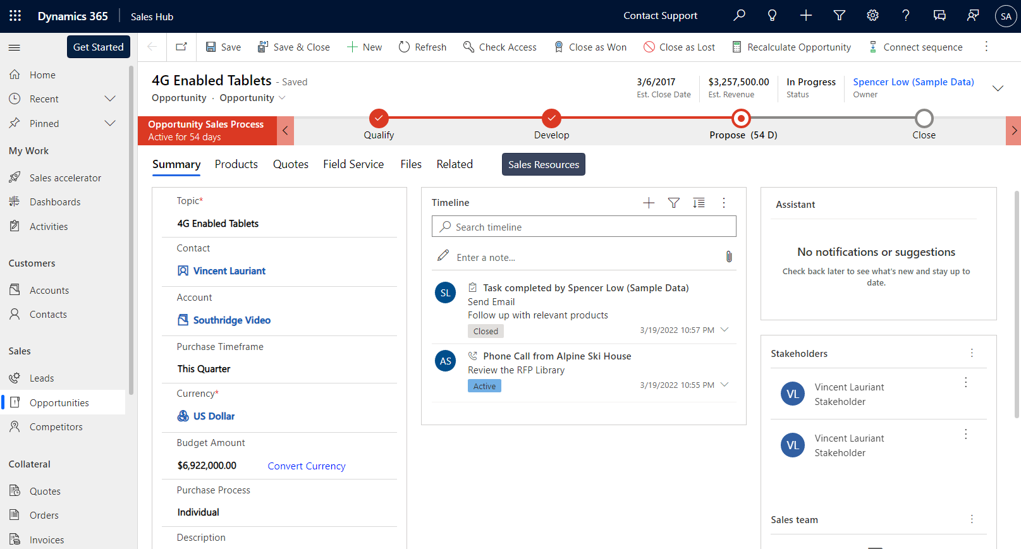
Closing Complex Sales course is now available. Take this 10 mins course to earn your Complex Sales certification
Start Course
Notes:
Scenario
A salesperson is visiting one of her opportunities in Microsoft Dynamics. A banner appears automatically on top of the page letting her know that a new course on Closing Complex Sales is available that she might be interested in and it will provide her the Complex Sales certification. The banner is persistent so it doesn’t block her work. When she is ready, she clicks on the Start Course button in the banner.

Slide 9
Closing Complex Sales course is now available. Take this 10 mins course to earn your Complex Sales certification
Start Course
Notes:
The course (which is hosted in the internal LMS) starts in a dialog box in the middle of the page. It does not switch her context from the application she is in which is Very important for the user since it doesn’t take them out of the flow of their work.
When she is done with the course, she closes the window and goes back to her work. By doing this, she gets credit for taking the course and it’s reflected in the LMS.

Slide 10
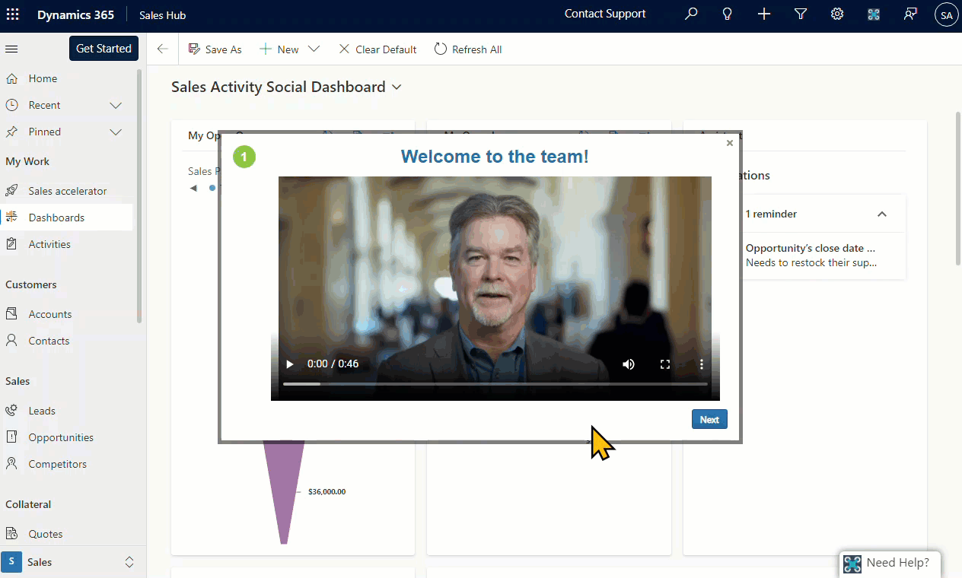
Interactive step by step guided walkthrough
Notes:
Scenario
Onboarding new Dynamics Sales users by providing them interactive step-by-step guided walkthroughs automatically as they first enter the application.

Slide 11
I wanted to learn more about Dynamics…
Notes:
I decided that I needed to learn more about Microsoft Dynamics as a product and the community as a whole so we can support our customers better.

Slide 12
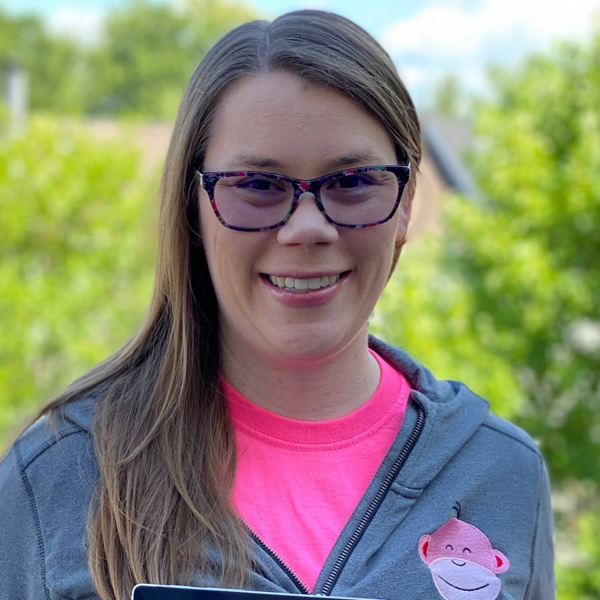
Vibrant Dynamics Community
Notes:
Along the years, the Dynamics community has grown quite a bit. I discovered the many faces behind the vibrant Dynamics community.
Dynamics MVPs pictured:
Heidi Neuhauser, Lisa Crosbie, Ashley Steiner, Kylie Kiser, Geoff Ables, Gus Gonzalez, Dian Taylor.

Slide 13
So what is Dynamics 365 anyway…??
Notes:
Let’s dig into what Dynamics really is.

Slide 14
A brief history of Dynamics
Around 2001, Microsoft acquired ERP & CRM companies like Navision (NAV), Great Plains (GP), Axapta (AX), iCommunicate
All remained individual solutions until Dynamics 365 was created when all got rolled up under the Dynamics 365 umbrella
Notes:
Let’s look through a brief history of Dynamics.
Around 2001 and 2002, Microsoft started pushing into business applications space and acquired a few companies that were focusing on ERP like Navision (NAV), Great Plains (GP), Axapta (AX), iCommunicate (a web based CRM company), etc. standalone ERP systems acquired and rolled into Dynamics 365 when that cloud offering was introduced later in 2016.
Great Plains was a solution meant to compete with QuickBooks.
Axapta was a solution that was commonly used by manufacturing organizations, distribution types of organizations
They were allowed to keep their own names like Dynamics NAV and Dynamics GP to begin with but eventually it all got rolled into the Dynamics branding when Dynamics 365 was created.
The software that was previously known as Microsoft Dynamics CRM (Customer relationship management) is now known as Dynamics 365 CE (Customer Engagement)
Dynamics 365 was officially released November 1st 2016. classic interface was a clunky user experience.
In 2018 Microsoft released the unified interface for Dynamics.

Slide 15
Dynamics 365 – set of business applications
CRM
ERP
Notes:
When I dug in further to truly understand what Dynamics 365 was all about, I realized that it is a set of business applications for CRM and ERP.
Many companies start by using the CRM capabilities of Dynamics like Dynamics 365 sales, marketing, customer service. Then when the time is right for them they go into the ERP side of things which is either business central or finance and operations to manage their financials, supply chain, operations, manufacturing, and so much more.
Model driven apps are based on the Common Data Service - a secure cloud based storage space - and take a data first approach.

Slide 16
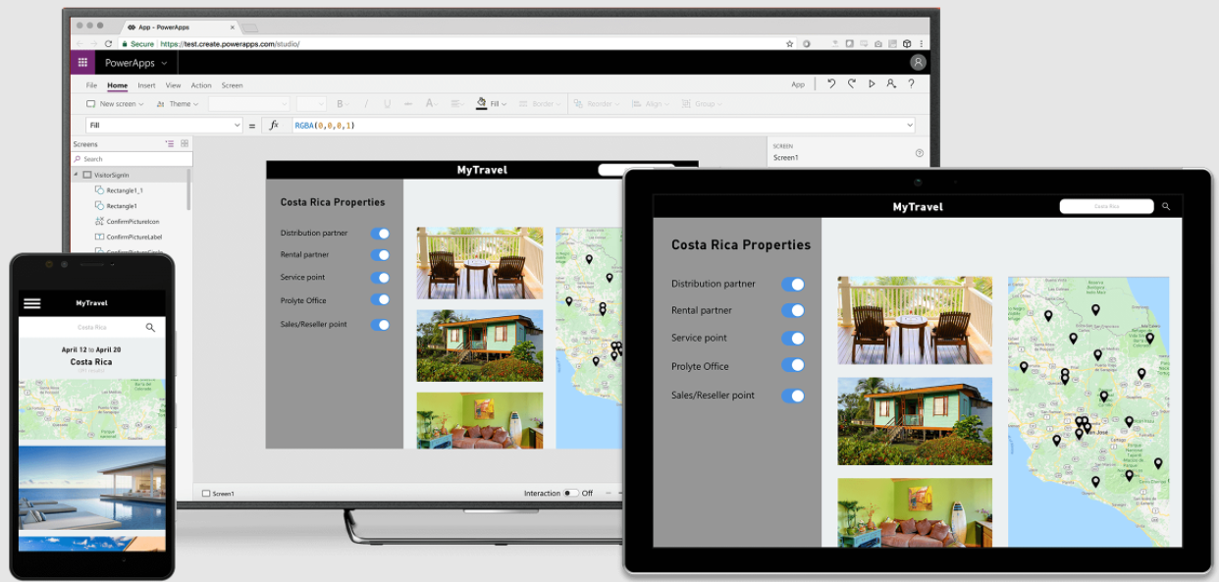
Canvas App – What M365 folks are familiar with
Notes:
Most Microsoft 365 folks are familiar with Canvas apps created using Power Apps. These types of apps provide drag and drop capability of elements to create apps for desktop and mobile devices. They are much more free form in nature.

Slide 17
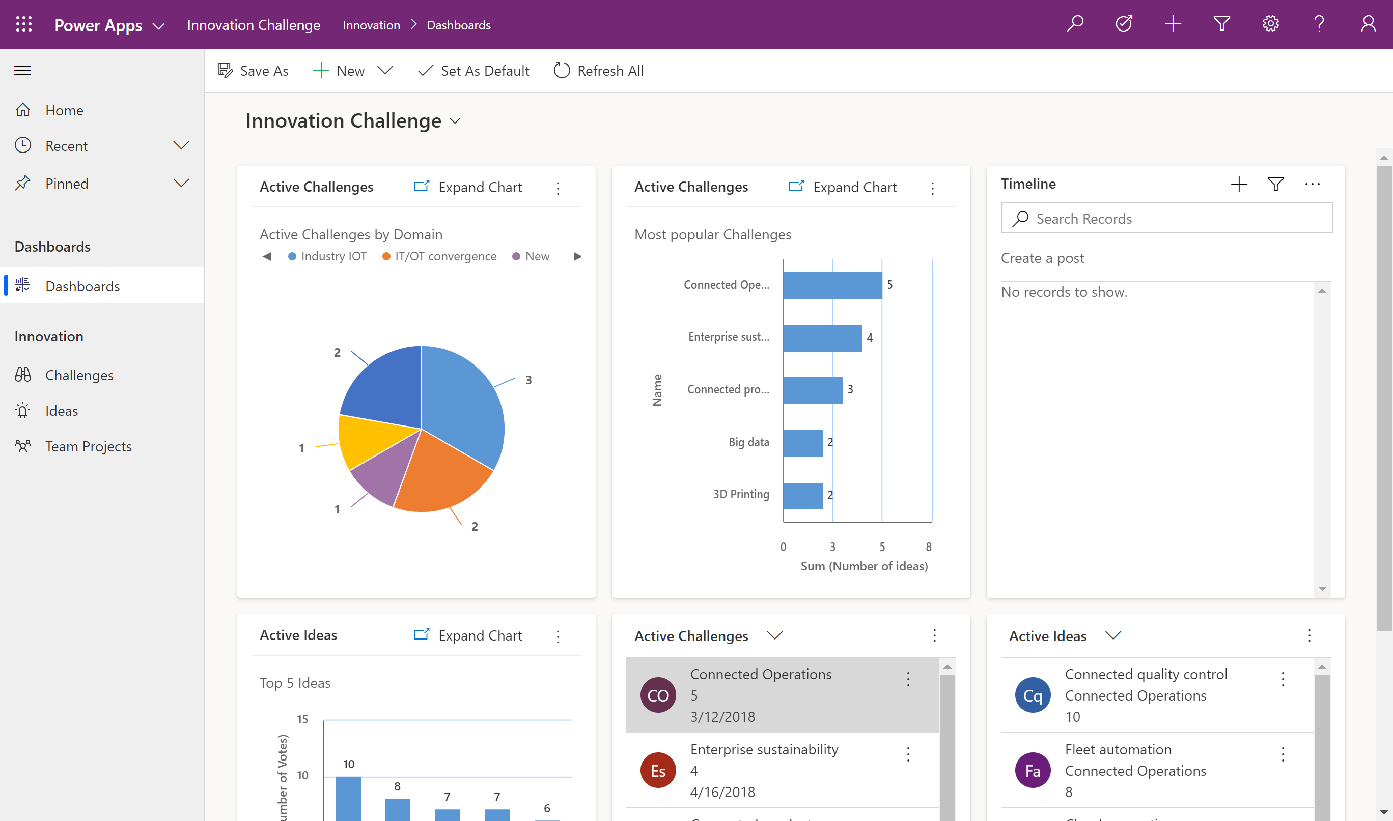
Model-Driven App – What D365 apps are built upon
Notes:
There is another type of app that you can create using Power Apps called model-driven app. All Dynamics 365 applications are created using the model driven app capability using Dataverse as a database.
Every single field in model-driven app is tied to underlying data. Within the Dataverse.

Slide 18
Microsoft Dynamics applications
Sales
Marketing
Customer Service
Business Central
Finance and Operations
Field Service
Human Resource
Supply Chain Management
Commerce
Project Service Automation
Artificial Intelligence
Mixed Reality
And more…
Notes:
There are lots of different Dynamics applications you can buy either separately or as packages.
Most of them are now only sold exclusively as online applications, thus Dynamics 365, but some you can still buy as on-premises deployments as well.

Slide 19
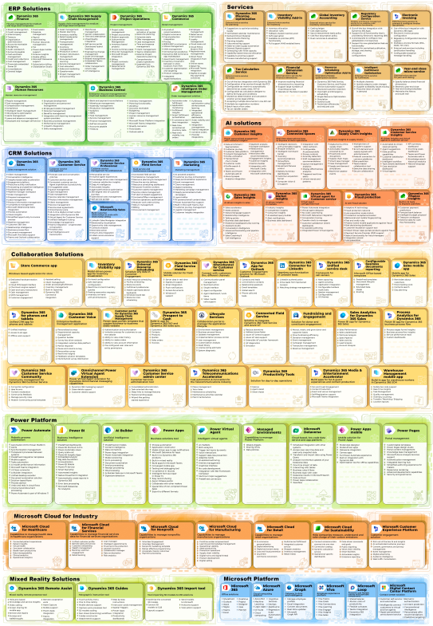
Products in the Dynamics family
Grab this image with presentation at:
https://bit.ly/AsifConference
Notes:
This is what the Dynamics 365 family of products looks like today. It is Huge!
Modules include:
Sales
Marketing
Customer Service
Business Central
Finance and Operations
Field Service
Human Resource
Supply Chain Management
Commerce
Project Service Automation
Artificial Intelligence
Mixed Reality
And more…
With these products, Microsoft competes with Salesforce, Oracle, SAP, NetSuite, QuickBooks, HubSpot, Workday, and many other applications.

Slide 20
Microsoft Dynamics 365 business applications compete with: Salesforce, Oracle, SAP, NetSuite, QuickBooks, HubSpot, Workday, and many other applications.

Slide 21
Demo
A quick tour through Dynamics 365 CRM and BC
Notes:
Demos of
Dynamics 365 sales hub
Dynamics 365 customer service
Dynamics 365 field service
How Microsoft 365 and Dynamics 365 work together
Dynamics 365 BC interfaces

Slide 22
Why should you care about Dynamics 365?
Chances are High that Dynamics will be coming to Your company soon
Notes:
Because chances are high that your company will head to Dynamics business applications as well since that's what Microsoft is pushing for pretty hard
You will need to know how to integrate Microsoft 365 and Dynamics 365 and support your users in both

Slide 23
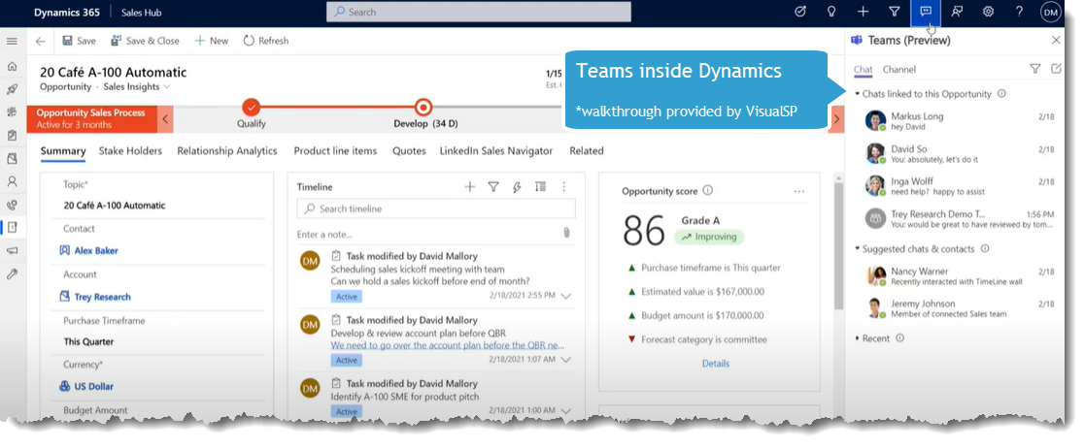
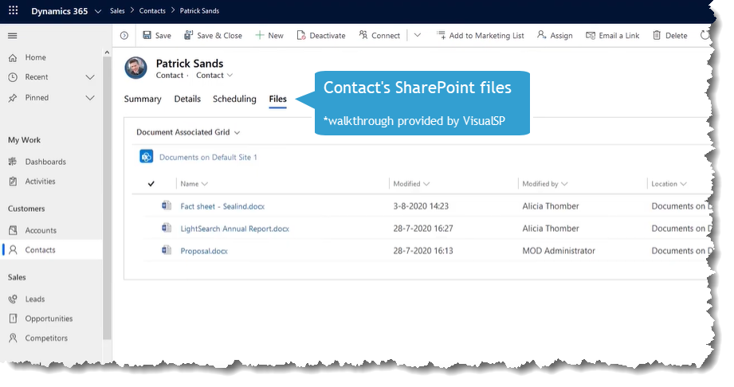
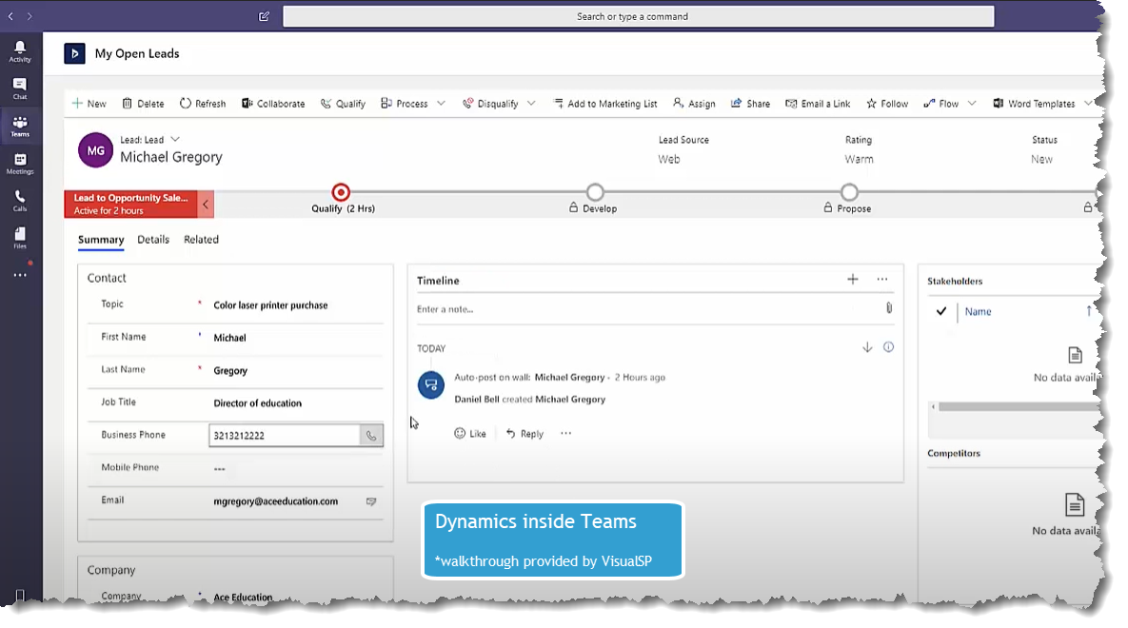
How Microsoft 365 integrates with Dynamics 365
Notes:
SharePoint files in Dynamics
Teams in Dynamics
Dynamics in Teams
The same power platform, power apps, power bi, power automate work in both to transfer information as you need it.
Blog article talking about and showing the integrations:
https://info.visualsp.com/blog/teams-sharepoint-and-dynamics-365-integration-points

Slide 24
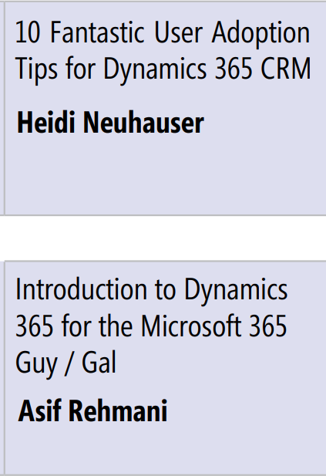
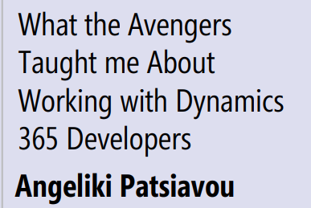
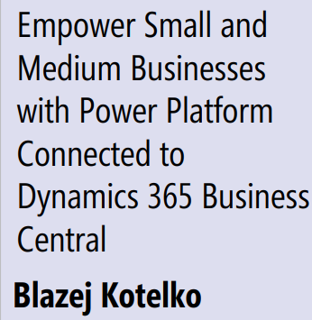
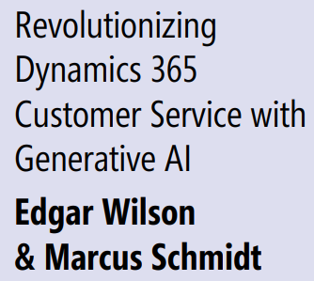
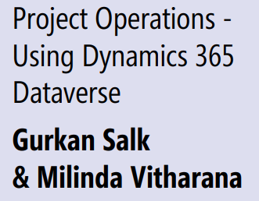
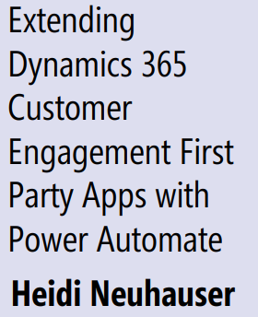
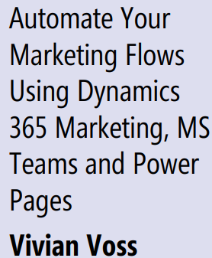
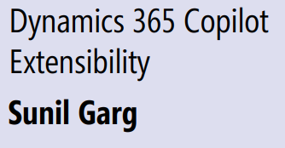
Dynamics sessions at MPPC 2023

Slide 25
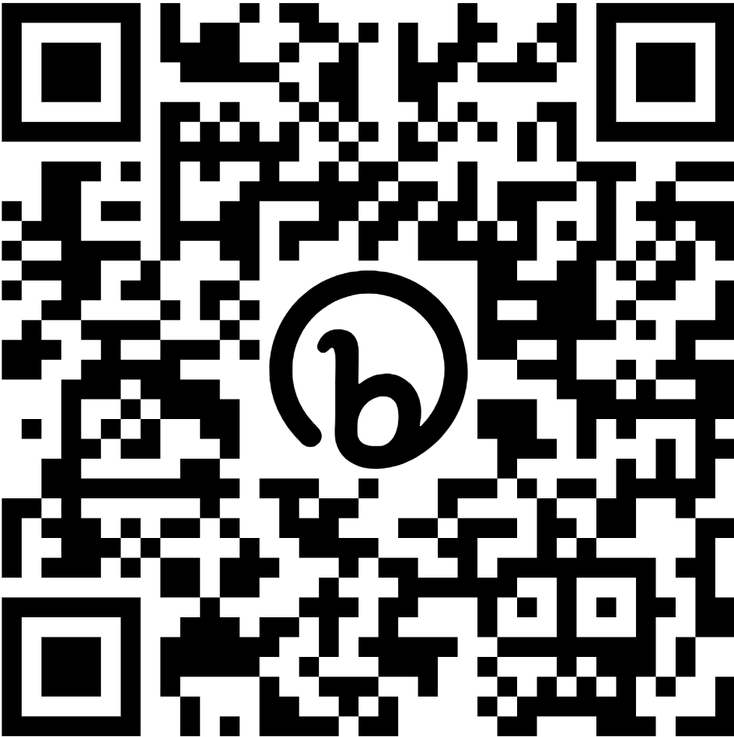
Download VisualSP plugin for free context sensitive tutorials on Dynamics CRM & BC
https://bit.ly/download-visualsp

Slide 26
All great stuff but….
Notes:
It's all great stuff but there are challenges in the Dynamics world which remind me of the challenges we have had in the SharePoint , Teams and Microsoft 365 world

Slide 27
The Challenge
Many Many Dynamics 365 Projects Fail Unfortunately😕
Notes:
Do you want to make the same mistakes that we made in SharePoint and then Microsoft 365 where users don't adopt it fully
Overwhelming because sometimes it's too flexible and customizable. Too many options. Looks too non-standard when it's all said and done and implemented.
Not as robust for specific industries - like warehouse management or manufacturing. For those, you want to go for others that will align well to you Or buy from a company that is taking Dynamics, customizing it and selling the resultant pre-built solution aligned to specific industries and/or specific use cases.
The built in help in Dynamics is useless and not customized for your needs. No persistent help or training system to help users.
Dynamics 365 has two release waves per year. Release wave one covers features releasing from April through September while wave two covers features releasing from October through March. When you are accepting these releases, there are most times minor and sometimes major changes that are happening which you need to let your users know about.
----
Most CRM projects fail. Sources:
https://www.stravatechgroup.com/2018/04/10/why-microsoft-dynamics-crm-365-projects-fail-a-microsoft-partners-perspective/
https://www.linkedin.com/pulse/why-70-all-crm-projects-fail-how-yours-one-them-anne-guethoff/?articleId=6662379840106188800

Slide 28
Average number of applications used by knowledge workers in a week
12
Notes:
a study revealed that an average knowledge worker is expected to jump around between multiple applications to do their job such as
Dynamics, Salesforce, HubSpot, SharePoint, Teams, Outlook, ServiceNow, Workday, SuccessFactors, NetSuite, custom web applications, …
Do we really expect our users to be thoroughly trained in all of the applications they need to use? Do we expect them to remember everything when they actually need it?

Slide 29
How do you solve for user onboarding training and adoption challenges?
Roll out Dynamics 365 modules gradually
Don’t try to train users, orient them instead
Implement a digital adoption platform on top of your interface so users always have the answers they need
Notes:
Start with Dynamics 365 Sales, Marketing, Customer Service.
Then consider Finance, Operations, Retail and other modules.
Provide blended learning to your employees
a combination of orientation, learning management system (to teach broad concepts within Dynamics such as about Leads, Accounts, Opportunities, Work Orders, Cases, etc.) and a digital coach to provide continuous contextual support and training to users.

Slide 30
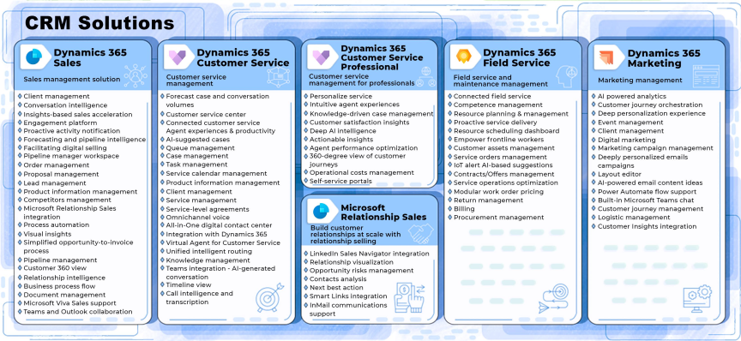
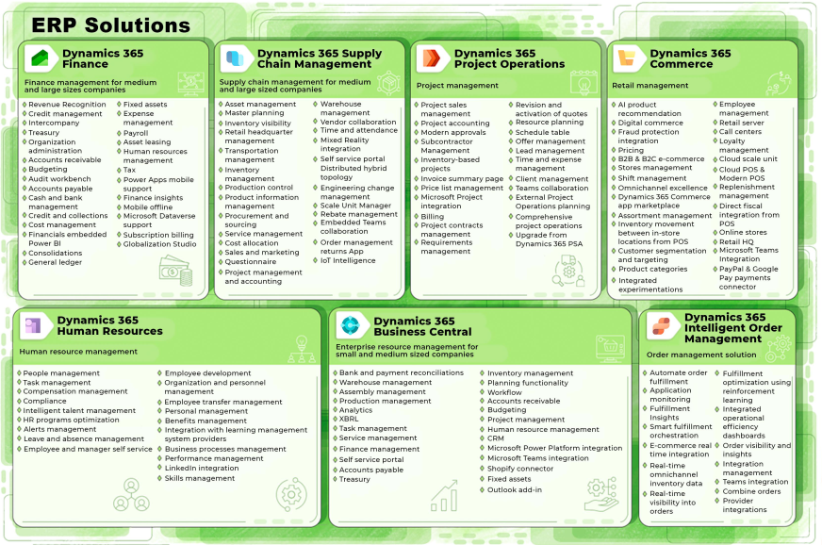
Start with CRM Or ERP then go to the other when ready
Notes:
Taking on and rolling out multiple modules of Dynamics 365 all at once is not advisable. Just like rolling out every single module of Microsoft 365 all at once it is not advisable 😊
Why is it not advisable? Because just like any technology, you will need to plan out governance, employee engagement and user adoption methods for each module so your efforts don’t go to waste. And trying to do it all at once seldomly has good result.
Instead, start with Dynamics 365 CRM solutions and then go to Dynamics 365 ERP solutions when ready.
Typically for CRM, Dynamics 365 Sales Marketing and Customer Service our rolled out first.
For ERP, Finance & Operations are the main modules that big companies roll out.

Slide 31
Traditional training doesn’t work for Dynamics
The interfaces are always evolving and changing
Train on processes and not technology
Provide short and frequent orientation sessions
Notes:
Trying to thoroughly train users on the Dynamics 365 modules you are rolling out is a waste of time.
Why you ask?
Because your Dynamics environment will be constantly evolving and changing.
It's much better to hold an orientation session at the beginning and then regular monthly webinars to answer user questions and show them specific functionality and processes as needed.
A 4 hours orientation session is usually the right amount of time. Covering:
Orientation to the system
Have folks understand their role in the system

Slide 32
Implement a Digital Adoption Platform like VisualSP for continuous end user support & training
Notes:
Make sure to implement a digital coach that is ever present for your users. You want your users to always have the answers they need at their moment of need.
VisualSP is an example of that digital coach which produces an overlay on top of your Dynamics 365 environment to support and guide your users so they don't get frustrated. It is super important for all phases of your Dynamics 365 implementation to have a digital coach implemented to increase user adoption and reduce your support burden.

Slide 33
Demo
Built in Help and VisualSP for Dynamics 365

Slide 34
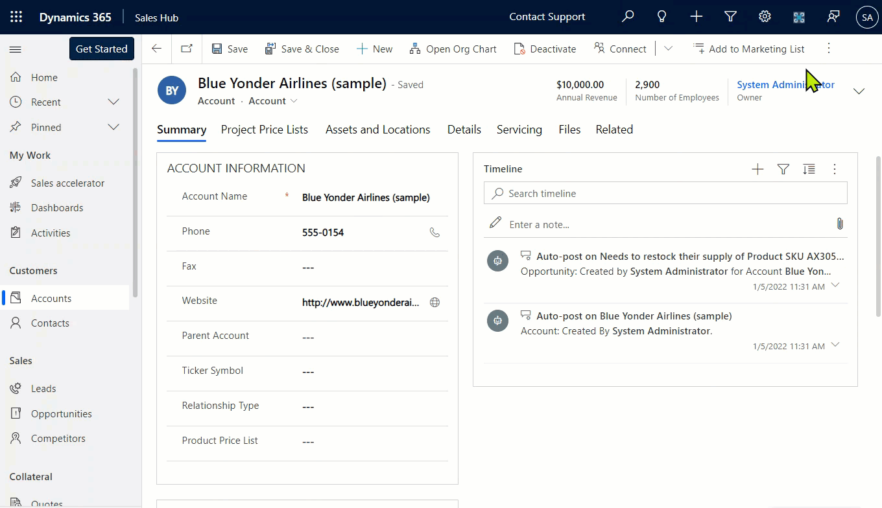
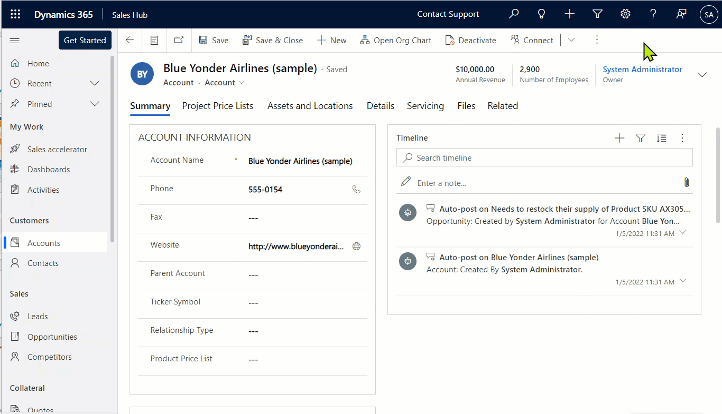
VisualSP End User Help Experience in Dynamics
Notes:
Here’s an example of how the built in non-helpful Help (?) mechanism of Dynamics 365 can be replaced with actually helpful help mechanism from your own company using the Digital Coach concept.

Slide 35
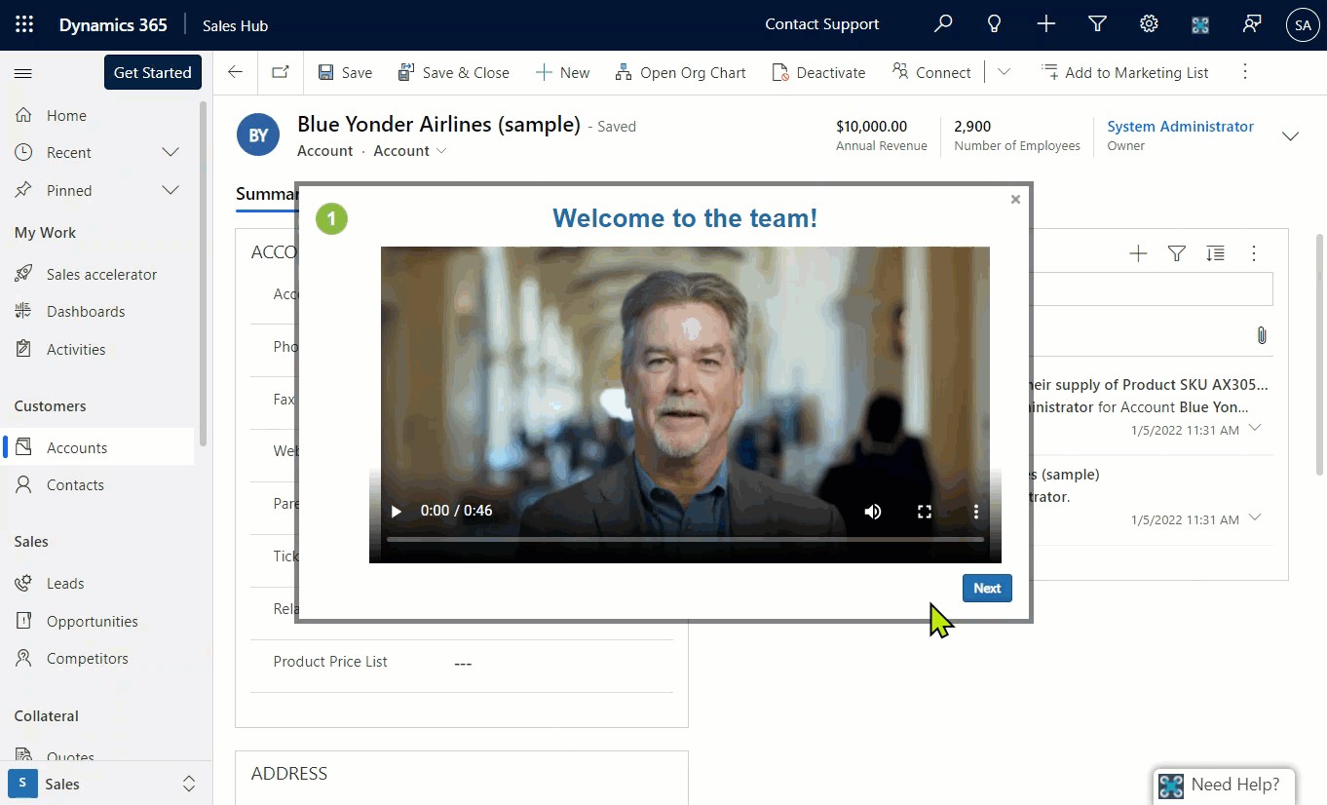
Onboarding New Users Efficiently
Notes:
Onboard your users the right way with interactive guided walkthroughs.
Reach out to us at VisualSP if you would like to learn more about how to implement this type of a Digital Coach.

Slide 36
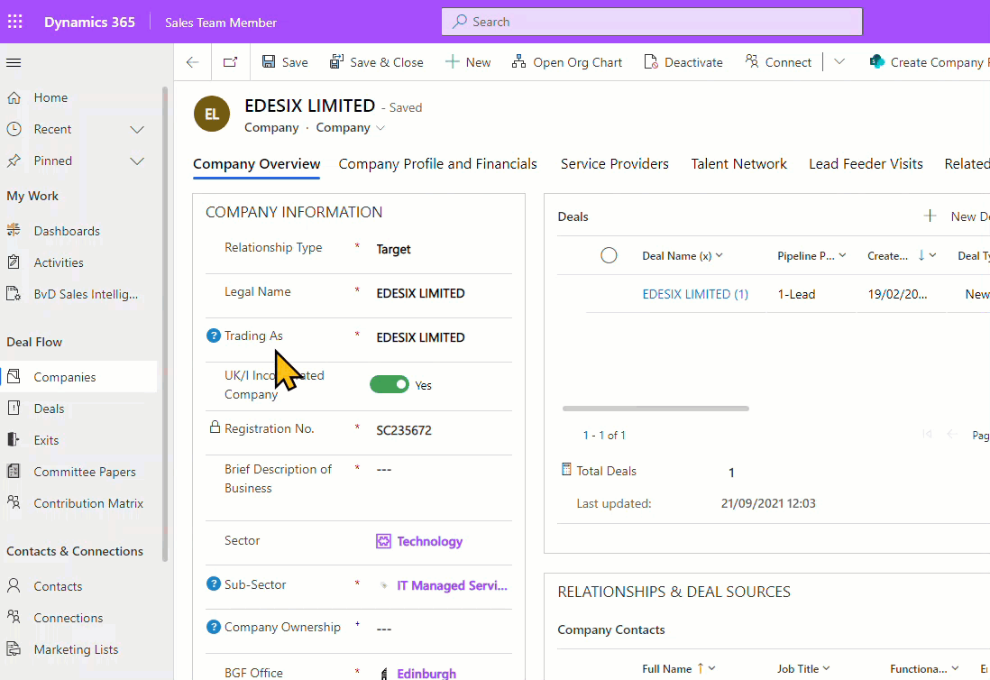
Inline Help Throughout Your Interfaces
Notes:
Provide tooltips / inline help to users so they always have the info they need and never frustrated.
These type of contextual experiences you want to consider strongly to implement into your blended learning and support for Microsoft Dynamics users

Slide 37
Summary
Understand what Dynamics 365 is all about
Explore the integration points of Dynamics 365 & Microsoft 365
Know the user adoption challenge that exists
Avoid mistakes and execute the Dynamics 365 rollout properly
Notes:
Let's recap some of the points we talked about.

Slide 38
Next Steps
Reach out to me with your questions on context sensitive support and training
asif@visualsp.com
Download this and my other presentations
http://bit.ly/AsifConference
Digital Adoption Platform for All web applications
Notes:
Feel free to reach out to me at my email address or message me on LinkedIn. I Love hearing from like minded folks.
The long URL where I upload All of my presentations:
https://info.visualsp.com/download-conference-presentations-1

