Slide 1
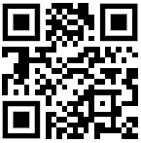
Increase Dynamics 365 CRM Usage While Decreasing Support Costs with Contextualized Support and Training
Presented by:
Asif Rehmani, MVP
VisualSP
Download All of my presentations at:
https://bit.ly/AsifConference
Notes:
Microsoft Dynamics 365 is a very powerful solution. However, just like any other CRM, Dynamics 365 also suffers with lack of user adoption and acceptance. The result is not as efficient usage of the product and an increase in the support burden.
This presentation talks about how you can replace the existing help and support system within Dynamics 365 with a system that helps the users by providing them help, guidance and answers to their questions contextually within their own environment and end the flow of their work.
The URL to download all of Asif’s presentations:
https://info.visualsp.com/download-conference-presentations-1

Slide 2
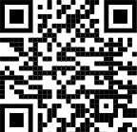
About me - Asif Rehmani
Conference Speaker
MS Ignite
Dynamics Summit
DynamicsCon
ESPC
365 EduCon
TechEd
Learning Conferences
And many more…
Microsoft MVP
CEO
Founder and CEO
VisualSP
Chicago, IL
16X MVP
Digital Adoption Platform
Author
My LinkedIn profile
asif@visualsp.com
www.VisualSP.com
Notes:
My name is Asif Rehmani
Founder and CEO of VisualSP – a Digital Coach providing Contextual Microlearning.
Been in the Learning business since 2005 as a trainer.
Speak at conferences around the world on end user training, user adoption and performance support.
Authored multiple books on Microsoft technologies for Wiley publications
Microsoft MVP since 2007.
I started my journey and SharePoint back in 2002 (when the software really sucked!). as the software became better and better and better and more popular in companies, I stuck with it training, consulting , mentoring and writing about it.
In 2016, I turned my focus to SharePoint online and then to Microsoft Office 365.
All along the way, my interactions have been with administrators, power users and end users of the software throughout the world. I see my job as empowering these folks to get the best use out of the software That their companies have invested in.
end user adoption is near and dear to my heart. I strongly believe that without proper usage of the software, it is all for nothing. Getting users on board and having them see what's in it for them is the Holy Grail that all of us should be chasing to make sure we get it right!

Slide 3
Almost 50% of CRM projects fail to meet expectations
#1 Challenge: User Adoption
CRMs are Very customizable so it’s always unique to a company
No off the shelf training can be provided to users
Users struggle when they have questions
CRMs continue to evolve as SaaS vendors as well as your company makes changes to it
Notes:
Taking the example of Dynamics CRM specifically…
Dynamics 365 is overwhelming because it's too flexible and customizable. Looks too non-standard when it's all said and done and implemented and looks different for every organization.
The built-in help in Dynamics is useless and not customized for your needs. No persistent help or training system to help users.
----
Most CRM projects fail. Sources:
https://www.stravatechgroup.com/2018/04/10/why-microsoft-dynamics-crm-365-projects-fail-a-microsoft-partners-perspective/
https://www.linkedin.com/pulse/why-70-all-crm-projects-fail-how-yours-one-them-anne-guethoff/?articleId=6662379840106188800

Slide 4
The usual Dynamics 365 CE (CRM) implementation
The internal team or an external consulting company creates the Dynamics environment for the company based on their needs
When the environment is being deployed, a training is conducted for the future users
The recording of the training as well as any documentation is provided to the users for future reference
Notes:
When a company is looking to implement Microsoft Dynamics 365 CE, they either do it with internal resources or hire an outside party to create and implement it for them.
Either way, usually at the end of the project, the future users of this system are gathered together, physically or virtually, and shown the new environment.
The “training” is done on this environment for these users and they are expected to remember what they have been shown in regards to the processes that they will need to conduct to do their job.
The recordings of these trainings are hosted either in SharePoint, MS Teams or Stream or just the regular file share and links to those are shared with the users for future reference. If the users are lucky, additional documentation or short videos are also produced or procured and shared with them so they can refer to that more quickly as the need arises.
Whatever the case, the users are then left to their devices to “figure it out” or ask someone when they have questions.

Slide 5
Dynamics 365 interfaces and processes change frequently making it difficult for administrators to continuously support and train their users
The Challenge
Notes:
Throughout the year, Microsoft pushes out two releases for Dynamics 365 - Release wave one covers features releasing from April through September while wave two covers features releasing from October through March.
In addition to that, organizations are continuously releasing changes of their own within the interface.
That makes it very challenging to continuously keep the users informed, updated, trained and supported on the most current policies guidelines and processes.

Slide 6
Agenda
Understand the challenge of supporting Dynamics 365 users at their moment of need
Explore the trend that Microsoft and other organizations are using to train and support people within the flow of work
Learn how to implement contextual learning and support in Dynamics 365 to increase adoption and reduce support tickets
Understand the pros and cons of this approach
Look into 3rd party approaches to accomplishing this more robustly
Notes:
We will start by understanding the current challenge supporting and training users in Dynamics 365.
Then we will look at some trends that Microsoft and other vendors are following to train and support users within the flow of work.
We will then dive into how you can replace the default help system within Dynamics 365.
Then we will look at the pros and cons as well as limitations of this approach.
We will also look into third-party approaches to accomplishing this same concept in a more robust way.

Slide 7
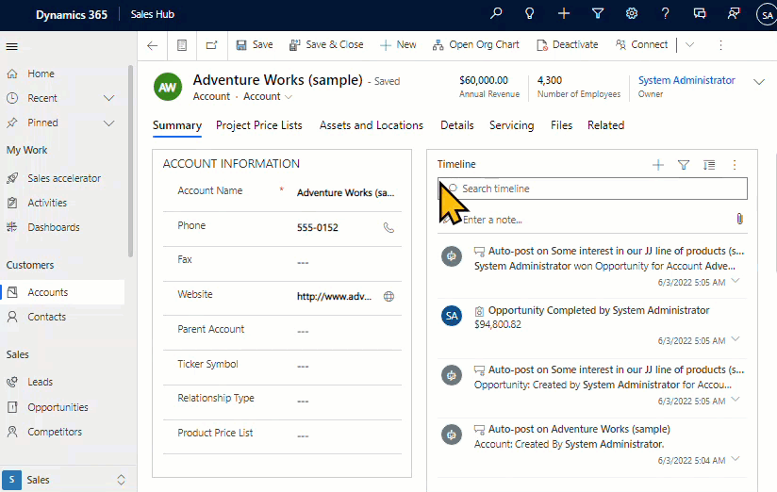
Built in Dynamics 365 help is not useful for everyday users
Notes:
The built in Dynamics 365 help is not useful for everyday users of the application. In addition, it just gives generic documentation which does not apply to your specific implementation of Dynamics 365.

Slide 8
The current way that Dynamics users get help at their moment-of-need
Search on the interface for help
Look at documents or info they have on hand
Search on the web
Ask a colleague or manager
If no solution… they give up and go back to their old way of doing things using spreadsheets, files and notes. Not good!
Notes:
When users of Microsoft Dynamics get frustrated by some process, they usually look around for clues first.
If no clues are present, they usually try to look up docs or info they have on hand to help them with the issue.
If they come up empty on finding resources, then usually the next step is to ask someone for help.
Asking someone is difficult to do these days because many of us are working remotely and constant pinging someone on Teams can get annoying.
The next option the person might try is to look for the answer online if it’s a common fundamental question such as ‘how do you close an opportunity’ or something similar.
If this person is still frustrated and can’t find the answer to the issue where she is stuck, she might go back to the old ways of doing things in spreadsheets, files or other notes or places where she used to keep the info. More often than not, that’s going to be within disconnected files which means now others don’t have access to that info if they need it ☹

Slide 9
Context Switching hurts productivity and adoption
Context switching constantly can cost up to 40% drop in productivity
Notes:
When an employee has to switch context to find something, it hurts productivity as well as adoption of the process that she was working on.
Context switching usually has an impact on the average of about 15 minutes when looking for the information and trying to get back in context of what you were initially working on. That's a pretty high switching cost and should be avoided whenever possible.
Reference for 40% drop in productivity due to context switching:
https://www.psychologytoday.com/us/blog/brain-wise/201209/the-true-cost-multi-tasking

Slide 10
Less info in-context is better than more info out of context
Contextual Microlearning / Microsupport / Microcommunication
Notes:
It has been proven time and time again that specific information that is available in context is far better than loads of information that is available out of context.

Slide 11
Stop Training and Start Helping your users
Notes:
When our users come to us for support, be cognizant of the words they are using. Are they asking for help or training?
Are they asking:
“Can you train me”
Or
“Can you help me”
Chances are that when your users ask you for support, they are asking you to help them.
Having said that, let's stop training our users and start helping them instead at their moment-of-need.

Slide 12
Provide users learning and support in the flow of work using custom help panes and guided tasks functionality in Dynamics 365 and Power Apps
The Solution
Notes:
there is no way you can continuously train and support Dynamics 365 users. Instead, look for other ways to continuously train and support your users within the flow of their work
Dynamics 365 has the functionality called custom help panes and guided tasks that can be enabled in a very simple and easy manner which replaces the default help documentation with contextual help and support that can be easily customized.

Slide 13
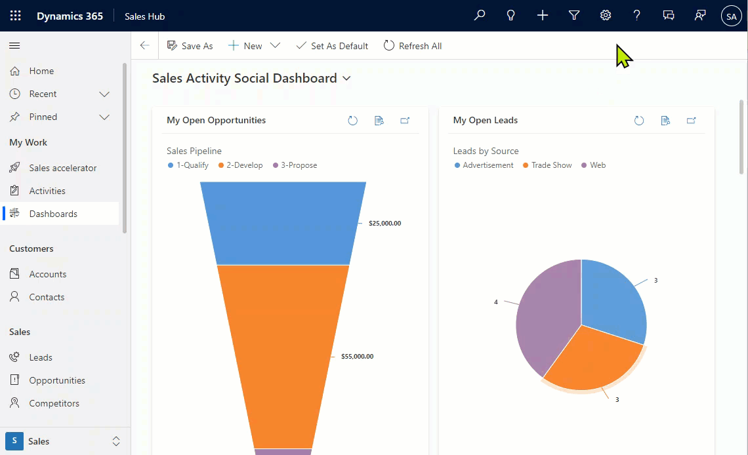
Enable Custom Help Panes and Guided Tasks functionality
Notes:
This animated image shows exactly how the custom help panes and guided tasks functionality in Dynamics 365 is enabled.

Slide 14
Configure Custom Help Panes and Guided Tasks
Notes:
This video shows how to configure custom help panes and guided tasks functionality within Dynamics 365.

Slide 15
Live Demo
Notes:
Live demo of setting up custom help panes and guided tasks functionality

Slide 16
Limitations of Custom Help Panes and Guided Tasks functionality
Lack of official support from Microsoft
Images and videos integration has some bugs
Some elements on page don’t work with balloons and coachmarks
No way to implement multi step guided walkthroughs
No way to draft items before publishing
No customization and branding options
No way to target items to specific user groups or scopes
Notes:
The custom help panes and guided tasks functionality is a good starting point. But… it has limitations.
Be aware of these limitations and make sure you are OK with them before going down this route.
Otherwise, look for alternatives. Many companies, such as VisualSP, have solutions similar to the custom help panes and guided tasks functionality without these limitations.

Slide 17
If Custom Help Panes and Guided Tasks functionality is limiting…
Notes:
Depending on your current needs , you might find that the custom help panes and guided tasks functionality is enough. However, if you find that it is too limiting in nature then consider going beyond this functionality to the next level

Slide 18
Implement a solid Contextual Support Platform for Dynamics 365 & Power Apps
Notes:
A Digital Adoption Platform (DAP) takes the custom help panes and guided tasks functionality in Dynamics 365 to the next level

Slide 19
Digital Adoption Platform choices
WalkMe
VisualSP
WhatFix
Pendo
and more….
Tight integration with
Microsoft Dynamics 365 & M365
Notes:
There are several organizations that provide a Digital Adoption Platform (DAP).
VisualSP is the only digital adoption platform built from ground up with Microsoft products in mind such as Dynamics 365, SharePoint, Teams, Microsoft 365 apps.
VisualSP has the tightest integration and the most capability for Microsoft applications such as auto-activation of users, permissions-based and scope based content serving, out-of-the-box training and guidance starter content, and more.

Slide 20
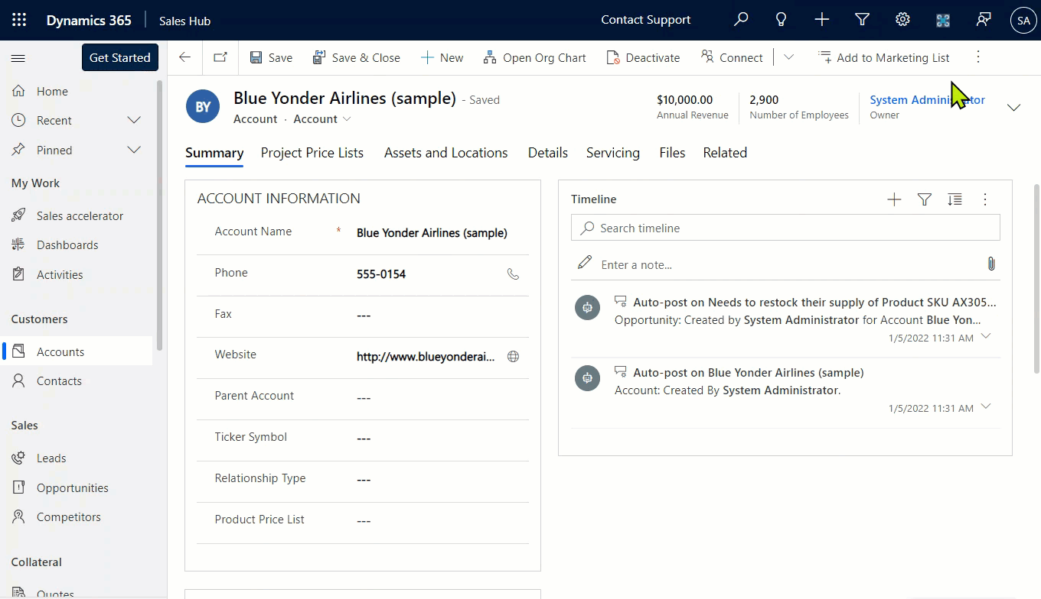
End User Help Experience in Dynamics
Notes:
Here’s an example of how the built in non-helpful Help (?) mechanism of Dynamics 365 can be replaced with actually helpful help mechanism from your own company using the Digital Coach concept.

Slide 21
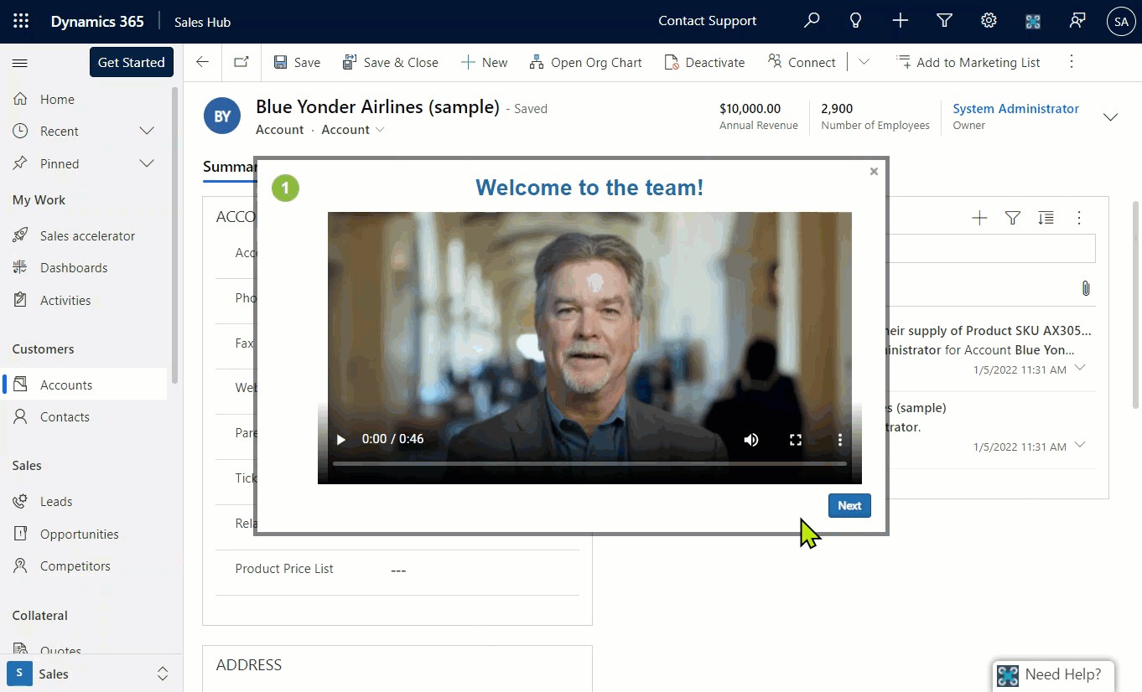
Onboarding New Users Efficiently
Notes:
Onboard your users the right way with interactive guided multi-step walkthroughs.
Reach out to us at VisualSP if you would like to learn more about how to implement this type of a Digital Coach.

Slide 22
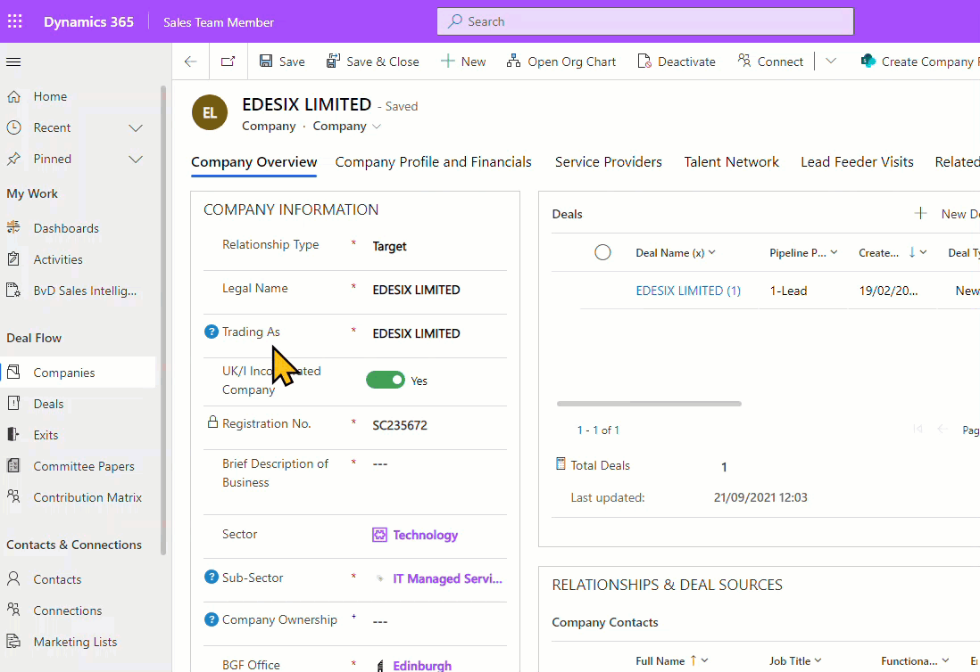
Inline Help Throughout Your Interfaces
Notes:
Provide tooltips / inline help to users so they always have the info they need and never frustrated.
These type of contextual experiences you want to consider strongly to implement into your blended learning and support for Microsoft Dynamics users

Slide 23
Summary
Replace default help in Dynamics 365 to increase chances of user success and adoption
Consider the built-in functionality called Custom Help Panes and Guided Tasks
Understand the limitations of this functionality
Implement a Digital Adoption Platform (DAP) like VisualSP to take contextual experiences to the next level
Notes:
Let's recap some of the points we talked about.

Slide 24
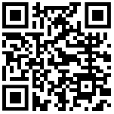
Next Steps
Reach out to me with your questions on context sensitive support and training
asif@visualsp.com
Start with built in custom help panes and guided tasks to support your users
or
Start a free trial of VisualSP to fully support your Dynamics users and reduce support costs
https://www.visualsp.com/request-trial/
Contextual Micro-support
Platform
Notes:
Feel free to reach out to me at my email address or message me on Twitter or LinkedIn. I Love hearing from like minded folks.
The long URL where I upload All of my presentations:
https://info.visualsp.com/download-conference-presentations-1

