Slide 1
Everything you need to know to get the best use out of Microsoft 365 learning pathways
Asif Rehmani
Download my presentations at:
http://bit.ly/AsifConference
@asifrehmani

Slide 2
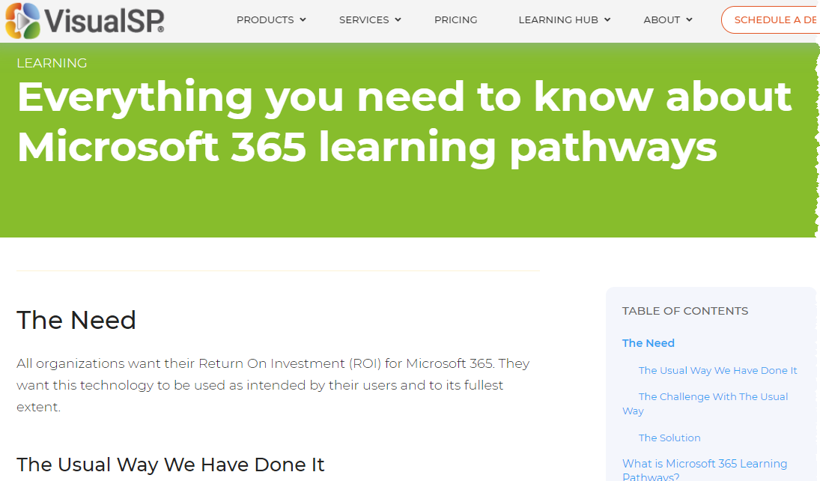
Accompanying article on Everything you need to know to get the best use out of Microsoft 365 learning pathways
https://bit.ly/VSP-M365LP
Notes:
Accompanying article with embedded videos and explanation of all things learning pathways related.

Slide 3
Recorded video of the presentation on YouTube
https://youtu.be/aqwdY65M7aE
Notes:
https://youtu.be/aqwdY65M7aE

Slide 4
Agenda
Understand the need for user training and common solutions
Overview of Microsoft learning pathways (MLP)
Installation & Configuration
End user experience
Getting users to use MLP
Measuring MLP usage
Updating & Roadmap of MLP
The Better Together partner story of MLP

Slide 5
About me - Asif Rehmani
Conference Speaker
Ignite
ESPC
SPTechCon
SP Fest
SPC
TechEd
And many more…
SharePoint MVP
Founder and CEO
Founder and CEO
VisualSP
Chicago, IL USA
Since 2007
Author
My LinkedIn profile
asif@visualsp.com
www.VisualSP.com
Notes:
My name is Asif Rehmani. I reside in Chicago, IL, USA.
I have been around in the SharePoint community since 2001. last few years focused on Microsoft 365.
I have been a Microsoft MVP since 2007.
Over the years, I've had the opportunity to meet thousands of administrators, power users as well as end users in the community. I have heard learned a lot through those experiences and try to carry them through in my teaching. Fortunate to write a few books about my teachings as well. My current focus is very much on creating tools and processes to make end users successful doing their jobs - Not by training them but helping them at their moment-of-need

Slide 6
We need our users to feel confident and supported using Microsoft 365
The Need
Notes:
At the end of the day, all organizations want the same thing as far as Microsoft 365 utilization is concerned. They want their users to feel confident and comfortable using the Microsoft 365 products and tools to get their jobs done.

Slide 7
The usual way
Build a knowledge portal on SharePoint
Put a bunch of videos, documents and links to external content on that portal
Content bought from a vendor or created internally
Link to the portal and hope for the best (fingers crossed)
Notes:
The usual way has been that you build a learning portal as a SharePoint site collection, populate that portal with lots of good content such as videos, articles , links to great resources. then you link to that portal so users can go there to get ‘trained’ as they have questions

Slide 8
The videos and other content must be kept updated by You
The challenge with the usual way
Notes:
the challenge with the usual approach has been that You are the one who needs to keep everything updated – the portal as well as the content on the portal. That's hard to do because usually it's a team of one or a few people who are taking care of the entire end user base.

Slide 9
Microsoft 365 learning pathways
The Solution
Notes:
The solution to this challenge is Microsoft 365 learning pathways. You deploy the solution which is automatically kept updated all the time so you don't have to do it.
Let's dig into it.

Slide 10
What is Microsoft 365 Learning Pathways?
A learning portal created as a SharePoint communication site within your Microsoft 365 tenant
Learning content for end users focused on Microsoft 365 apps such as OneDrive, SharePoint, Teams, etc.
Content automatically updated, curated and delivered by Microsoft into your portal
Your own training content can be added to this portal
An open source solution created by Microsoft
Notes:
Microsoft 365 learning pathways is a learning portal that is created and supported by Microsoft themselves.
The training content for most of Microsoft 365 apps is provided and more is released every quarter by Microsoft.
The connection to the Microsoft training repository is always open so the content is updated automatically in your portal.
The content is served through GitHub Content Data Network (CDN).
Your own content can be added to this training portal to supplement learning for your users.

Slide 11
What Learning Pathways is Not
Learning pathways is not a product. It’s an open source solution
Learning pathways is not an LMS and Microsoft has no plans to go that route
Notes:
An important thing to keep in mind and be aware is that learning pathways is not a product. It is an open source solution created by Microsoft and you would have to support it yourself. The only help that's provided is by other community members and a forum where you can ask questions.
Learning pathways is also not a Learning Management System (LMS). You are not able to assign courses to users nor can you track their progress. This was never the intent of this solution.
We will be talking about the “Great, Good and not so Good” aspects of learning pathways throughout the presentation.

Slide 12
Installation

Slide 13
Prerequisites
You need to be a Microsoft 365 tenant administrator
An app catalog site must exist or needs to be created at the tenant level
Notes:
You must be the Microsoft 365 tenant administrator to be able to install learning pathways.
An app catalog must exist at the tenant or you must create one in order to install learning pathways.
More info about app catalog: https://docs.microsoft.com/en-us/sharepoint/use-app-catalog

Slide 14
Install process
Navigate to https://provisioning.sharepointpnp.com/
Click on View the designs > Solutions > Microsoft 365 learning pathways
Click on Add to your tenant button
Carefully read and accept the permissions being requested
Fill out the form and provide your contact email address and the location for the Learning Pathways site in your tenant and submit
3 mins video showing the install process step by step:
https://www.youtube.com/watch?v=Rj3U6ds-x1c
Notes:
The install process has been automated by Microsoft. You start with navigating to https://provisioning.sharepointpnp.com/ and then from there look for the Microsoft 365 learning pathways solution. Once there, it guides you through the process of what it needs from you to install learning pathways inside your tenant.

Slide 15
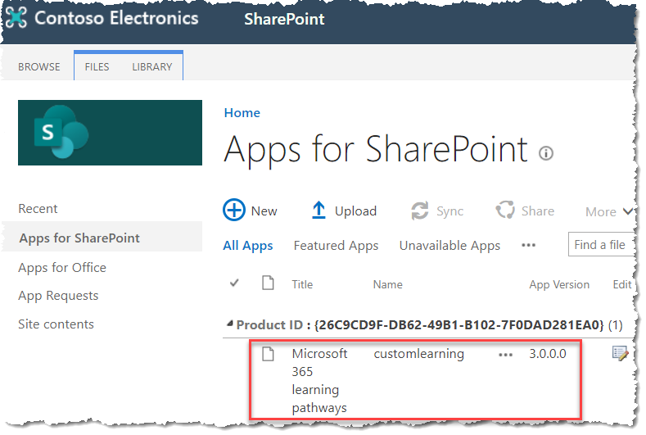
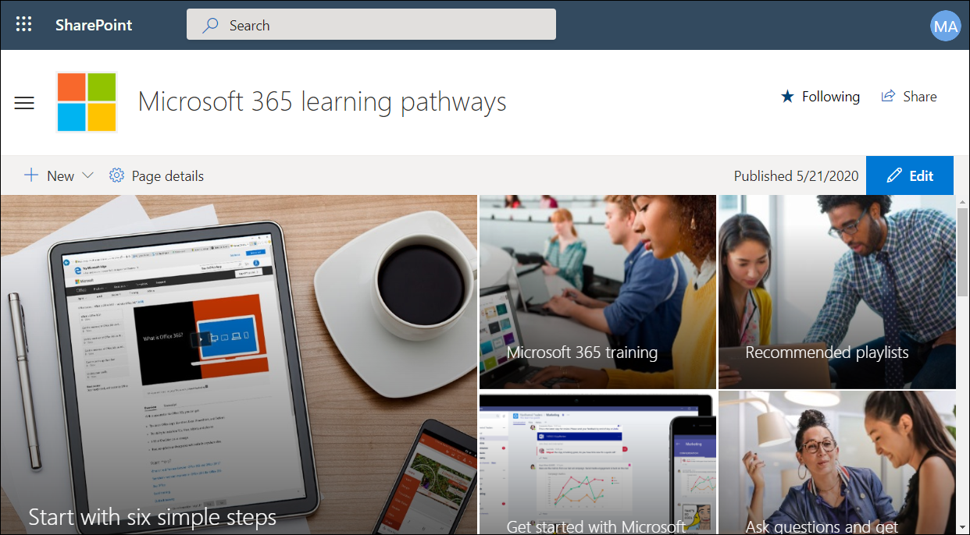
What the heck is learning pathways installing at my tenant?
The Microsoft 365 learning pathways app got installed in your app catalog
A SharePoint communication site got created in your tenant to host learning pathways
Notes:
It is important to understand what learning pathways creates inside your tenant.
The Microsoft 365 learning pathways app gets installed in the app catalog for your tenant.
The other thing that gets created is a SharePoint communication site to host learning pathways content and administration pages.

Slide 16
Configuration

Slide 17
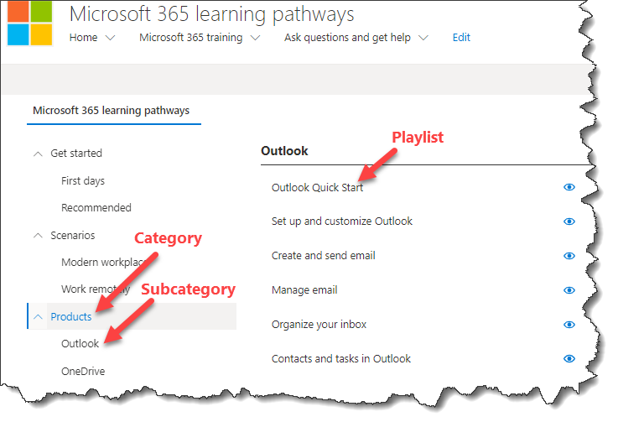
Learning pathways terminology Admin’s perspective
Notes:
when you as an administrator navigate to the administration page of learning pathways, you will see a list of categories and subcategories underneath each category.
when you click on a subcategory, all the playlists available in that subcategory will be shown.

Slide 18
Basic configuration of learning pathways
Tenant admin should provide the person in charge of learning and development ownership of learning pathways site
Hide all navigation elements of the site you don’t want end users to see
Fill in the placeholder information with content specific to your organization
Hide application content you don’t want your users to see
Provide everyone access to the learning pathways site
Link to the learning pathways site from places your users usually see
Video showing these basic configurations: https://www.youtube.com/watch?v=qgPrPt-OIFk
Notes:
There are a few basic things you should do before inviting end users to come to the learning pathways portal.
You want to make sure that when users come to the portal, they have a good experience. They should not see anything that you don't want them to see. It's best to take your time and hide products, playlists and assets which demonstrate or talk about functionality that you have not made available to users. Otherwise, they will just be frustrated if they see training materials for products that they don't have access to.

Slide 19
Advanced configuration
Can’t
You cannot change the order of existing products, subcategories, playlists, assets provided by Microsoft
You cannot add a new asset to a Microsoft playlist
You cannot edit nor remove Microsoft provided assets
Can
You can create a new subcategory
You can create a new playlist
In existing subcategories
In new subcategories
You can copy a playlist, then remove or add assets to it
Video showing what you can and cannot do with administration:
https://www.youtube.com/watch?v=RmosQi-Df0E
Notes:
Once things get going, you will want to come back and do some advanced configuration within learning pathways such as creating your own subcategories and playlists.
It's good to understand the limitations of what learning pathways will let you do. For example you cannot add a new asset to an existing Microsoft learning pathways playlist. You also cannot edit or remove assets from an existing playlist.
then there are things that you can do such as creating a new subcategory , creating a new playlist and then also managing the assets in that new playlist.

Slide 20
End user experience

Slide 21
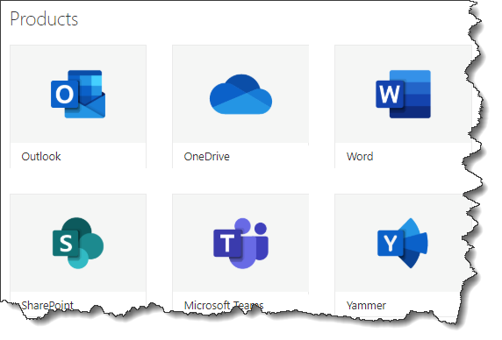
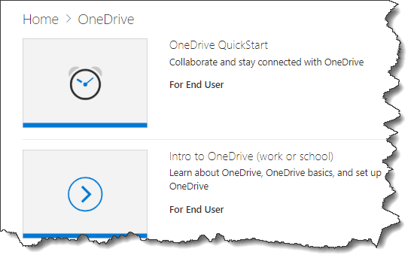
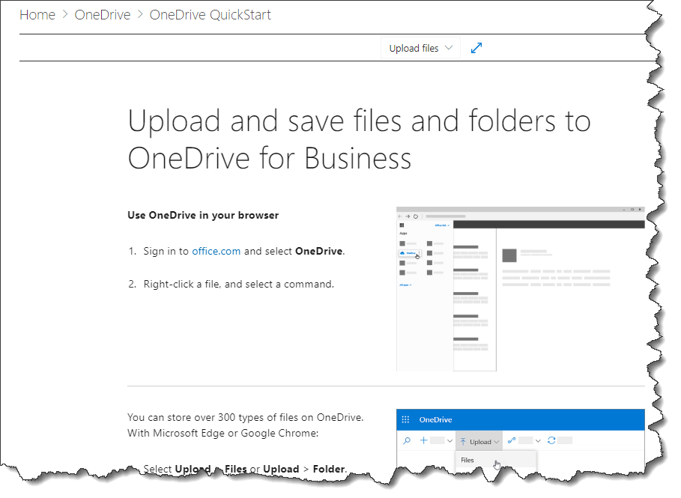
Learning pathways terminology End user perspective
Product
Playlist
Asset (learning unit)
Notes:
From an end user perspective, the first thing they see when they go to the training page in the learning pathways portal is a list of Microsoft 365 products. Once they click on a product, they see a number of playlists available for that product. When a playlist is picked, all the assets (learning units) included in that playlist are shown.

Slide 22
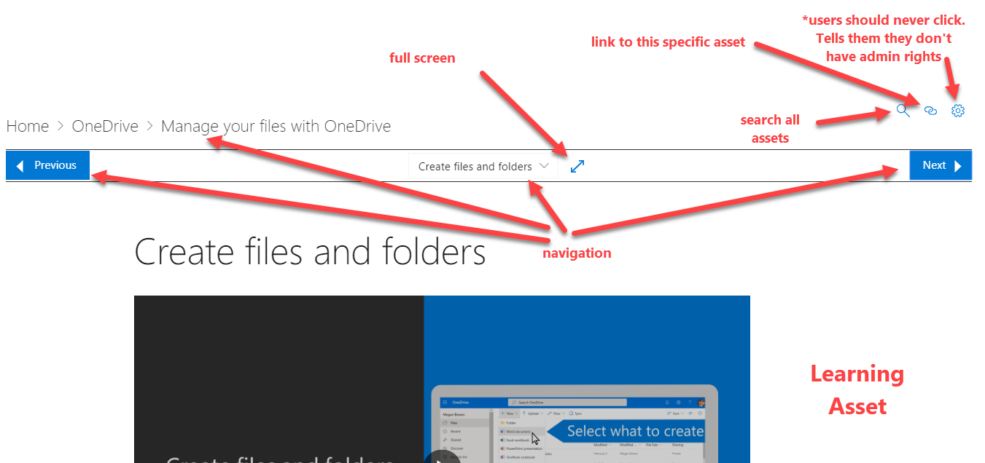
The Anatomy of an Asset
Notes:
An asset (learning unit) has many navigational and search components.
The gear should never be clicked by the users. It takes them to a page which basically tells them that they don't have admin rights to see that page. A bit frustrating.
Unfortunately, the gear cannot be hidden so this just must be explained to users to not click it to avoid disappointment.
Deep linking to assets available. Don’t take the link from the address bar and send it… it won’t work.

Slide 23
End user’s perspective
Users start their journey by visiting the learning pathways site
Navigate to the training page > product > playlist > asset
Ability to navigate and search assets as needed
Caveats
Browser back and forward buttons don’t work as expected while using MLP
Linking to specific asset needs to be learned and isn’t logical
Video showing learning pathways from the user’s perspective:
https://www.youtube.com/watch?v=bmTAQzpi3qY
Notes:
An end user would start by going to the learning pathways site and then from there going to the main landing page where all the products are listed. Then she would select the product that she is interested in learning more about and would be presented with the available playlists for that product. Once she clicks on a playlist, the first asset for that playlist is shown. From there, she can navigate to other assets in the playlist.
A couple of main caveats to be aware of:
The regular browser back and forward buttons do not work as expected when navigating assets within learning pathways. For example, when a user navigates from one asset to the other and then they click on back to go to the previous asset, instead of them going back to the previous asset, they will end up on the main product training page. The reason for that is that the learning assets have their own navigation within the page. That navigation must be used by the users instead of the browser navigation which will be a transition from regular user behavior.
The regular links that show up in the browser cannot be used. Meaning, a user cannot simply take the link they see in the browser address bar and send it to someone else thinking that they would arrive at the same page that they are looking at by following that link. That does not work for the same reason as the browser navigation does not work. Instead, to find a link to an asset, the link icon must be clicked and only then the link to that asset appears.

Slide 24
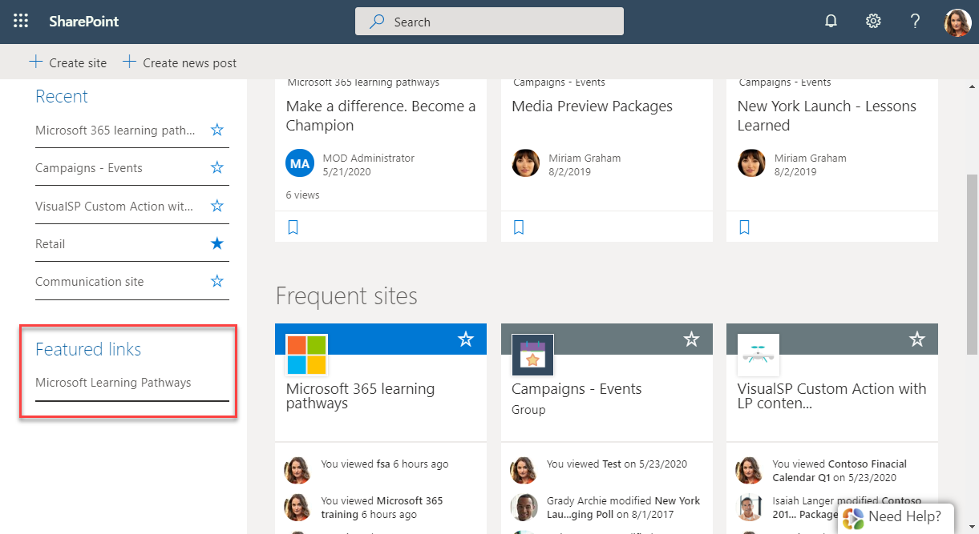
Getting people to the learning pathways site
Link to the site from your site navigation top link bar
Featured link on SharePoint page
Encourage folks to bookmark the site
Notes:
You want to allow users various ways to be able to get to the learning pathways site.
Within SharePoint, you can put the link to the learning pathways site from the top link bar of your site navigation. Since there is no global site navigation built in within SharePoint, you will need to do that for all the different sites where you want users to be able to have access to the learning pathways portal.
You can also put a link to the learning pathways portal as a Featured Link on the main SharePoint landing page. That way, the link will always be available to users when they go to that landing page.
If you want your users to always have access to get to the learning pathways portal, it would be advisable to encourage them to save it as a bookmark. Specially if you want them to be able to access learning pathways when they are in a different Microsoft 365 application such as Planner, Teams, OneDrive and other places like that where you cannot put your own links within those applications.

Slide 25
Deploy learning pathways on other sites
Add the Microsoft 365 learning pathways app to your site
Deploy Microsoft 365 learning pathways web part to any page on that site
Customize the web part as needed – show all products, single product, single playlist, or single asset
Video showing how to deploy learning pathways on other sites:
https://www.youtube.com/watch?v=hZynh8fcPU0
Notes:
When Microsoft learning pathways gets installed as a communication site, the web part that displays the learning pathways component is only available at that site.
In order to deploy the learning pathways web part to a different SharePoint site, you would need to first deploy the app to that other site and only then you can deploy the web part on that site and show learning pathways content to users.

Slide 26
Usage reporting

Slide 27
How do I know if learning pathways is helping my users?
Usage reporting is available for the SharePoint communication site that hosts learning pathways
Shows generic info such as number of unique viewers, site visits, site traffic insights, type of devices used to navigate the site, and pages most viewed
Video showing usage reporting options available for learning pathways:
https://www.youtube.com/watch?v=hZynh8fcPU0
Notes:
The usage reporting / analytics for learning pathways is only available by looking at the actual usage of the SharePoint communication site that hosts learning pathways. There is no separate analytics that's available for learning pathways content specifically.

Slide 28
Updating

Slide 29
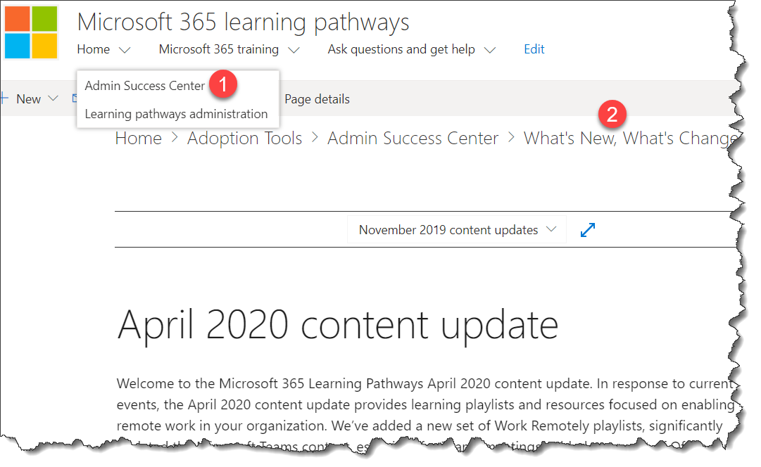
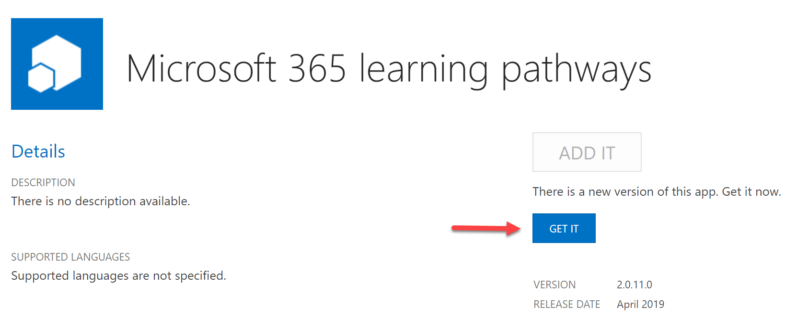
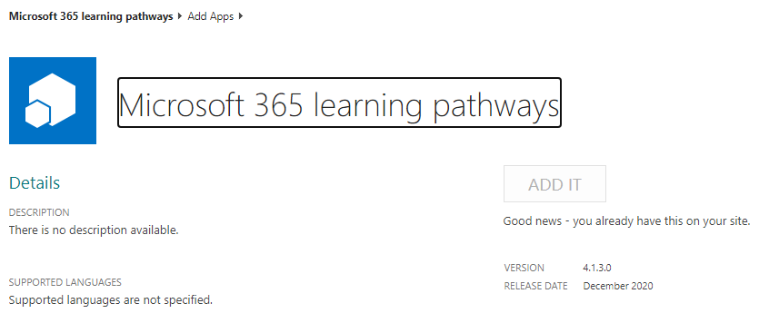
Updating learning pathways
Content is updated automatically – usually on a quarterly basis
Update info available at Home > Admin Success Center > What’s New, What’s Changed
Application update is done manually
Site contents > Microsoft 365 learning pathways > Details
If a new version is available, you will see a GET IT button
Notes:
The content for learning pathways is automatically updated so you don't really have to do anything.
The application that runs learning pathways is a different story. You need to make sure to keep the application updated by checking the version and making sure it's up to date.

Slide 30
Roadmap

Slide 31
Ver. 4.0
Language support for 9 languages:
English
Chinese (Simplified)
French
German
Italian (Italy)
Japanese (Japan)
Portuguese (Brazilian)
Russian (Russian)
Spanish
Notes:
This version has support for 9 languages altogether (including English).
You can provision a learning pathways site in a different language.

Slide 32
Better Together Microsoft’s Partner Story

Slide 33
Building on top of learning pathways
Learning pathways is a solution, not a product
Partners build on top of learning pathways and provide products to complete the story
VisualSP is one of those partners
Notes:
Because learning pathways is a solution and not a product, Microsoft partners are encouraged to build on top of the learning pathways open source solution.
There are still many gaps within learning pathways and opportunities for enhancements where partners come in to complete the story for customers who need a more complete solution for their users.
VisualSP is a Microsoft partner which builds on top of the learning pathways solution and provides it to their customers as a fully baked product that they can deploy quickly and easily.

Slide 34
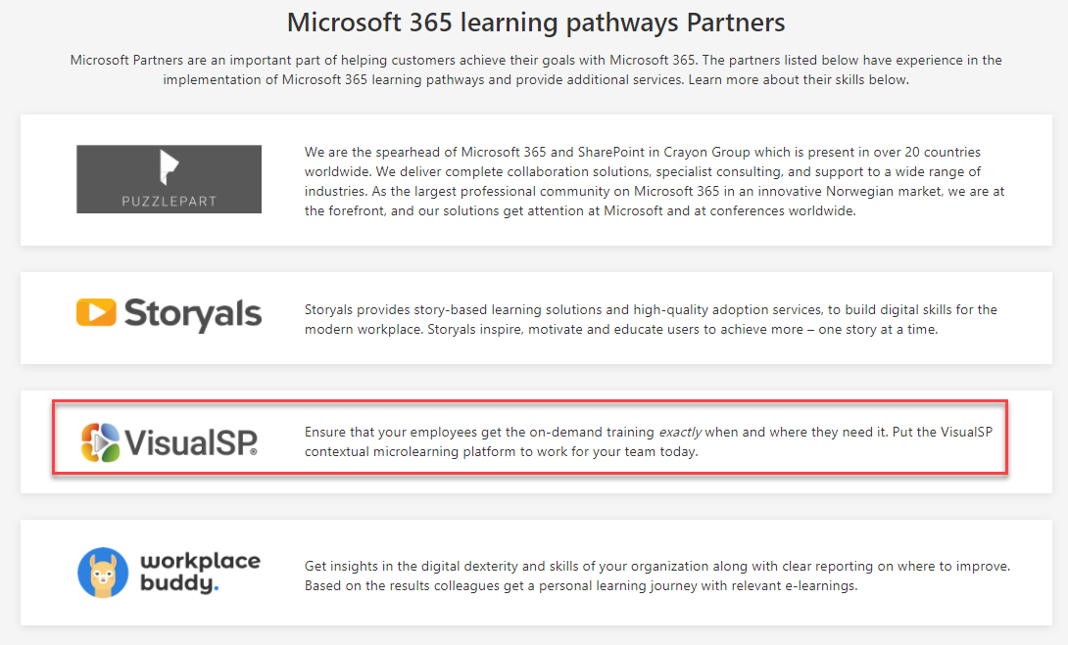
Notes:
VisualSP partners with Microsoft 365 learning pathways to provide a customizable supported product and services built around the learning pathways content.
https://adoption.microsoft.com/microsoft-365-learning-pathways/

Slide 35
VisualSP + Microsoft learning pathways content A Better Together story
Over 700 videos and articles from Microsoft
Ability to customize and create your own content
100s of additional content items
Content delivered in-context to the user
Analytics of content usage
Security trimming of content
Full customer service support
+
Notes:
Microsoft learning pathways provides the articles and video content.
VisualSP puts it all together in context for the user when and where they need it and provides analytics of usage with full customer service support for our customers.

Slide 36
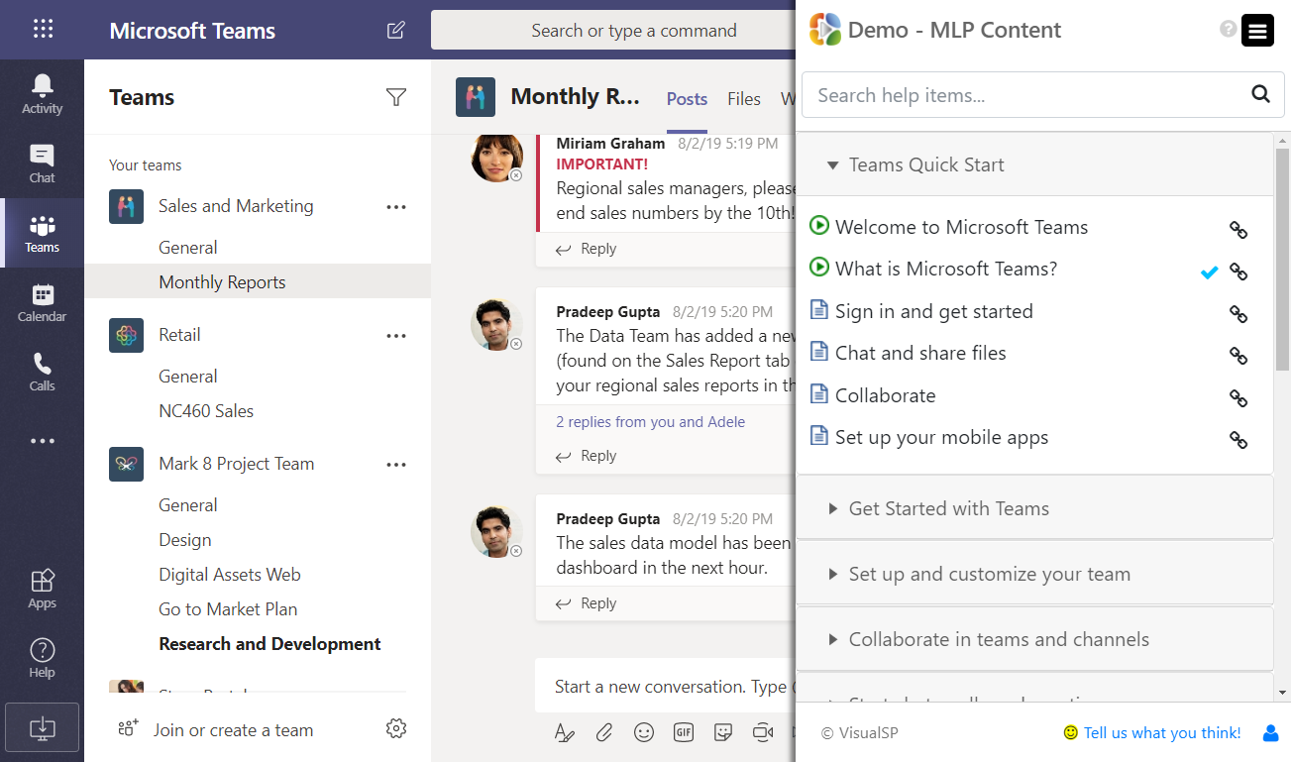
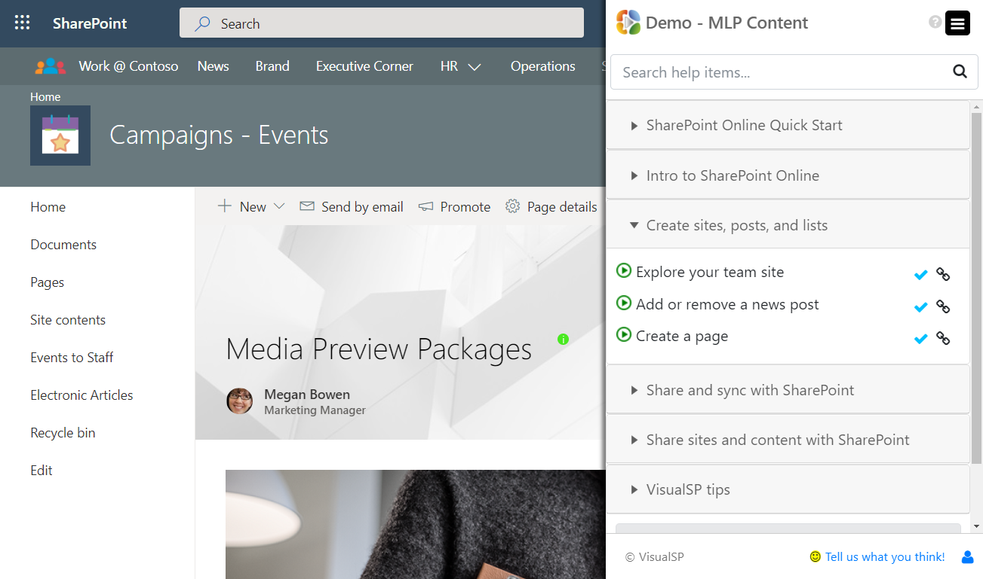
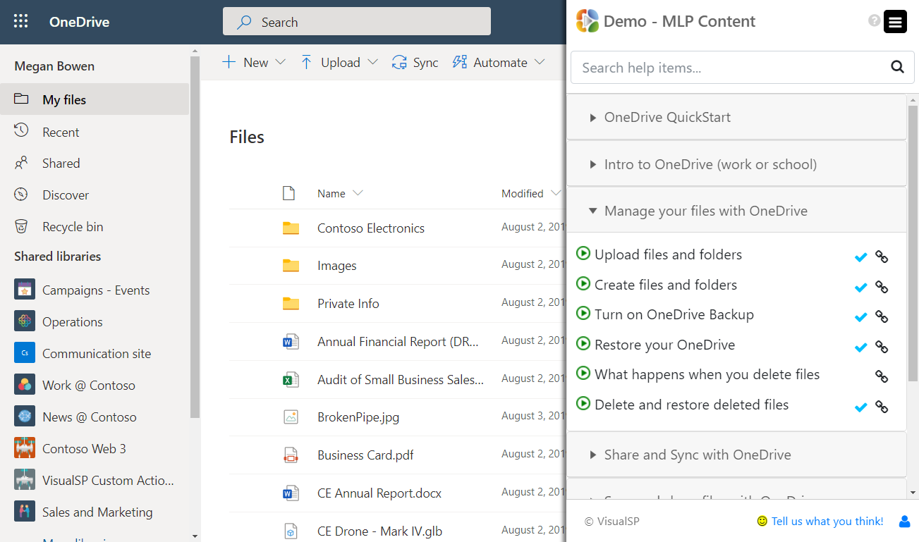
Learning Pathways content delivered in-context
Notes:
VisualSP provides a training overlay on top of Microsoft 365 applications that serves up learning pathways content contextually to the user.
So for example, when the user is within Teams, SharePoint, OneDrive, Yammer or other apps, they will see training content specific to just that app they are in. This experience makes the learning and understanding of features much easier for the user to consume instead of having to go to a communication site and look for the content that they want.

Slide 37
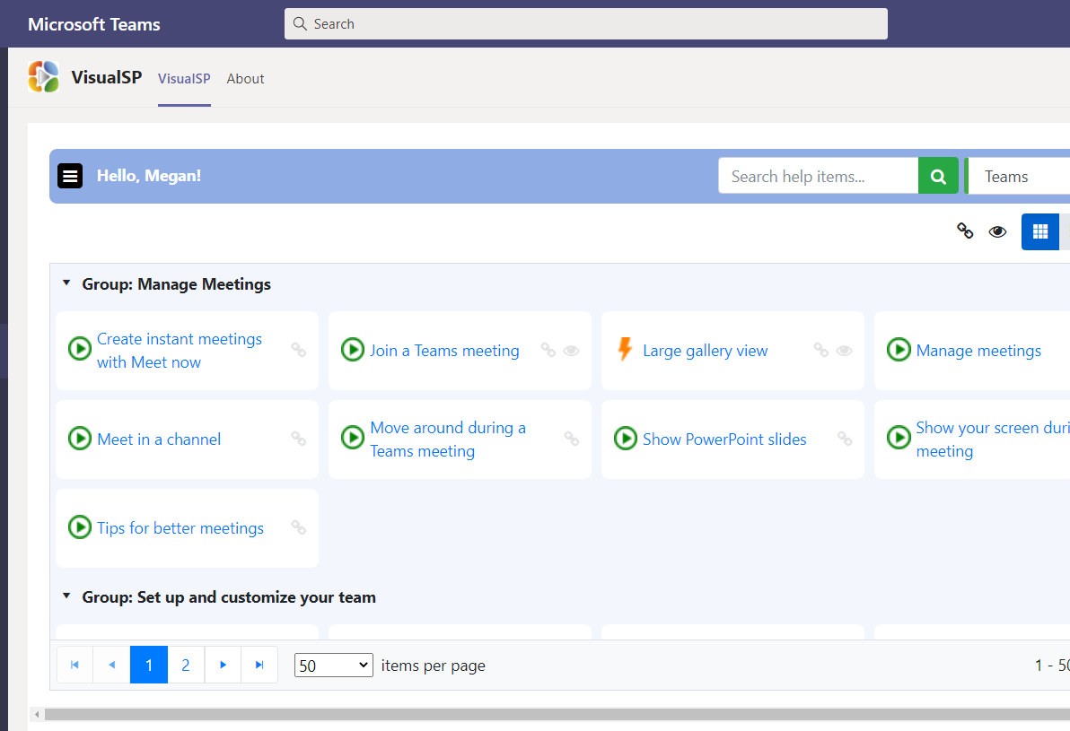
VisualSP app for Microsoft Teams
Notes:
The same learning pathways content is also available when you deploy the VisualSP Teams app for learning pathways.
The content is available directly from an icon in the left bar navigation of Microsoft Teams.

Slide 38
Learning pathways enhancement with VisualSP
VisualSP for Microsoft learning pathways
Contextual delivery of learning pathways content in all Microsoft 365 apps
Full usage reporting for learning pathways content
Not necessary to deploy and maintain a learning pathways communication site
Security trimming of content within SharePoint
Easy customization and administration of content (including creation of Walkthroughs)
Content can be pushed to users as needed
Inline icons, auto show on load
Full support for the product
Notes:
This slides shows the many features and enhancements that VisualSP provides on top of learning pathways.

Slide 39
Watch VisualSP for learning pathways in Action
Video showing VisualSP for learning pathways in action:
https://www.youtube.com/watch?v=UWxBIEJX0gQ
Notes:
The best way to experience VisualSP for learning pathways is to check it out in action.
https://www.youtube.com/watch?v=UWxBIEJX0gQ
Content contextually delivered – plug n play with all existing learning pathways as well as VisualSP content
Customize and create content easily
Autoload content for users
Create walkthroughs/tours also
See analytics of everything

Slide 40
Call to Action
Info about Microsoft learning pathways:
https://aka.ms/M365LP
Get started with VisualSP for learning pathways for free at:
https://www.visualsp.com/learning-pathways/
Connect with me if you have any questions:
@asifrehmani
asif@visualsp.com
Notes:
You want your end users to be comfortable using all Microsoft 365 applications with the best knowledge at hand.
You can start by either deploying Microsoft learning pathways by itself or you can also try VisualSP for learning pathways for free and see if that helps you get the best use out of learning pathways for your users.

