Slide 1
Cracking the User Code: How Microsoft Clarity Transforms Microsoft 365 Governance
Asif Rehmani
Microsoft MVP
asif@visualsp.com
Notes:
Want to get inside the minds of your Microsoft 365 users without relying on hit-or-miss surveys to increase user adoption? Learn how to leverage the free Microsoft Clarity product for real-time behavioral analytics along with the VisualSP help system to contextually support and train your users. Learn how to spot popular pages, dead clicks, rage clicks, and more in your environment and interpret them to improve your user training and support initiatives. By the end of this session, you'll know how to utilize heat maps, session recordings and other dashboard insights available in Microsoft Clarity to identify key areas where users struggle, ensuring your governance and compliance measures are both effective and user-friendly. Then use the VisualSP digital adoption platform to guide users using interactive walkthroughs, inline help and always available just-in-time learning.

Slide 2
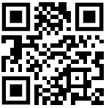
Download all my presentations and video recordings
http://bit.ly/AsifConference
Presentations on:
Organizational Change Management
Increase user adoption while decreasing support tickets
Learning in the flow of work
Blended learning
Microsoft Clarity
Microsoft Learning Pathways & Viva Learning
And more…
Notes:
My conference topics include:
Organizational change management
Microsoft Clarity
Ways to increase user adoption
Learning in the flow of work
Introduction to Dynamics 365 for the Microsoft 365 guy or gal
Microsoft Viva: what are the components of Viva and why you should care

Slide 3
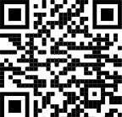
About me - Asif Rehmani
Conference Speaker
Power Platform conf
Dynamics Summit
DynamicsCon
MS Ignite
ESPC
TechCon / EduCon
Learning Conferences
And many more…
Microsoft MVP
CEO
Founder and CEO
VisualSP
Chicago, IL
Since 2007
Digital Adoption Platform (DAP) for M365 & D365
Author
My LinkedIn profile
asif@visualsp.com
www.VisualSP.com
Notes:
My name is Asif Rehmani
Founder and CEO of VisualSP – a Digital Adoption Platform (DAP) providing Contextual Microlearning to Dynamics 365 users to increase user adoption by 3X and reduce support tickets by 50%.
Been in the Learning business since 2005 as a trainer.
Speak at conferences around the world on end user training, user adoption and performance support.
Authored multiple books on Microsoft technologies for Wiley publications
Microsoft MVP since 2007.
I started my journey and SharePoint back in 2002 (when the software really sucked!). as the software became better and better and better and more popular in companies, I stuck with it training, consulting , mentoring and writing about it.
In 2016, I turned my focus to SharePoint online and then to Microsoft Office 365.
All along the way, my interactions have been with administrators, power users and end users of the software throughout the world. I see my job as empowering these folks to get the best use out of the software That their companies have invested in.
end user adoption is near and dear to my heart. I strongly believe that without proper usage of the software, it is all for nothing. Getting users on board and having them see what's in it for them is the Holy Grail that all of us should be chasing to make sure we get it right!

Slide 4
Agenda
Why you need Clarity before Governance
Introducing Microsoft Clarity
Internal organizational Clarity
Using VisualSP to remedy the issues
Notes:
Before you can provide governance for your Microsoft 365 or any other applications for that matter, you need to have clarity. And that's exactly what Microsoft Clarity provides.
Once you have clarity, you want to remedy the situation that you discovered. And that's exactly what VisualSP provides. That's the focus of this presentation.

Slide 5
What is Microsoft 365 Governance
“A framework of policies, roles, responsibilities, and processes that control how an organization's IT teams and business divisions work together to achieve their goals. It involves managing user access to resources, compliance with business standards, and data security.”
Notes:
This definition of Microsoft 365 Governance is directly from Wikipedia.

Slide 6
How do you “Govern” something without understanding the current state?
Notes:
How do you keep people and policies compliant when you don't understand the current behavior of your users?
You can’t “govern” what you don't understand. Understanding and empathizing with users - their frustrations, their challenges, and everything in between is a must before we even think about governance.

Slide 7
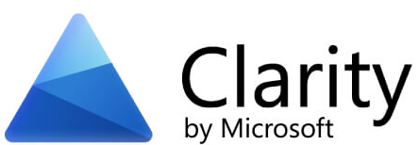
Get insights using the free Microsoft Clarity
A digital experience analytics tool
Provides insights into user behavior on your site
Features: session recordings, heat maps, dead clicks, rage clicks, JavaScript issues, etc
Fully GDPR and CCPA compliant
Notes:
Have you heard of Microsoft Clarity? If you haven't, don't feel bad. Even many Microsoft employees don't know what it is.
If you have heard of or used products like Crazy Egg, Hotjar, etc. to understand user behavioral analytics for your website, this is exactly the same thing.
The difference being that Clarity is a Microsoft product, it's completely free and it's fully GDPR and CCPA compliant!

Slide 8
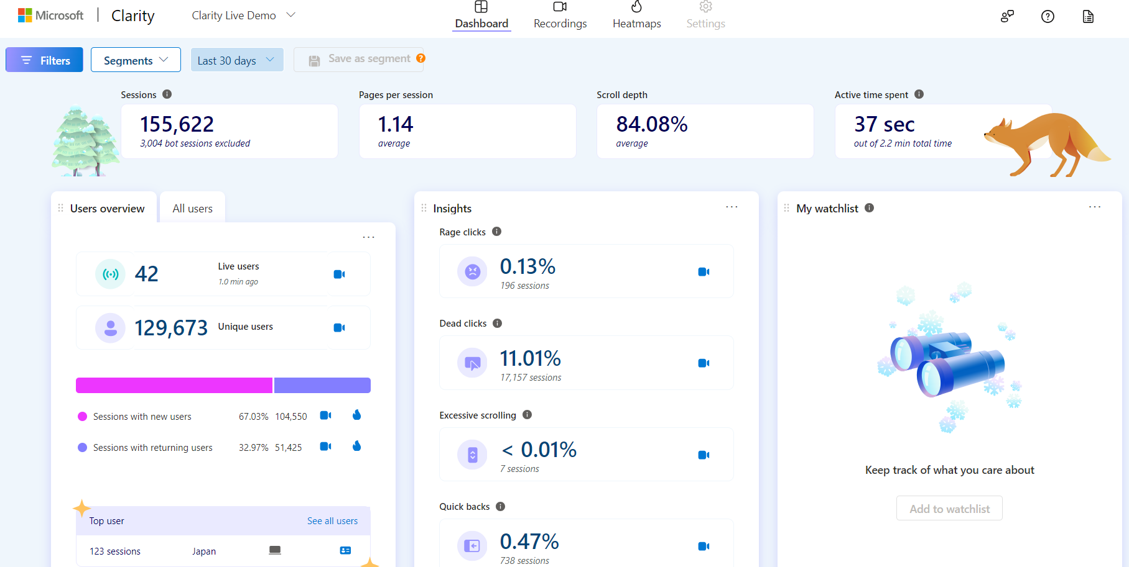
User behavior analytics dashboard (using Microsoft Clarity)
Notes:
This is a screenshot from an actual Microsoft Clarity dashboard showing the top insights into a website.

Slide 9
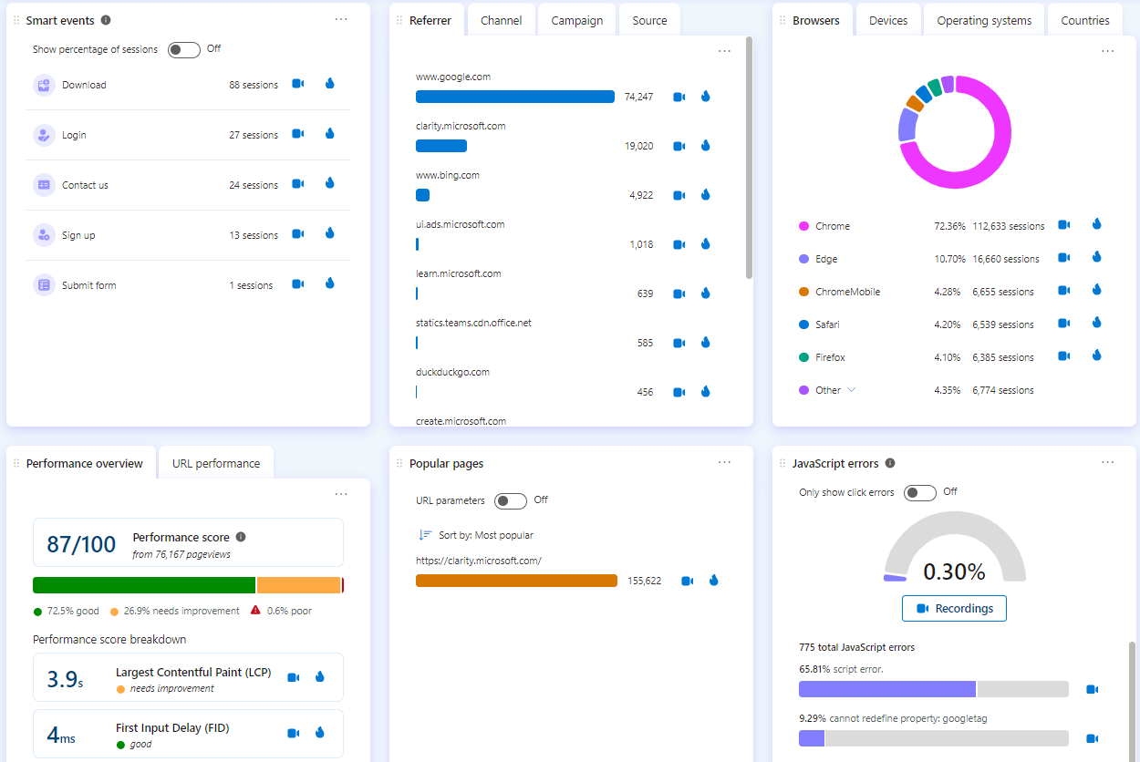
Notes:
And here is the rest of the Clarity dashboard…

Slide 10
User Behavior Analytics (UBA)
Digital marketers have been using user behavioral analytics for a long time
Understanding how users interact with digital products
Helps build cohort data that can help with
Building campaigns
Retention
Conversions
Customer acquisitions
Improving customer satisfaction
Notes:
This is not new functionality. User behavior analytics have been observed by marketers for decades in some shape or form.
Understanding cohort data and analyzing it to build marketing campaigns, user retention and conversion information, strategies for customer acquisition and more have been tactics that digital marketers have been using for a long long time.

Slide 11
Microsoft Clarity vs Google Analytics
Microsoft Clarity
Google Analytics
Comprehensive tracking solution
Detailed reports
Conversion tracking
Traffic analysis
Free
Heat maps, session recordings
Identify friction actions and areas
UX insights
Free
Notes:
The question will inevitably come to mind: how is Microsoft Clarity different than Google Analytics?
While Google Analytics is incredible for analyzing traffic acquisition patterns and doing detailed reporting and analysis, Microsoft Clarity is a fantastic tool for user experience insights.
With Clarity you can watch recordings of how your visitors interacted with your site and see with your own eyes where they get confused or angry. When you can identify these friction points, you can fix and remove barriers to site performance.

Slide 12
What if you could use UBA for your Microsoft 365 users?
And also Microsoft Dynamics if you have that…
Notes:
What has not been done much is using the same type of user behavioral analytics for your internal applications such as SharePoint, Microsoft 365 apps, Dynamics, etc.
Wouldn't that be cool if you could analyze employee/user behavior the same way that digital marketers have been analyzing website visitor behavior?
Well, you can. By deploying Microsoft Clarity on your control applications.

Slide 13
Clarity on top of Microsoft 365 applications
Track feature usage
Pinpoint trouble spots
Assess impact of your training and support programs
Uncover hidden usability issues
Identify hard to find bugs
Notes:
With Clarity on top of your Microsoft 365 applications, you can truly uncover user behavior that lets you identify things you could never do with a simple survey.
Wondering if the new functionality you rolled out is actually being used?
Having trouble understanding what your users are complaining about since you're not able to reproduce their usability issues and bugs?
Struggling to show evidence of if your training and support programs are actually working?
You can do all of this and whole lot more by deploying Microsoft Clarity on top of your Microsoft 365 applications. In fact, you can do the same thing by deploying Clarity on top of many internal applications.
It almost feels like you are reading your user's minds and in a sense you are 😊

Slide 14
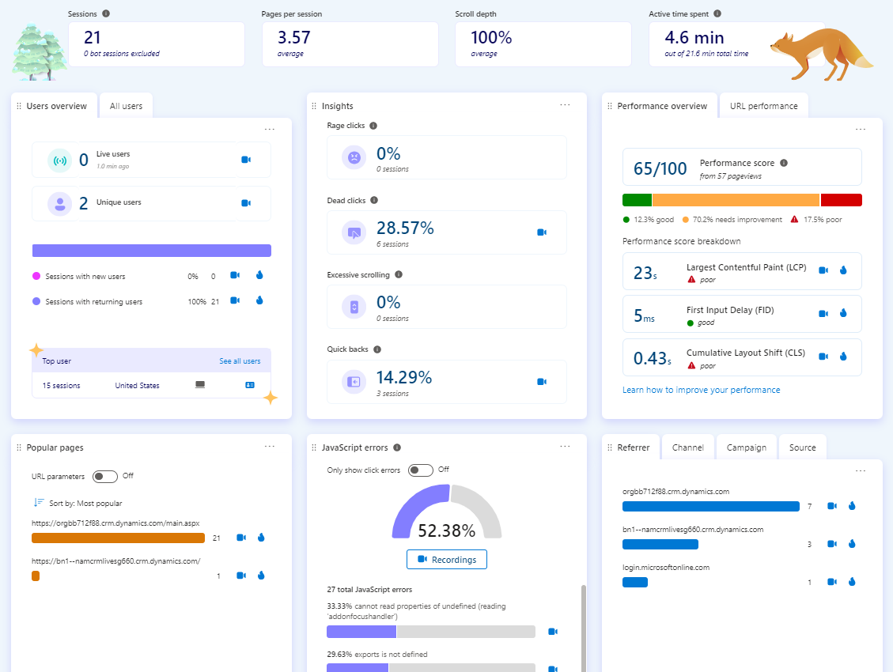
Clarity for your M365 apps
Notes:
The image in this slide shows a sample of what a Clarity dashboard will look like once you deploy it on top of your Microsoft 365 environment.
You'll be able to see if there are any current live users on your applications, who are your top users, if users are struggling by clicking on areas on pages that are not meant to be clicked, if they are quickly clicking on the back button after arriving at a specific location, what the performance of your site looks like, what are the popular pages, if there are any JavaScript errors that are occurring on your apps, and so much more…

Slide 15
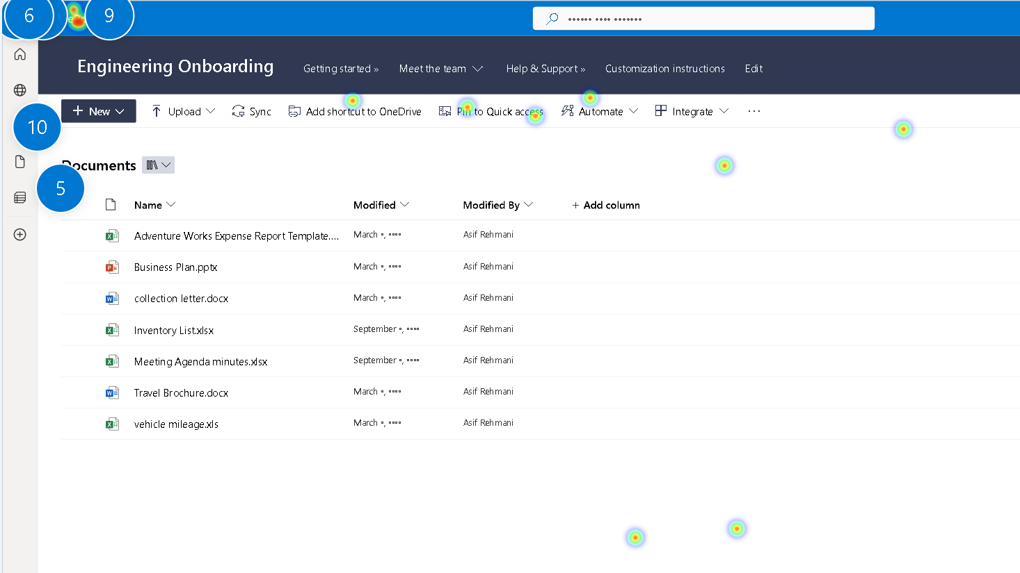
Heatmap of a SharePoint page
Notes:
This slide shows a sample screenshot of a document library within a SharePoint site.
You can see the heatmap areas where people have been clicking the most. You can also see specific elements which are being clicked by ranking.
This type of heatmap is a pretty popular feature used through Microsoft Clarity. Keep digging and you'll find a lot of good insights about your users through using Microsoft Clarity.

Slide 16
Once you know the problem areas, use VisualSP to provide user support mechanisms
Notes:
https://www.youtube.com/watch?v=Tj9LJSTPlvQ
Reduce IT support tickets by providing Tier 1 support to your users.
A plug ‘n play solution to provide base training for Microsoft Office 365, Dynamics 365 and custom training on your enterprise apps for everything else.
The VisualSP help system is available wherever your users go. It provides the answers they need at their moment of need. Over 1,400 pre-built help items on Microsoft Office 365 and Dynamics 365 CRM are delivered out of the box on day 1 so you don't have to start from scratch building out the content. You build and maintain the help content that is specific to your business needs.
Content provided by VisualSP is always automatically up to date so you don’t have to worry about keeping the fundamental content updated. Ohh
Complete analytics and usage reporting.

Slide 17
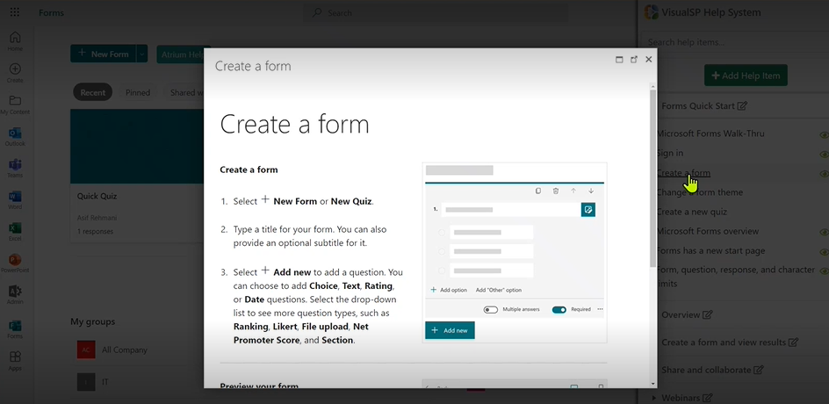
Quick Tip Sheets
Notes:
Provide quick tip sheets which answers the main questions your users have without them switching context.

Slide 18
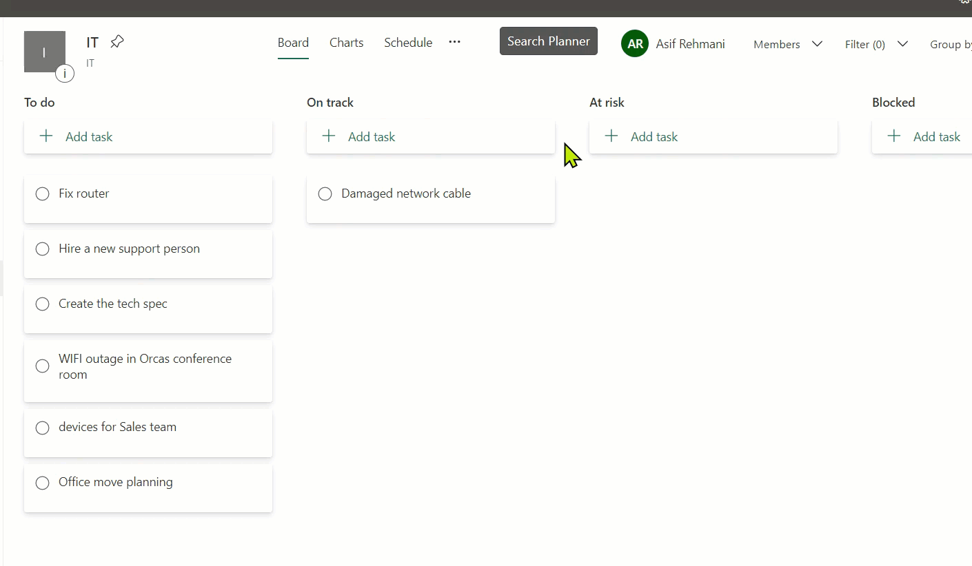
Guided Walkthroughs
Notes:
Custom guided walkthroughs like you see on the Internet now on your internal applications. Create them by simply clicking on interfaces without doing any coding whatsoever.

Slide 19
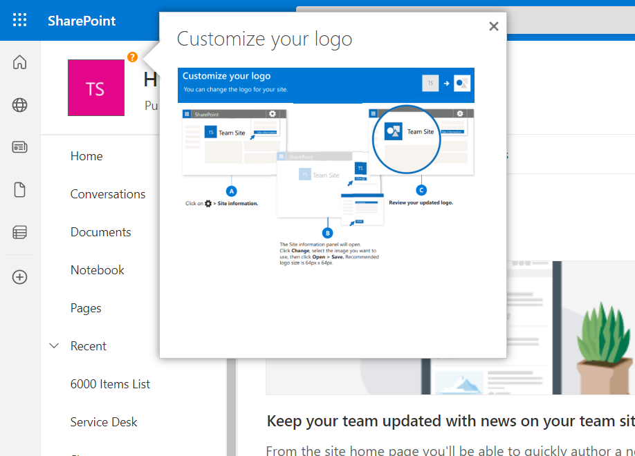
Inline Help
Notes:
Create inline help bubbles, buttons and links that when clicked or hovered over bring up information you want your users to see about specific visual elements on the page.

Slide 20
Let’s Dive In…
YouTube playlist of Microsoft Clarity for enterprise web applications
Notes:
Check out the YouTube playlist of Microsoft Clarity that brings to life examples of what you can expect to see when Clarity is deployed.

Slide 21
Adding Clarity to SharePoint and other M365 Apps
You have 2 Options
1) Deploy Clarity for SharePoint
Done by yourself
2) Deploy Clarity for SharePoint and M365 apps and All other internal apps And assist your users with in-app support
Through VisualSP
Notes:
You have a couple of options to deploy Microsoft clarity to SharePoint and other Microsoft 365 applications.
1) Add only to SharePoint:
https://learn.microsoft.com/en-us/clarity/third-party-integrations/sharepoint-integration
2) Add Clarity to All Microsoft 365 apps, SharePoint and any other internal enterprise web application using VisualSP:
https://visualsp.com/blog/microsoft-clarity-installation/
Take advantage of the free offer from VisualSP to deploy Clarity on top of your applications.

Slide 22
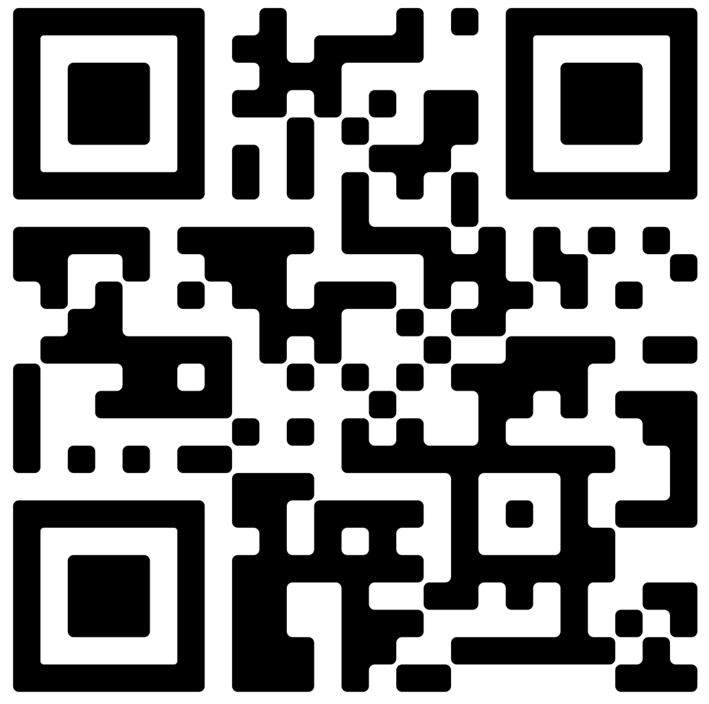
Next Steps
Get started with the Microsoft Clarity guide and checklist (Scan QR code →)
Reach out to me with your questions on context sensitive support and training for your users
asif@visualsp.com
Digital Adoption Platform for All web applications
Notes:
Start by grabbing the Microsoft Clarity guide and checklist using the QR code on this slide.
Feel free to reach out to me, Asif Rehmani, at my email address or message me on LinkedIn. I Love hearing from like minded folks.
The long URL where I upload All of my presentations:
https://info.visualsp.com/download-conference-presentations-1

