Slide 1
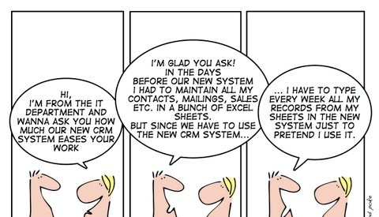

Slide 2
A DYNAMICSCON PRESENTATION
LIVE.DYNAMICSCON.COM

Slide 3
5 Steps for Driving Sustainable Dynamics 365 CRM User Adoption
Presented by:
Asif Rehmani, MVP
VisualSP
Notes:
This is not going to be a technical session but without the session the technical stuff is not worth it either.

Slide 4
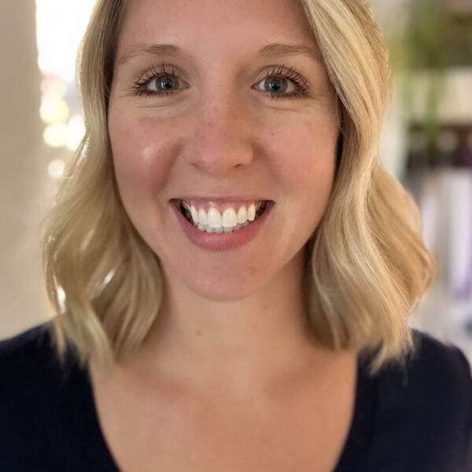
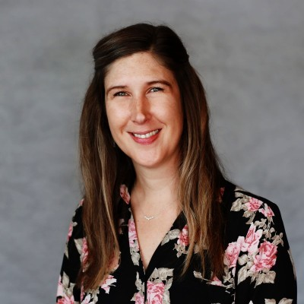
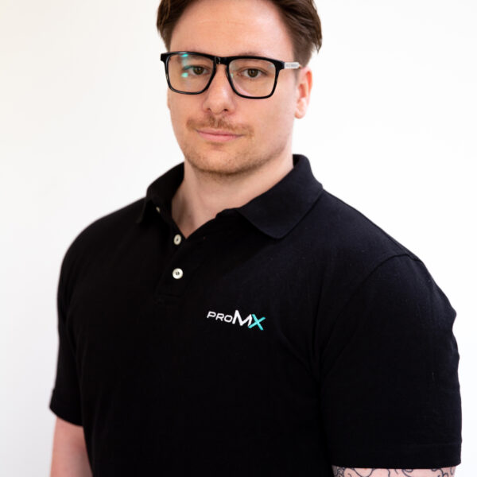
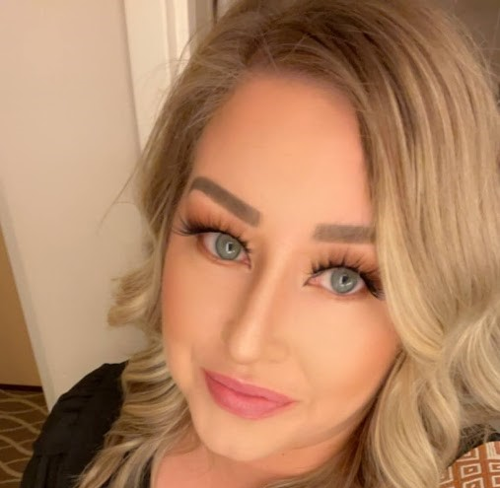
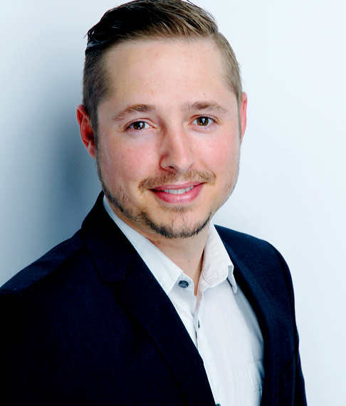
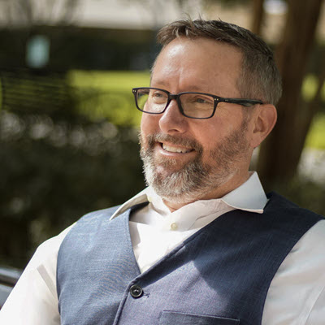
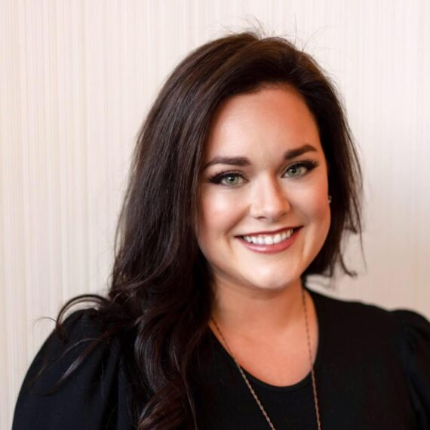
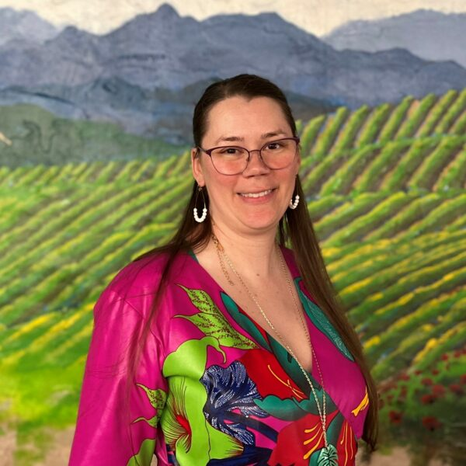
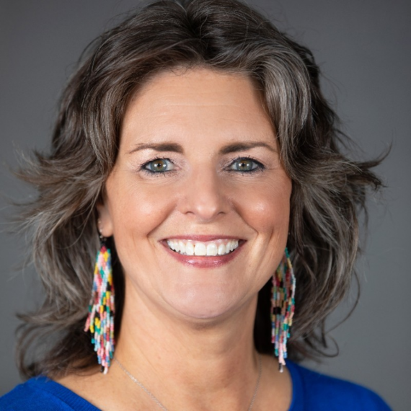
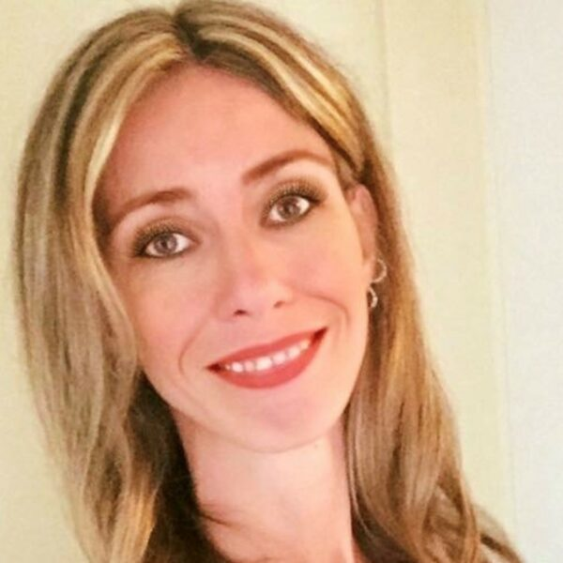
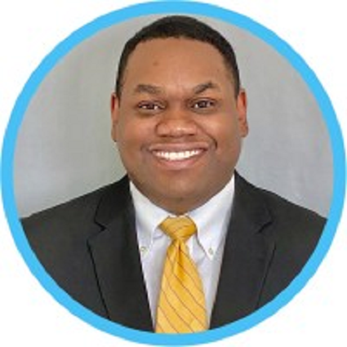
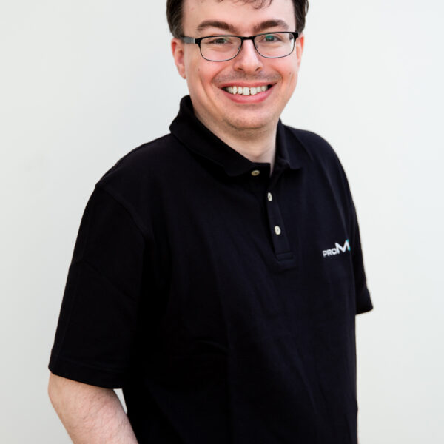
Dynamics 365 CE/CRM Presenters at DynamicsCon Live
Notes:
Lots of awesome presenters

Slide 5
Great Dynamics 365 CRM session topics being presented at DynamicsCon Live!
Sales
Marketing
Customer Service
Field Service
Project Operations
But none of this knowledge will do us any good if we're not able to get our users to use these products effectively.
Notes:
You can build solutions all day long but if nobody uses them then there is no point on building any of them.

Slide 6
Are you thinking about any of the following?
I put so much work in making our Dynamics environments are great performing and looking, but end users don’t seem to care
We have been doing ‘adoption’ type activities for a while without seeing much benefits
We have provided so much training and content to people, but I don’t see people using it. They are still always coming to me for help
If Yes, Great! This session is for You!
Notes:
If any of these points or similar is true then this is the right presentation for you.

Slide 7
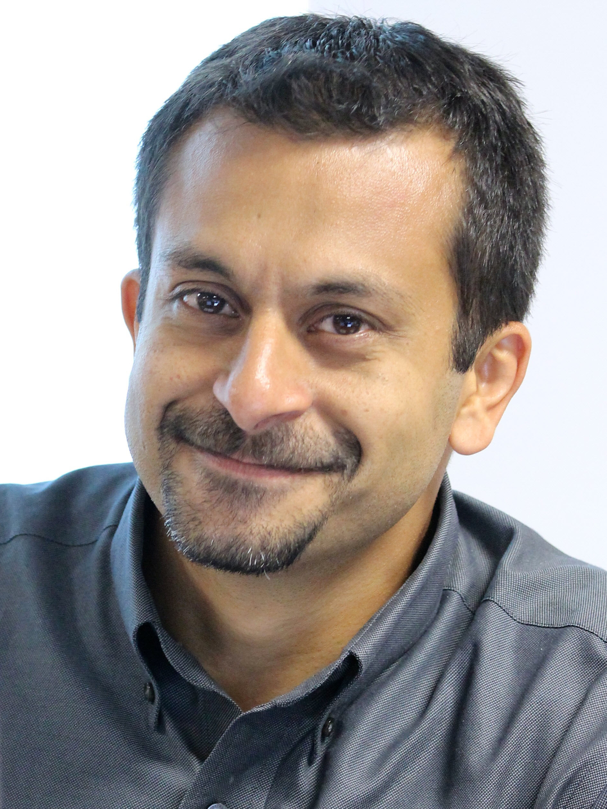
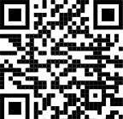
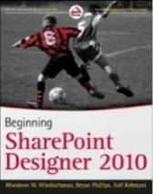
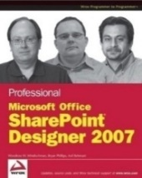
About me - Asif Rehmani
Conference Speaker
MS Ignite
Dynamics Summit
DynamicsCon
ESPC
365 EduCon
TechEd
Learning Conferences
And many more…
Microsoft MVP
CEO
Founder and CEO
VisualSP
Chicago, IL
Since 2007
Digital Adoption Platform (DAP) for M365 & D365
My LinkedIn profile
asif@visualsp.com
www.VisualSP.com
Author
Notes:
My name is Asif Rehmani
Founder and CEO of VisualSP – a Digital Adoption Platform (DAP) providing Contextual Microlearning to Dynamics 365 users to increase user adoption by 3X and reduce support tickets by 50%.
Been in the Learning business since 2005 as a trainer.
Speak at conferences around the world on end user training, user adoption and performance support.
Authored multiple books on Microsoft technologies for Wiley publications
Microsoft MVP since 2007.
I started my journey and SharePoint back in 2002 (when the software really sucked!). as the software became better and better and better and more popular in companies, I stuck with it training, consulting , mentoring and writing about it.
In 2016, I turned my focus to SharePoint online and then to Microsoft Office 365.
All along the way, my interactions have been with administrators, power users and end users of the software throughout the world. I see my job as empowering these folks to get the best use out of the software That their companies have invested in.
end user adoption is near and dear to my heart. I strongly believe that without proper usage of the software, it is all for nothing. Getting users on board and having them see what's in it for them is the Holy Grail that all of us should be chasing to make sure we get it right!

Slide 8
Almost x% of CRM projects fail to meet expectations
ⓘ Start presenting to display the poll results on this slide.

Slide 9
Almost 50% of CRM projects fail to meet expectations
#1 Challenge: User Adoption
CRMs are Very customizable so it’s always unique to a company
No off the shelf training can be provided to users
Users struggle when they have questions
CRMs continue to evolve as SaaS vendors as well as your company makes changes to it
Notes:
Organizations migrate from CRM to CRM thinking that the system is the problem. That's rarely the case.
The real issue almost always is a lack of user acceptance of the system.
Taking the example of Dynamics CRM specifically…
Dynamics 365 is overwhelming because it's too flexible and customizable. Looks too non-standard when it's all said and done and implemented and looks different for every organization.
The built-in help in Dynamics is useless and not customized for your needs. No persistent help or training system to help users.
----
Most CRM projects fail. Sources:
https://www.stravatechgroup.com/2018/04/10/why-microsoft-dynamics-crm-365-projects-fail-a-microsoft-partners-perspective/
https://www.linkedin.com/pulse/why-70-all-crm-projects-fail-how-yours-one-them-anne-guethoff/?articleId=6662379840106188800

Slide 10
The usual Dynamics 365 CE implementation
The internal team or a Microsoft partner creates the Dynamics environment for the company based on their needs
When the environment is being deployed, a training is conducted for the future users
The recording of the training as well as any documentation is provided to the users for future reference
Notes:
When a company is looking to implement Microsoft Dynamics 365 CE, they either do it with internal resources or hire an outside party to create and implement it for them.
Either way, usually at the end of the project, the future users of this system are gathered together, physically or virtually, and shown the new environment.
The “training” is done on this environment for these users and they are expected to remember what they have been shown in regards to the processes that they will need to conduct to do their job.
The recordings of these trainings are hosted either in SharePoint, MS Teams or Stream or just the regular file share and links to those are shared with the users for future reference. If the users are lucky, additional documentation or short videos are also produced or procured and shared with them so they can refer to that more quickly as the need arises.
Whatever the case, the users are then left to their devices to “figure it out” or ask someone when they have questions.

Slide 11
User adoption does not have a Begin and End date
Be prepared for the journey…
Notes:
User adoption is not a project. You can't just tackle user adoption within a set period of time.
User adoption is an ongoing effort. But it's worth it. If you are consistent in your quest to increase user adoption, users will love you for it because you will be showing them What’s In It For Them and why they should care.

Slide 12
User Adoption as a Service (UAaaS)
Treat User Adoption as a Service and not as a Project
Notes:
UAaaS (yes… I’m aware how that sounds 😆) is an ongoing way of supporting users to help them do their job.
The more you can automate, the better it will be … for You and for Them.

Slide 13
Get Executive Buy-In
Notes:
Without executive sponsorship and buy-in, you might as well forget about your initiative to achieve sustainable user adoption. It just doesn’t work if you don’t have at least one executive sponsor.
An executive sponsor needs to be at a pretty high level in the organization – at least a Director or above and a business decision maker

Slide 14
The necessity of a project executive sponsor
Prioritization of budget and resources
Embracing the shift in processes and culture
Authority and influence of the project sponsor helps break down barriers and overcome resistance
The sponsor can lead by example actively using the software and demonstrating benefits to others
Notes:
In order to get the right resources - both human and material - you need an executive sponsor.
In addition to the resources, you need backup and support of a person who has the authority and respect of other leaders in the company as well as your colleagues.
You will need this person every step of the way to lead by example actively using the software you are championing, demonstrating benefits to others and backing you up all throughout the journey.

Slide 15
Who exactly is considered an executive?
For smaller companies it's a C-level executive
For larger companies, it can be someone at the director level or above
Notes:
The definition of ‘executive’ in our case is different based on your company size.
If you're in a smaller company, you will need a C level executive backing up your initiative.
If you're in a larger company, it can be someone at least at the director level or above.
At the end of the day, you are looking for an executive that has the power and influence within the company to back up your initiatives.

Slide 16
Without an executive sponsor, user adoption is an uphill battle
Notes:
If you don't have an executive sponsor and you're trying to fight this battle all by yourself, you might as well give up now.
Without the proper backup from the higher echelon of the company, it is going to be almost impossible for you to make an impact unfortunately.

Slide 17
Create a governance board with the executive sponsor
The composition of the governance board:
The Executive
System Administrator(s)
Influencers from each department – sales, marketing, customer service
You!
Notes:
Having a formal designated governance board if possible is a big plus.
You want representation from the executive sponsor, system administrators, influencers / power users from each department and yourself.

Slide 18
Charter of the governance board
Meet monthly
Create and maintain best practices (told with stories ideally)
Assess upcoming Dynamics release waves
Assess user behaviors to determine where they are getting stuck
Evaluate Microsoft provided or third-party solutions that would facilitate user adoption
Notes:
It would be best for this governance board to meet monthly.
The agenda of the governance board has to be grounded in what is going on currently and what's coming up on the horizon.
You want this team to decide on future direction way before it's time to execute so you are not in reactive mode.
The governance board also should be collecting stories of best practices demonstrated by individuals or teams in the company. These stories should be documented and available to others so they can learn from example.
For example, how a deal worth $60,000 that was lost years ago was revived by a salesperson looking at the meticulous notes that were kept by the previous salesperson about when the timing would be right for the buyer.
How a customer service person was able to delight a customer because of the readily available resources on hand produced by her team.
How a marketing person created a dozen e-mail templates based on best practices in the industry that resulted in $1,000,000 in revenue over 3 years.
Stories like these exist everywhere and that's what inspires people.
This board also needs to find ways to extend their Microsoft Dynamics implementation for better user adoption and support with either homegrown solutions or third party solutions.

Slide 19
Keep It Simple - Start With a Major Pain Point to Solve
It’s Always about WIIFM -
(What’s In It For Me?)
Notes:
You could roll out the best system in the world but if users don't understand what's in it for them then nothing will matter.
When designing the system, it cannot be based on what the IT department think is best. The interfaces and processes have to be laid out to be the most conducive for the users of the system.
Radio station WIIFM (What’s In It For Me).
Everyone is listening to it all the time. That’s the truth!
Finding and solving critical problems of users is what it's all about .

Slide 20
You never get a second chance to make a first impression
Notes:
If the Dynamics 365 CRM environment that users see day one is too complicated and slows down their work, chances are that they will start looking for workarounds to avoid using it.
The complicated environment is not only necessarily a busy environment. A complicated one is something that is difficult to work with and does not provide the support you need at your moment of need.

Slide 21
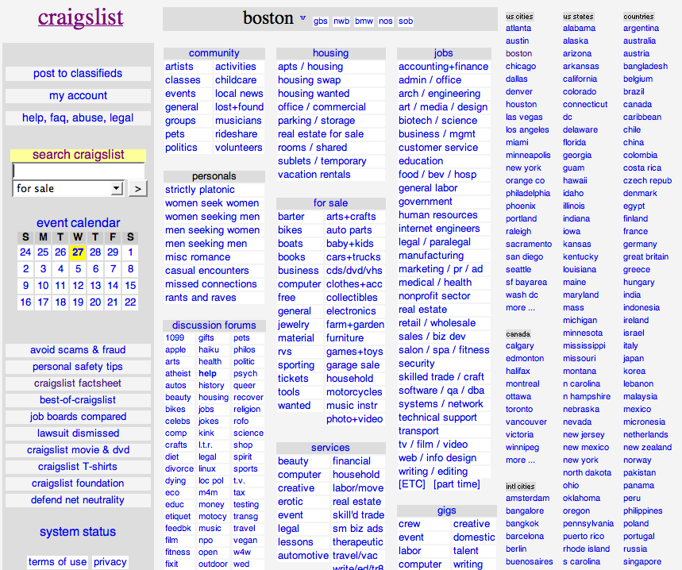
Terrible looking website
but…. Great adoption rate!
Notes:
Craigslist used to be Very popular in United States. Still is pretty popular even after so many years and so much competition.
Not because of the way it looks of course. It's a really busy looking interface and almost entirely covered with links.
It became popular because of the benefit it provides connecting buyers and sellers.
Providing simple classifieds – small advertisements organized in categories.
It started in 1995 as a way to get information to people – simply, easily and fast!
Site grew as the demand grew. They ‘listened’ to what people wanted and provided it.
With this type of an interface, they have $694 Million in revenue (as of 2016).

Slide 22
What pain point(s) can You solve for your users?
ⓘ Start presenting to display the poll results on this slide.

Slide 23
Usual pain points heard from salespeople
Too many meetings
Too much administrative work
Too much time handling customer Technical Support inquiries
Lack of standard processes
Lack of qualified leads
Lack of sufficient training and support while doing the actual work
Notes:
Salespersons often ask: “you want me to be out selling or doing administrative work and putting data into the CRM system? Because I can't do both”
Salespeople don't want to lose the personal touch with their customers.
Many times salespeople just feel that the CRM solution is too complicated - doesn't matter if it’s Dynamics or something else

Slide 24
What one major pain point can you solve for your users?

Slide 25
Pick a solution that can be built in days or weeks
This solution Must solve a Real challenge and Delight your team.
Formula for creating: Believers/Champions/Evangelists
Notes:
Doing it quickly matters!

Slide 26
Incentivize Desired Behavior of Champions and Evangelists
Notes:
Remember WIIFM…?

Slide 27
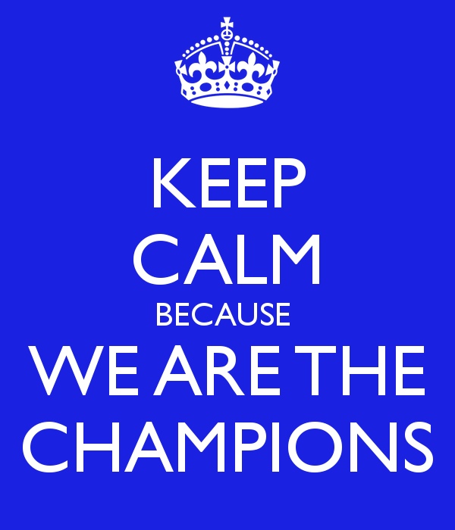
Why do you need Champions?
There’s just one of You!
You need ownership and accountability across departments
Champions help create and sustain excitement
Feedback on what is and is not working and overall sentiment regarding the changes you are implementing
Notes:
You can’t do everything. You need your own MVPs, champions, evangelists.
Decentralized Support should be provided ‘locally’ by each department/team/region, not globally by one or a couple SharePoint guys and gals.
Power Users in each group already exist that everyone looks to. Reach out and make them the champions.
Influencers always create excitement and you can get feedback from them of how things are going.
If not everyone is bought in to the idea, you will not be able to accomplish your goals. That’s why champions are needed in every business unit.

Slide 28
No need to create champions. Discover existing influencers and get them on your side.
Notes:
There’s always a person already in each department/team that is an influencer. It's best to identify that person instead of trying to get someone to become an influencer.

Slide 29
Why would anyone want to be a ‘Champion’? (additional possible titles: Champions, Evangelists, MVPs)
Money alone rarely ever truly motivates people
Increased visibility to senior management
Help define and shape business and technology roadmap
Visible distinction of honor (Bragging rights!)
Notes:
Studies have shown that money is not the main motivator for most.
Provide opportunities for exposure to senior management. Reports that go to upper management have their name on it as a contributor.
Influence technical platforms in their teams.
Impact on defining business policies throughout the company

Slide 30
Reward the behaviors you wish to see
Notes:
Filing a ticket instead of sending an ‘urgent’ message to the admin
Filling in all required fields with actual values instead of placeholders to finish later (which never happens)

Slide 31
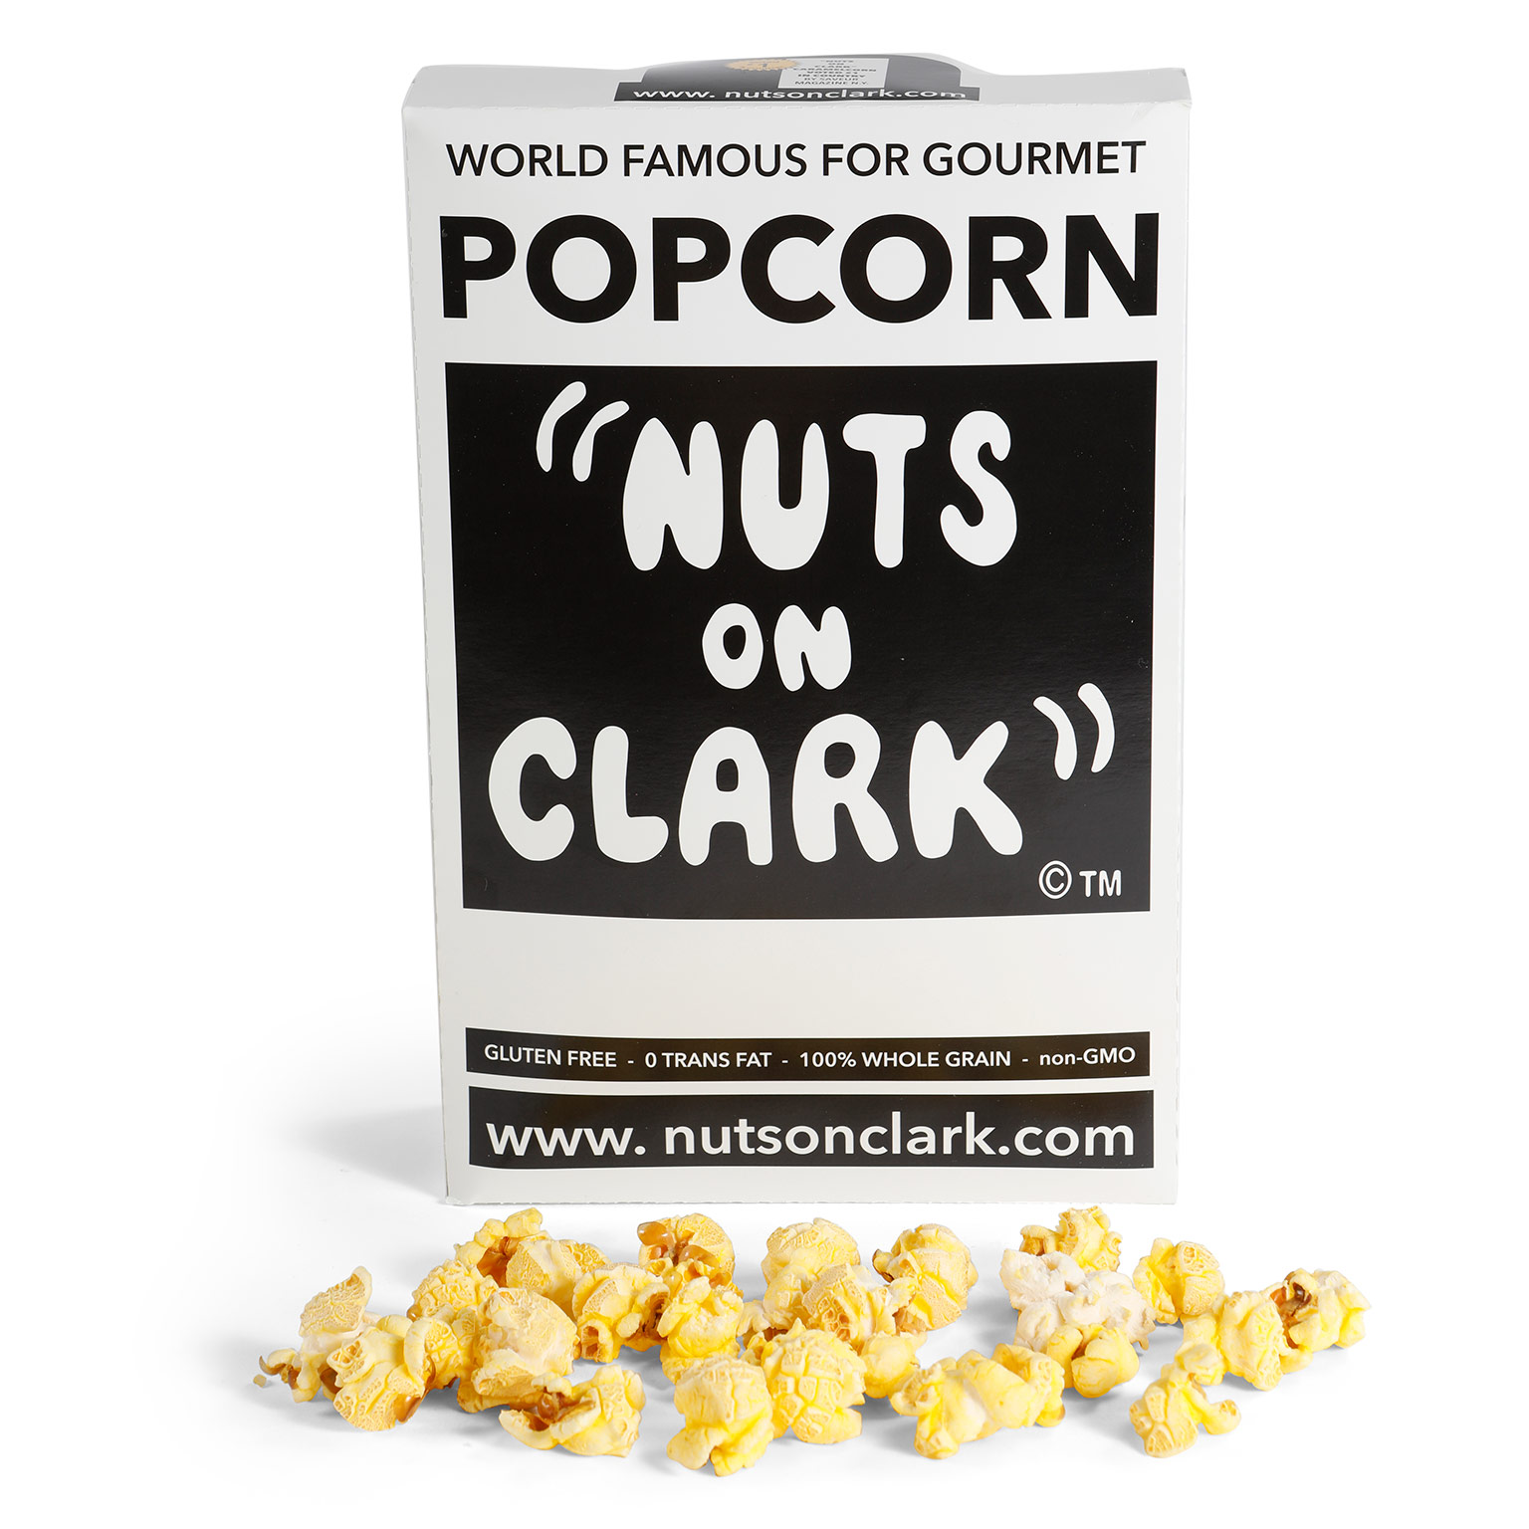
For example…

Slide 32
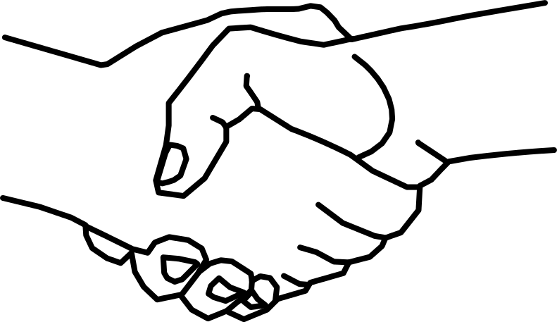
Even simple gestures go a long way
Notes:
You would be surprised how even a handshake or a pat on the back can motivate someone (although things are a bit different now in the post COVID world but you get what I mean ☺)

Slide 33
Facilitate
Peer-to-Peer Learning
Notes:
Social learning is key in today’s world.
But first… let’s talk about traditional end user training.

Slide 34
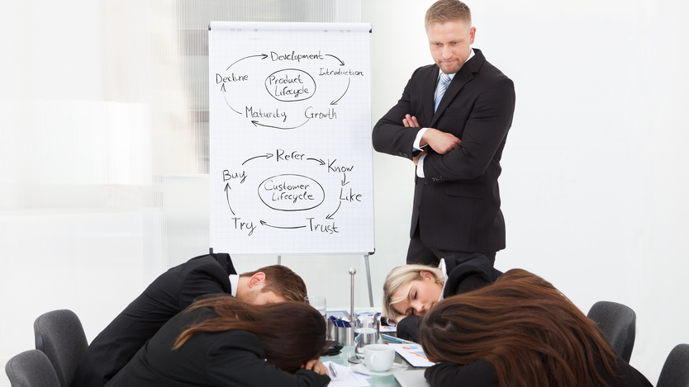
Traditional training doesn’t work for end users
Notes:
My conclusion was:
Thoroughly training end users doesn't really work.
Traditional classroom and binge learning just doesn’t work for end users. And it Never has!
We are not preparing employees to take a test. We are preparing them to help them do their job.

Slide 35
Users cannot be made to do things they don’t want to do
Notes:
Users cannot be made to do things they don’t want to do… Unless you want to take extreme measures – which for the record, I definitely do not recommend 😬

Slide 36
Do end users want to be trained… or helped?
Notes:
Do end users usually ask “Can you train me…?”
Or
“Can you help me with…?” And “Can I ask you a question…?”
The exact question and the tone of it should provide us all the information we need to know about what our end users are looking for and what they truly need.

Slide 37
Encourage
peer-to-peer learning
Notes:
Social learning is key in today’s world.

Slide 38
What are the various ways in which we can facilitate peer to peer learning?
ⓘ Start presenting to display the poll results on this slide.

Slide 39
An example of peer-to-peer learning
Keys to success:
Facilitated by (but not conducted by) the expert in the room
One person presents what they like And don’t like about some current process(es)
Held on a regular basis every other week or at least once a month
Focus on business processes and not technology
Don’t forget the free food sponsored by the company ☺
Notes:
Many folks say they have tried lunch and learn sessions in the past and they don’t work. Well, look at the format differently. Reconsider the WIIFM for attendees when conducting the lunch and learn sessions.
We did this at our company, VisualSP, with the use of Planner.
Going from simple Word and Excel sheets for task management and meeting minutes to Planner and OneNote makes things much simpler of course but we wanted to make sure it really sunk in for everyone.
Instead of hiring an expert to do this, one of our team members at VisualSP who was already good on Trello (which is a similar product to Planner) dug in and became “semi good” at Planner and then held a 30 mins orientation session for the rest of the group. It was much better than a ‘boss’ or ‘expert’ conducting this session for others.

Slide 40
Focus On Context Not Only Content
Access to content is not a challenge anymore
The new challenge is a lack of context
Notes:
The challenge used to be that we did not have access to much content. In the age of information that we live in, that is no longer the challenge. The new challenge is a lack of context:
How do we get the right information at our moment of need quickly and efficiently?
That's what we need to be solving for - for ourselves as well as for our end users.
Too much content is available these days - both good and bad. It's hard to decipher the good content from the bad (or plainly wrong) content.

Slide 41
Fragmented information hurts adoption
Notes:
Google
YouTube
Slideshare
Blogs
Quora
Pages and documents on your Intranet
Challenge:
Users are finding bad practices on how to do things creating more problems that then have to be cleaned up.

Slide 42
End Goal Get information and support to users as efficiently as possible
Context-sensitive delivery of information
Notes:
The actual information that a user needs should be brought as close as possible to them.
The information should not be on a SharePoint site or a separate portal where the user has to go looking for it.
Learning comes to the learner instead of the learner going to the learning.

Slide 43
The story of the Governance Guy
Notes:
My story about the intranet admin who wanted users to follow governance guidelines

Slide 44
Deliver governance, info and support “in-context” of the environment
Not a large governance document that no one will look at
But instead through contextual experiences
Notes:
Contextual Experiences are elements such as:
Inline help (in the form of icons, buttons, links) that are on the interface to be discovered as needed by the user
Interactive walkthroughs that appear automatically to guide the user to perform a task or give them a tour of a new interface they are not familiar with
Announcement banners at the top or bottom of the page that appear automatically targeted to the appropriate users to inform them about important information, events, etc.
A widget on the page that provides the user a way to explore their company’s knowledgebase of information
These are all types of context sensitive elements that support users naturally when they need support within their own application interface.

Slide 45
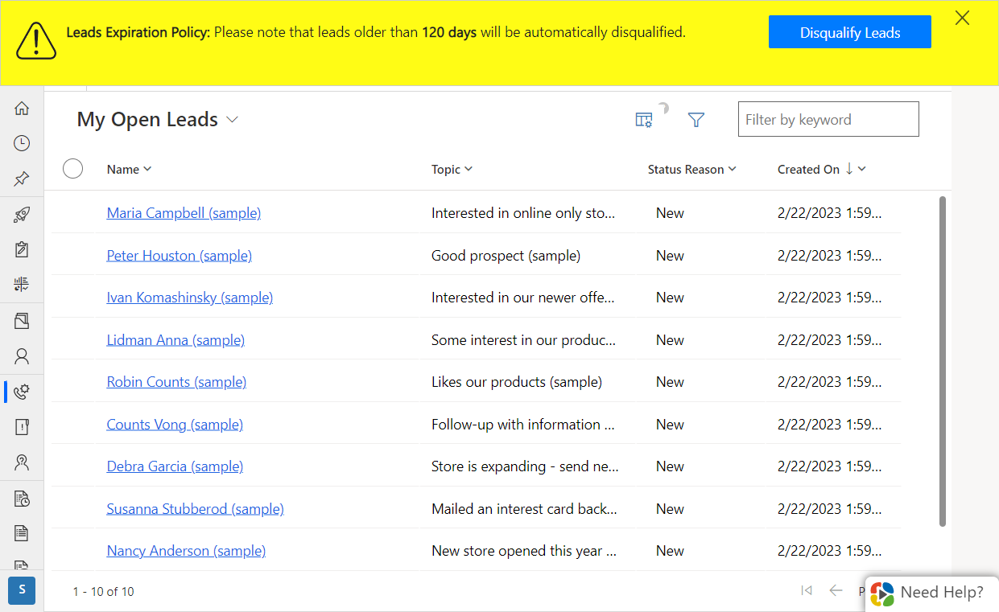
A policy communicated through an announcement banner when users arrive at a record
Notes:
Instead of regular email communication, an announcement banner like this it is impossible to miss when displayed over an application that the users routinely go to.

Slide 46
Context switching hurts productivity and adoption
Traditional learning and microlearning requires switching context.
Context switching constantly can cost up to 40% drop in productivity
Notes:
When an employee has to switch context to find something, it hurts productivity as well as adoption of the process that she was working on.
Context switching usually has an impact on the average of about 15 minutes when looking for the information and trying to get back in context of what you were initially working on. That's a pretty high switching cost and should be avoided whenever possible.
The company Okta, which a lot of big employers use to make it easy to get to enterprise applications, reported that at large employers they have 187 different applications deployed and 30% of them are just duplicative or add new value. That is a really large number!
A study of 20 teams across three big employers found that workers toggled between different apps and websites 1,200 times each day. That's just under 4 hours a week or roughly 5 weeks a year spent just toggling back and forth hitting the alt-tab key combination basically.
It's been dubbed by these researchers as the toggling tax - the same thing we are talking about here with context switching.
Aside from the obvious hit in productivity, this behavior makes it very hard to focus and over time it stresses people out.
Reference for 40% drop in productivity due to context switching:
https://www.psychologytoday.com/us/blog/brain-wise/201209/the-true-cost-multi-tasking

Slide 47
Provide visual cues and help in context to the user’s environment
Information in the
Flow of Work
Notes:
Visual cues in the production environment that are just… there. Ready to help you at your ‘moment-of-need’.

Slide 48
Also referred to as “Performance Support”
Helping users get their job done at their moment-of-need
Notes:
The Performance Support discipline has been around for decades. It just has not been popularized yet in the Microsoft ecosystem so not many people know about it yet.
https://elearningindustry.com/how-performance-support-tools-different-from-training-3-pst-examples-microlearning

Slide 49
An example of how I received Performance Support

Slide 50
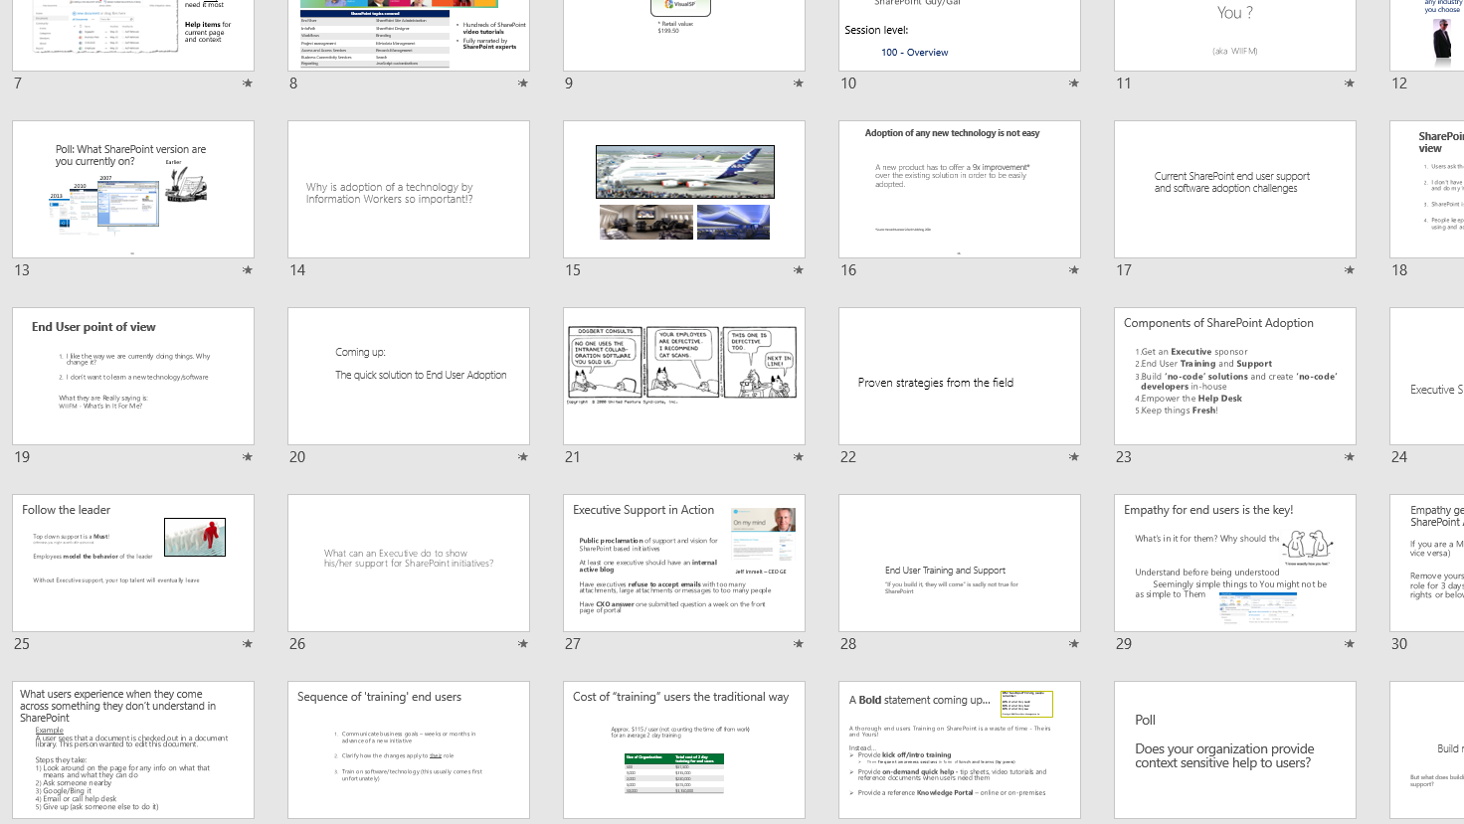
What my presentations used to look like

Slide 51
What my presentations look like now
Notes:
All thanks to the ‘Designer’ feature in PowerPoint that just presented itself to me one day.

Slide 52
Implement contextual support and training for your users
Deliver information to your users within
2 clicks and 10 seconds
Notes:
The 2 clicks and 10 seconds formula was developed by a renowned learning strategist named Dr. Conrad Gottfredson.
It has been proven that when you get info to the user within 2 clicks and 10 seconds, they experience a positive emotion and satisfaction in their amygdala.
This feeling of satisfaction and pride encourages them to try self support again next time they need help.

Slide 53
Contextual micro-assistance in action
Demo
using VisualSP platform
Notes:
VisualSP
https://www.visualsp.com
Context sensitive support and training platform for Dynamics 365 (and a whole lot more…)

Slide 54
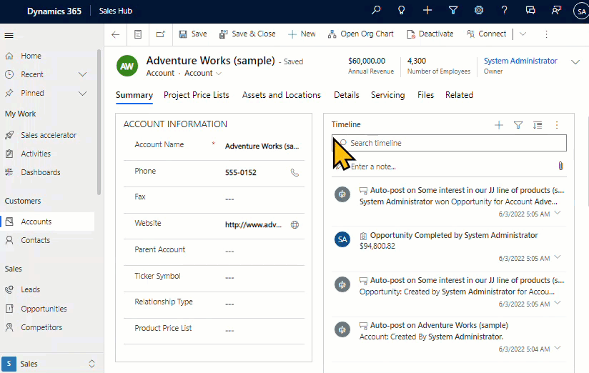
Built in Dynamics 365 help is not useful for everyday users
Notes:
The built in Dynamics 365 help is not useful for everyday users of the application. In addition, it just gives generic documentation which does not apply to your specific implementation of Dynamics 365.

Slide 55
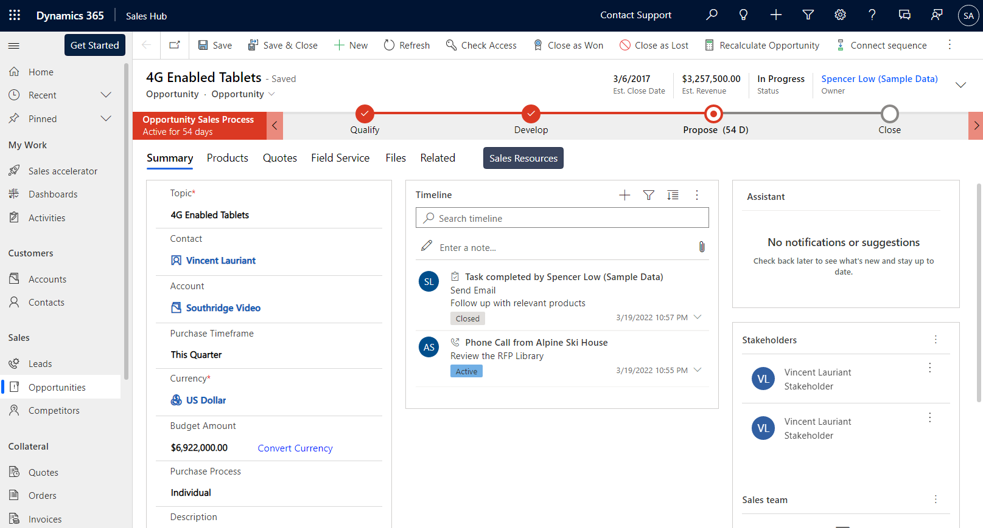
Closing Complex Sales course is now available. Take this 10 mins course to earn your Complex Sales certification
Start Course
Notes:
Scenario using VisualSP
A salesperson is visiting one of her opportunities in Microsoft Dynamics. A banner appears automatically on top of the page letting her know that a new course on Closing Complex Sales is available that she might be interested in and it will provide her the Complex Sales certification. The banner is persistent so it doesn’t block her work. When she is ready, she clicks on the Start Course button in the banner.

Slide 56
Closing Complex Sales course is now available. Take this 10 mins course to earn your Complex Sales certification
Start Course
Notes:
The course starts in a dialog box in the middle of the page. It does not switch her context from the application she is in which is Very important for the user since it doesn’t take them out of the flow of their work.
When she is done with the course, she closes the window and goes back to her work. By doing this, she gets credit for taking the course and it’s reflected in the LMS.

Slide 57
Summary – The 5 steps to increasing user adoption
1
Get executive buy-in
2
Identify a critical problem to solve
3
Incentivize desired behavior of evangelists
4
Offer frequent peer-to-peer learning events
5
Focus on context instead of just content

Slide 58
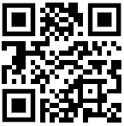
Next Steps
Reach out to me with your questions on context sensitive support and training
asif@visualsp.com
Download All of my presentations
http://bit.ly/AsifConference
Digital Adoption Platform for All web applications

